Slide 1
Life & Literature
Follow up

Slide 2
Purpose
Engage current & future constituencies
Ensure BHL can integrate/interoperate
Identify new options to integrate BHL
Review publishing models
Articulate agenda for next 5 years of BHL
Notes:
With other biodiv and dig lib programs

Slide 3
Conference: BHL is not a pilot project
Plenary speakers
Richard Pyle, taxonomy & biogeography of coral reef fishes
George Dyson, history of technology
Panels
Research, Informatics & the Published Record
Publishers, Aggregators & Authors: New models & Access
Learning & Education
Building Collaborative Networks for Science & the Humanities through Scientific Literature
Code Challenge: Ryan Schenk synynyms visualizing rise & fall of taxonomic names
Notes:
The speakers and panels added context to our future as well as our past. Showed that BHL is not a pilot project any longer.
Pyle: spoke to need for global names architecture using existing GUIDs—trying to get (botanists, zoologists to speak the same language.
Dyson: Darwin and machines
Research: Dr. Sandra Knapp (NHM-function of publications, cross linking of data, reputation important for pub, using abstracts b/c too much to read), Dr. Stan Blum (CAS), Dr. Donat Agosti (AMNH-semantically enhanced taxonomic lit), Dr. Ely Wallis (Museum Victoria- make legacy lit accessible and know target audience)
Publishers: Susan Skomal (BIOONE), Jan Reichelt (Mendeley Research networks—chankging the face of science), Lyubo Penev (Pensoft: BHL should be archive-old & new), Citebank, collaboration with Mendeley, ViBrant, libraries, publishers for metadat), Catriona McCallum (PLoS: innovations in editorial criteria, review, assessment), Abel Packer (SciELO)
Learning: Dr. Marie Studer (EOL/Harvard), Dr. Douglas Wilson (CK-12 foundation-open web based content for and by students). Dr. Devin Reese (NSF Resource Center-incorporating science education research into curriculum development ), Dr. Ken Walker (Museum Victoria-turning museum based science into information based science), Natalie Zamora (INBIO-director of education and communication)
Building Dr. Janet Browne (History of Biology, Harvard-specimen illustration as representation/mistakes), Dr. Alain Touwaide (Smithsonian-Renaissance Herbals digital collection, crosslinking refs, specimens, illustrations), Dr. Peggy Macnamara (Field Museum zoology artist), Dr. Chris Wildrick (Syracuse University-conceptual artist studing the creation & use of dinosaur imagery).

Slide 4
Conference 5 Year Plan: Breakouts
What new types of content & connections should BHL focus on adding?
What new technologies should BHL integrate & plan for?
What other institutions, domains, or user groups should BHL engage with?
What does education mean for BHL? What is the audience? Is it targeted or broad?

Slide 5
Notes:
Summary of Breakout session results,
Better marketing, better presentation of cool stuff, MORE stuff but already available
Usability tests for BHL Au and BHL completed, changes have been made to portal including better searching, donate button, wikipedia links, purposeful gaming http://biodivlib.wikispaces.com/BHL+and+Gaming

Slide 6
Staff Top Picks
Improve General Search
Article-level Access
Collaborate with partners with digitized literature for ingest
Harmonize BHL family of portals
Notes:
Other themes: exploiting art in BHL, educating citizens not just k-12,collaborating with entities that bring funding opportunities, Look for new audiences but keep the core happy and engaged, new tools, explore EOL relationship, Better searching

Slide 7
The 5 Year Plan in Progress
Search improvements
Purposeful gaming
Usability tests for US/AU portals
Donate button
Wikipedia linking
Itunes U
BHL Flickr
BHL E Exhibition tool
Notes:
Lest you think BHL staff are sitting around waiting for the 5 year plan……al of this is underway, some pre-dating the conference
Donat
More discussions coming as we revise the strategic plan and identify new and improved goals.
Chris blog posts, Mike Lichtenberg, Martin, Trish
http://spices.biodiversityexhibition.com/

Slide 8
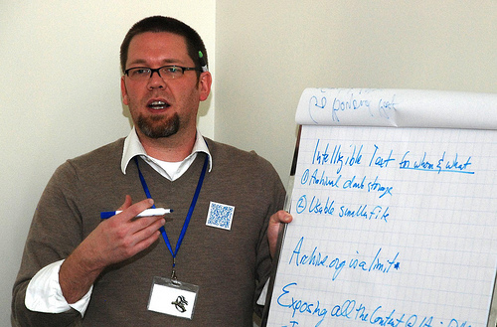
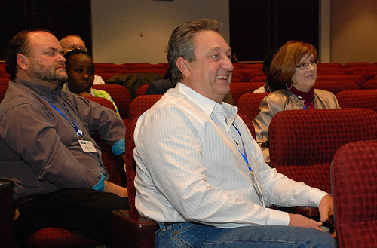
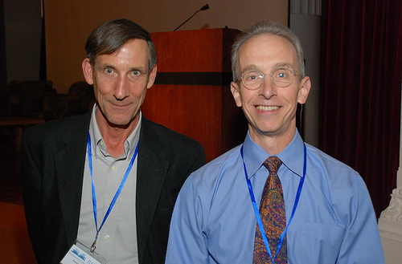
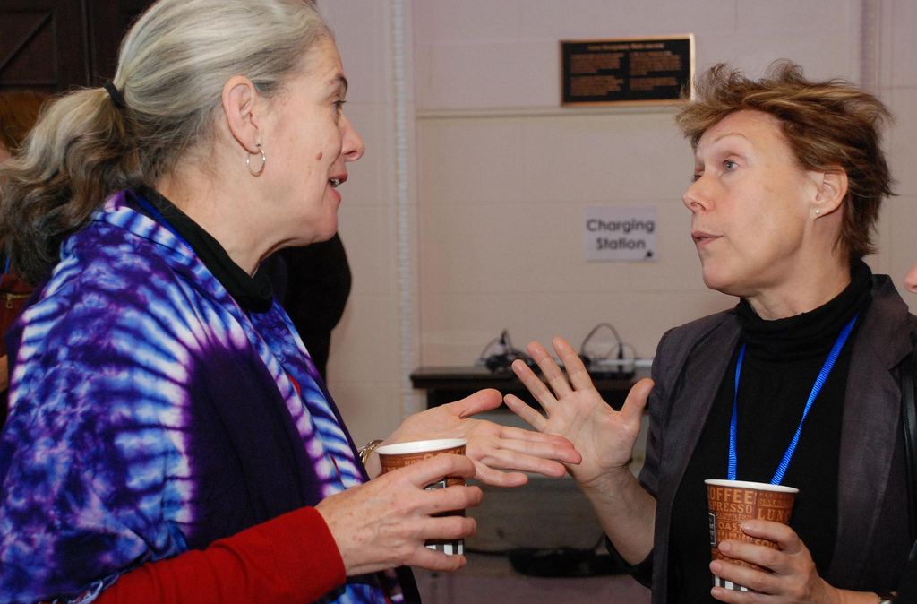
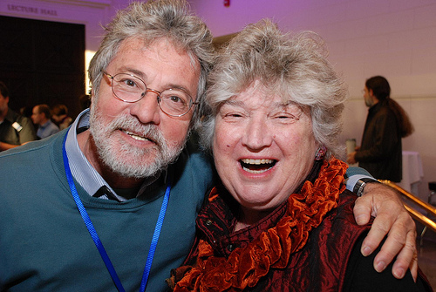
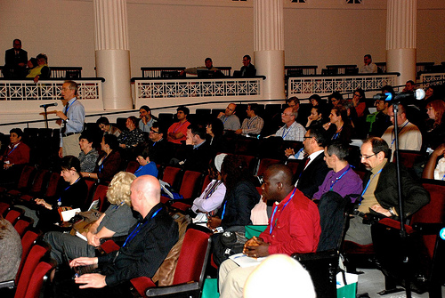
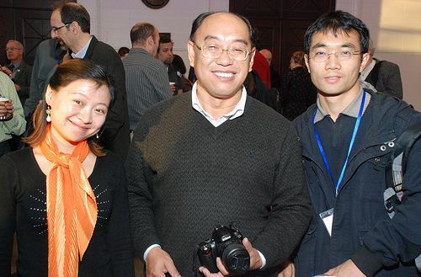
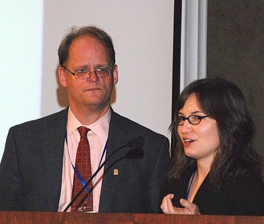
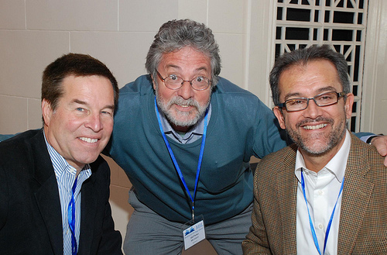
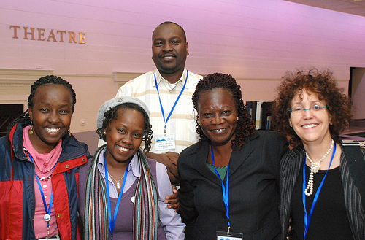
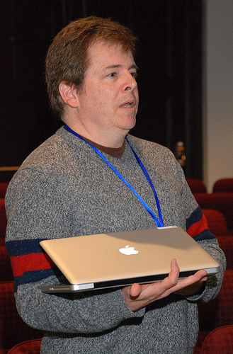
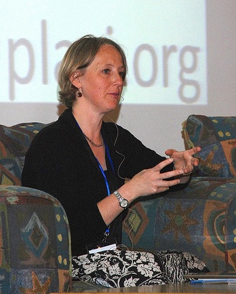
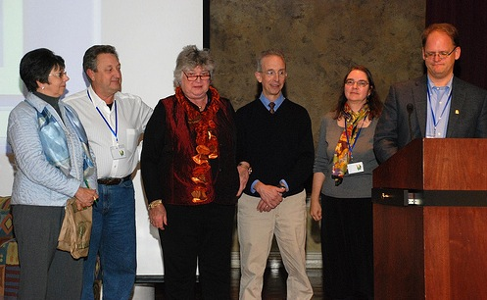
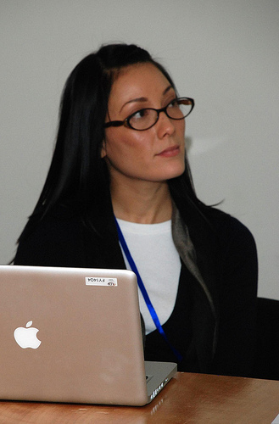
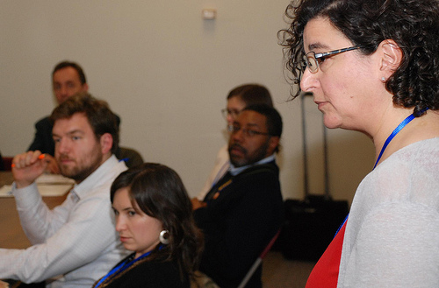
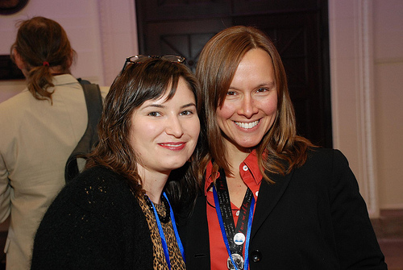
Details
http://www.lifeandliterature.org/
Life and Literature Conference Interviews
Life and Literature Conference Wiki
Staff Reactions to Life and Literature Report
Draft Report on the Life and Literature Conference
Notes:
Check out the interviews on the landl site
Photos courtesy of Martin, Chris, Connie and Paul Skeehan (student roving photog)

