Slide 1
The BHL Infrastructure
BHL Africa Workshop
Pretoria National Botanical Garden
Pretoria, South Africa
June 13th, 2012

Slide 2
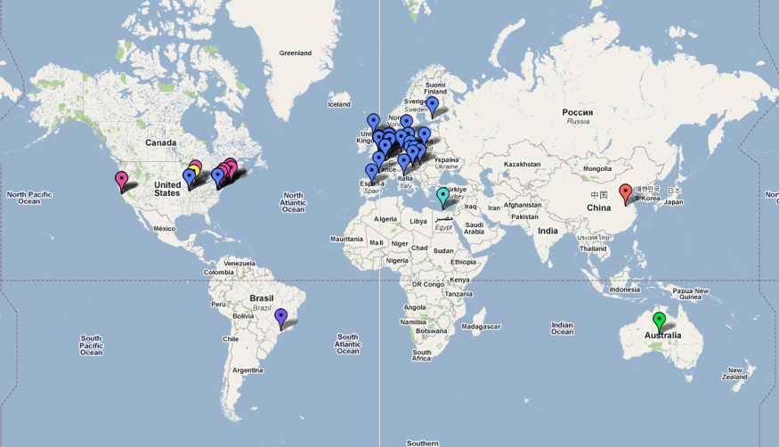









A brief history…
Notes:
Global BHL is a Global Partnership with programs in six continents, we hope to keep expanding to new geographies.
The BHL is a nimble, geographically distributed, virtual organization that delivers focused research content. Since 2009, the BHL has expanded globally. The European Commission’s eContentPlus program funded the BHL-Europe project, with 28 institutions, to assemble the European language literature. Additionally, the Chinese Academy of Sciences, the Atlas of Living Australia, Brazil (through SciELO and BIREME), and the Bibliotheca Alexandrina have created regional BHL nodes. These projects will work together to share content, protocols, services, and digital preservation practices.
Internet Archive 2007
BHL Europe May 10-15, 2009
BHL China Set. 2009
BHL Australia 1 - 4 June, 2010
BHL Alexandria 2010
BHL Scielo 2010 - kick off meeting
2008.06 BHL Europe funding proposal to European Union
2009.09 BHL-China formed, Beijing
2009.11 Pan-Arab Biodiversity Conference, Alexandria
2010.02 Brasilian Kick-off meeting, Sao Paulo
2010.06 BHL-Au Kick-off meeting, Melbourne/Canberra
2010.09 Global BHL Technical meeting, MBL/WHOI, Woods Hole
2011.11 2nd Global BHL Governance meeting, Field Museum, Chicago
2012.04 BHL & BHL SciELO Technical meetings, Washington, DC
2012.06 BHL Europe Final Events & 3rd Global Tech meeting, Berlin

Slide 3
New Partners and Geographies
Notes:
Global BHL is a Global Partnership with programs in six continents, we hope to keep expanding to new geographies.
So far we have started to work with African colleagues to define a project that would digitize Biodiversity Literature and new contacts with potential collaborators in Latin America are being pursued that we hope will help us expand BHL to new latitudes.

Slide 4
GLOBAL BHL is…
a cooperative network
of autonomous members
operating programs and projects
to make biodiversity literature available through open access principles.

Slide 5
Different models around the World
Notes:
Global Data requires a Social Infrastructure
The project may be about the content, but relies heavily on the people (and their collaboration for a common cause).

Slide 6

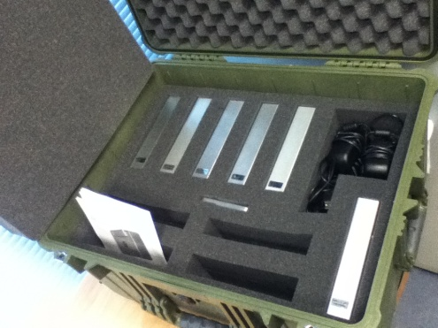
Global Replication & Serving
Replicated Data Center
Portal Application
Woods Hole
London
San Francisco
Alexandria
Beijing
Notes:
Redundancy achieved through Global Replication and serving.
Describe the current state:
Uploading all content into IA as the long-term repository
Copied seed data
and now we are starting to synchronize repositories (IA->WHO, WHO -> NHM, IA->EGYPT, then WHO->CHINA).

Slide 7
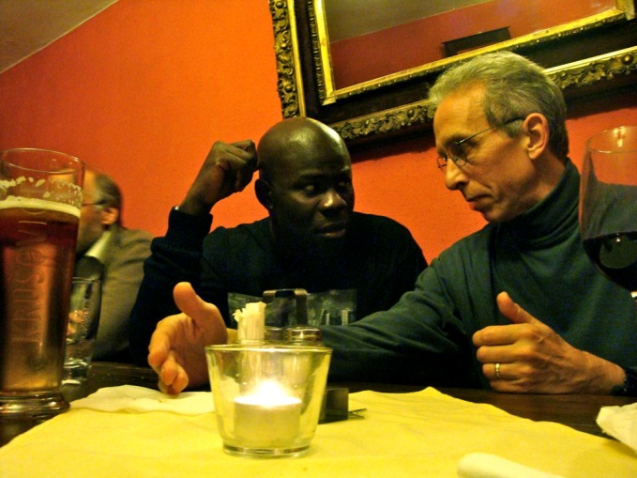
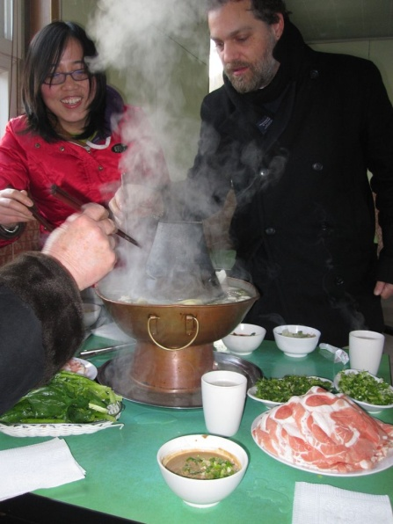
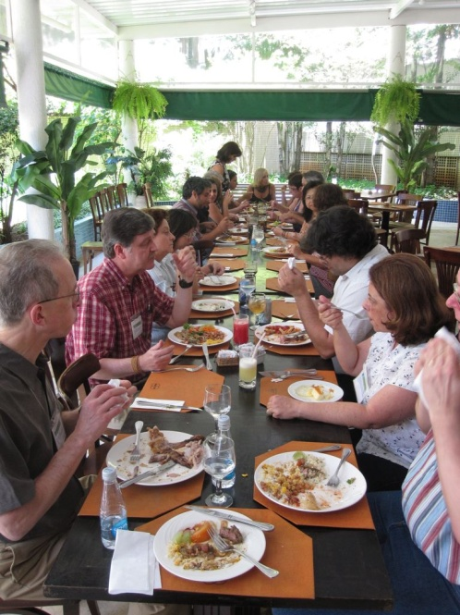
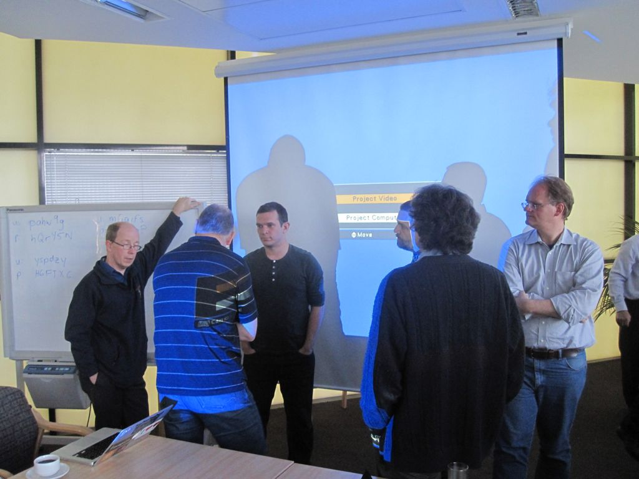
Sharing
Notes:
This is a take-away topic, and one we deal with everyday. Language, culture, plans, funding, commitments… all bring new challenges and new opportunities.

Slide 8
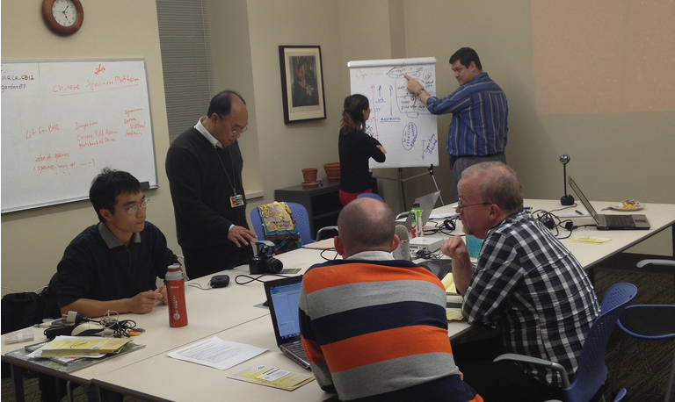
Sharing
BHL shares data through:
APIs
Data Export
OpenURL
OAI-PMH
Notes:
Sharing content, protocols, services and practices to support research, policy and conservation through appropriate repatriation of information.
How to share and benefit from local developments. For example, the User Interface and Annotations from BHL-Australia and BHL-US, the Search functionality from BHL-Europe, the OCR functionality at BHL-Egypt, the Common names functionality from BHL-China and BHL-Europe.
Could we consider co-development or adopting one set of tools for each service (portal, dedup/GRIB, exhibitions)?
When we all get together we have effective communications

Slide 9
Sharing
Scan Requests –
  Strategy for handling and managing scan requests
Deduplication –
  Avoiding duplication of scanning.
Feedback –
How to coordinate feedback (issues) between subregions?

Slide 10
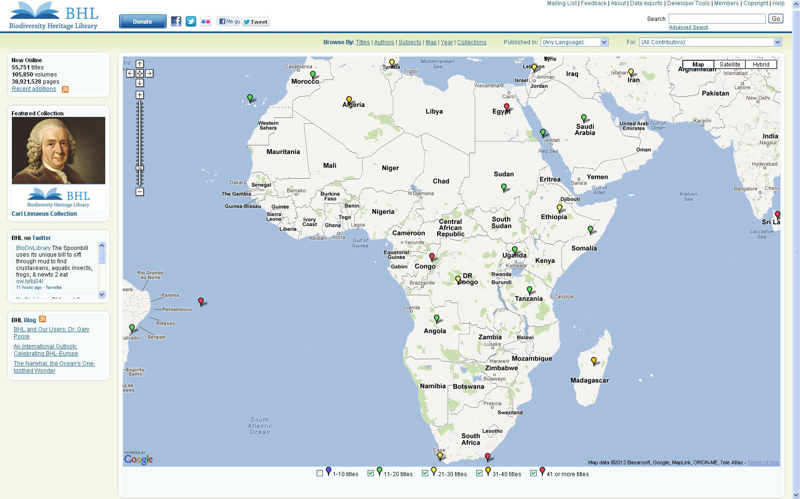
Repatriation of Information

Slide 12
Tools
Scanlist
Monograph Deduper
Portal
Macaw
Gemini & Feedback form

Slide 13
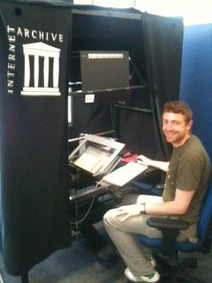
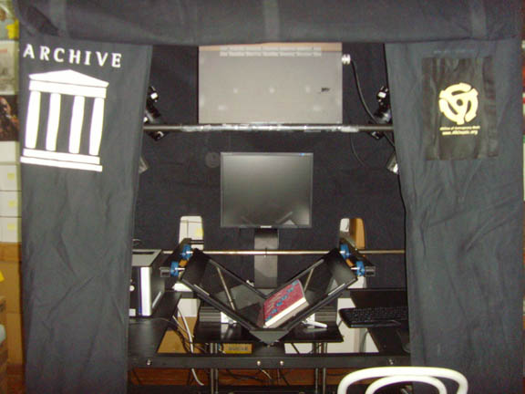
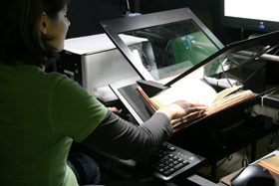
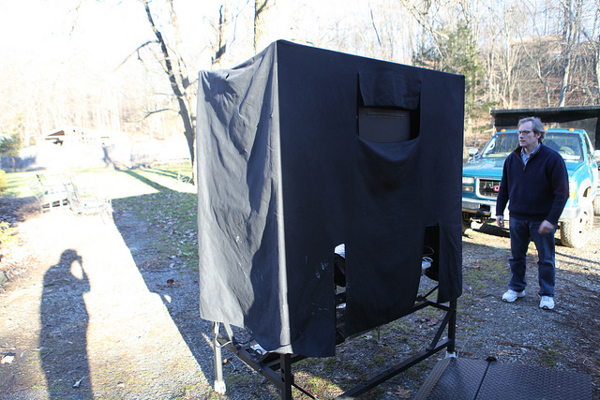
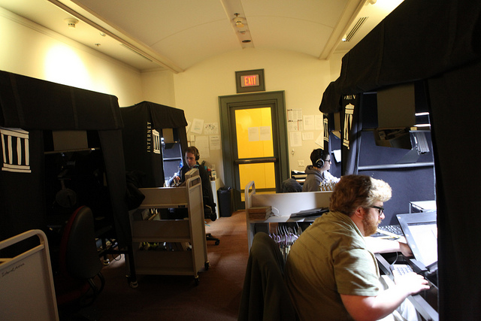
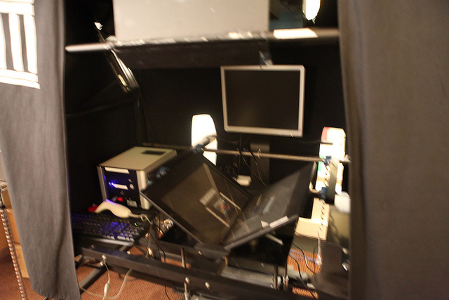
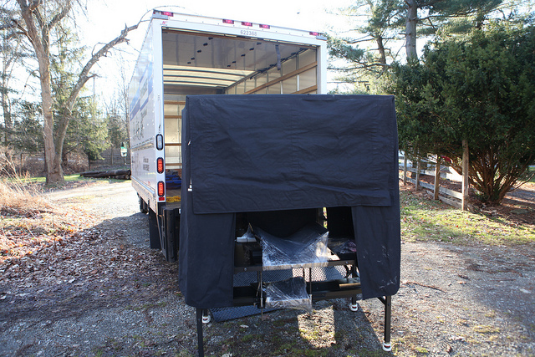
`

Slide 14
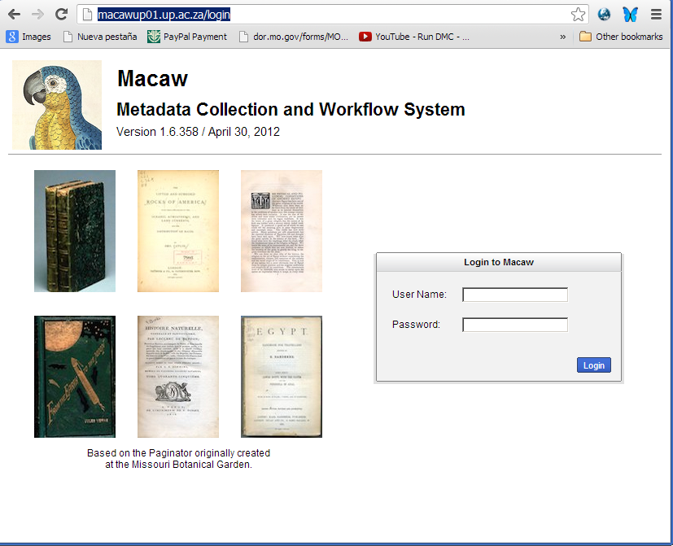
Macaw
http://macawup01.up.ac.za
Notes:
Demo Account
macaw.joelrichard.com
User: demo Password: demo
http://macawup01.up.ac.za
i
macaw.mobot.org

Slide 15
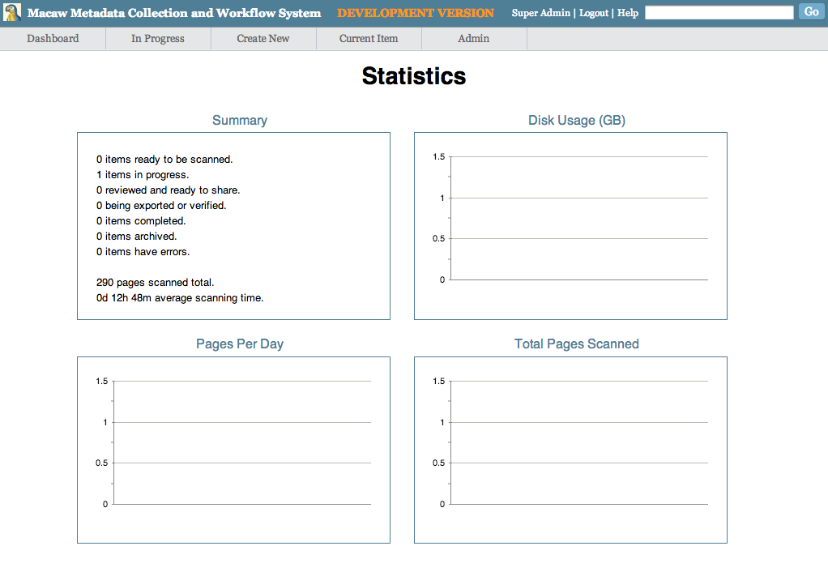
Viewing Activity
Notes:
Viewing Activity
Dashboard with some basic statistics (01-dashboard.png)
List of items that are in progress, filterable (02-list-of-items.png)

Slide 16
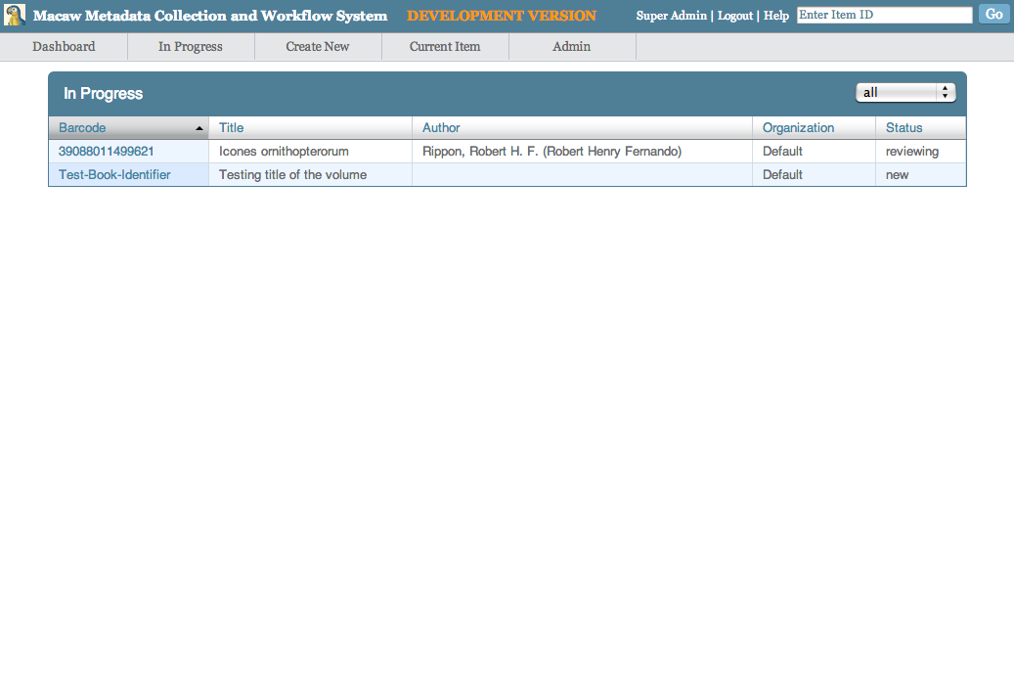
Viewing Activity
Notes:
Viewing Activity
Dashboard with some basic statistics (01-dashboard.png)
List of items that are in progress, filterable (02-list-of-items.png)

Slide 17
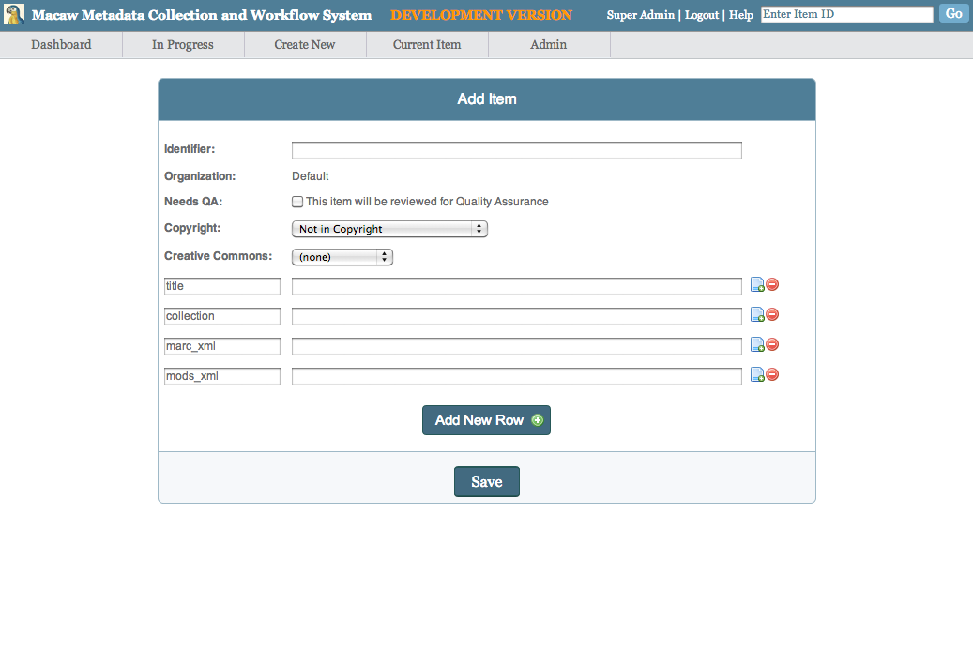
Loading Activity
Notes:
Loading Items
Creating by hand (03-add-item.png)
Uploading via CSV file
Creating automatically through a custom import
All items still need MARC XML data

Slide 18
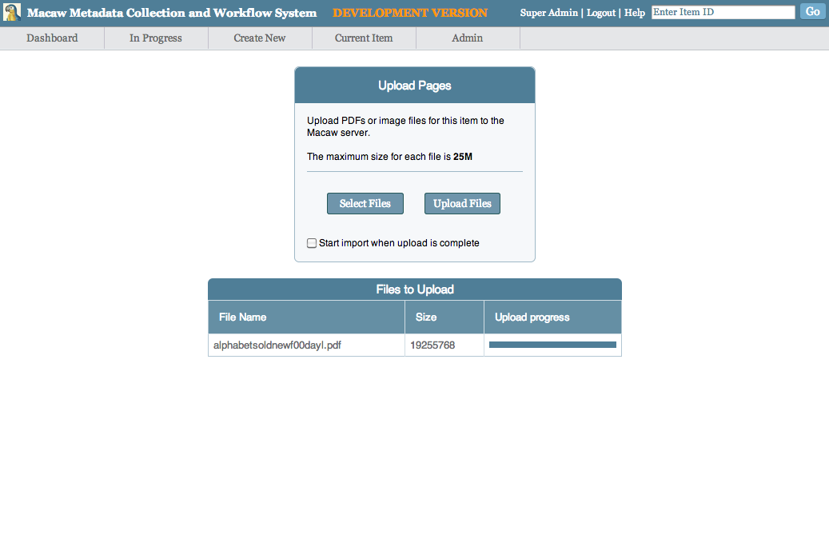
Uploading images via browser
Notes:
Uploading images via the browser (04-upload-pages.png)
Importing images to Macaw (05-import-pages.png)
Importing of JPG and PDF files is supported
Reviewing Metadata
Thumbnail view of the pages (06-enter-metadata.png)
Large version of the image has a magnifier
List view to see more metadata at once (07-metadata.png)
Standard Metadata is suitable for BHL use
No additional metadata modules are needed
Uploading to the Archive
Need to get set up with an account at IA first
Account at IA needs access to the biodiversity collection
Uploading of completed items is done via scheduled job or the command line
Demo Account
macaw.joelrichard.com
User: demo Password: demo

Slide 19
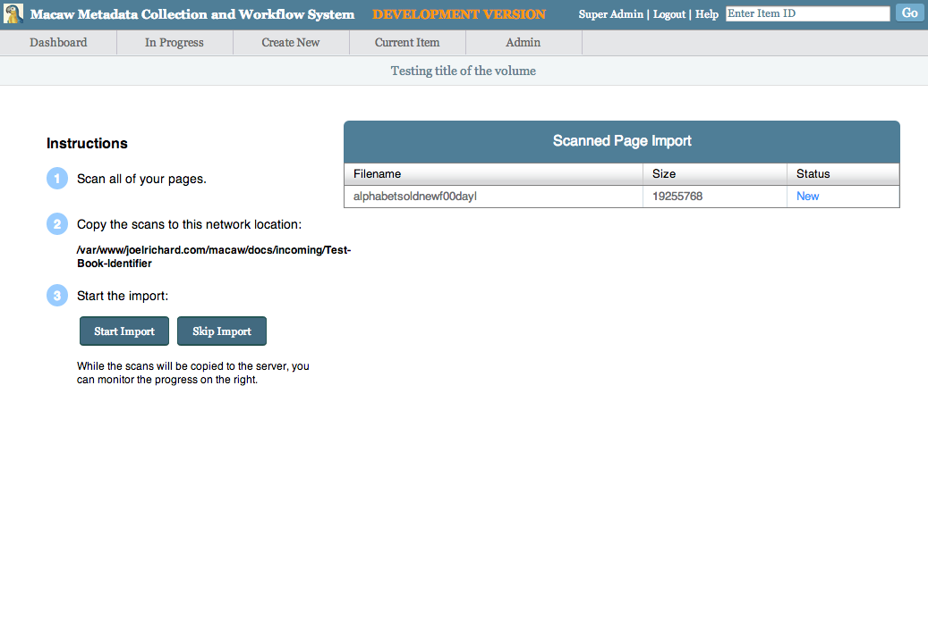
Uploading images via browser
Notes:
Uploading images via the browser (04-upload-pages.png)
Importing images to Macaw (05-import-pages.png)
Importing of JPG and PDF files is supported
Reviewing Metadata
Thumbnail view of the pages (06-enter-metadata.png)
Large version of the image has a magnifier
List view to see more metadata at once (07-metadata.png)
Standard Metadata is suitable for BHL use
No additional metadata modules are needed
Uploading to the Archive
Need to get set up with an account at IA first
Account at IA needs access to the biodiversity collection
Uploading of completed items is done via scheduled job or the command line
Demo Account
macaw.joelrichard.com
User: demo Password: demo

Slide 20
Uploading images via browser
Notes:
Uploading images via the browser (04-upload-pages.png)
Importing images to Macaw (05-import-pages.png)
Importing of JPG and PDF files is supported
Reviewing Metadata
Thumbnail view of the pages (06-enter-metadata.png)
Large version of the image has a magnifier
List view to see more metadata at once (07-metadata.png)
Standard Metadata is suitable for BHL use
No additional metadata modules are needed
Uploading to the Archive
Need to get set up with an account at IA first
Account at IA needs access to the biodiversity collection
Uploading of completed items is done via scheduled job or the command line
Demo Account
macaw.joelrichard.com
User: demo Password: demo

Slide 21
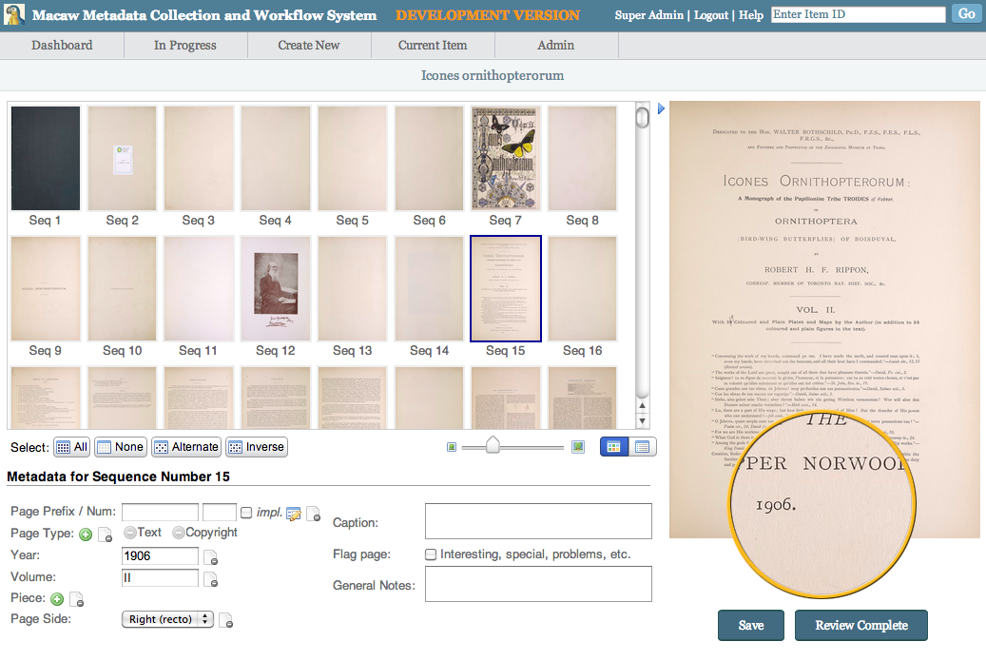
Reviewing Metadata
Notes:
Reviewing Metadata
Thumbnail view of the pages (06-enter-metadata.png)
Large version of the image has a magnifier
List view to see more metadata at once (07-metadata.png)
Standard Metadata is suitable for BHL use
No additional metadata modules are needed
Uploading to the Archive
Need to get set up with an account at IA first
Account at IA needs access to the biodiversity collection
Uploading of completed items is done via scheduled job or the command line
Demo Account
macaw.joelrichard.com
User: demo Password: demo

Slide 22
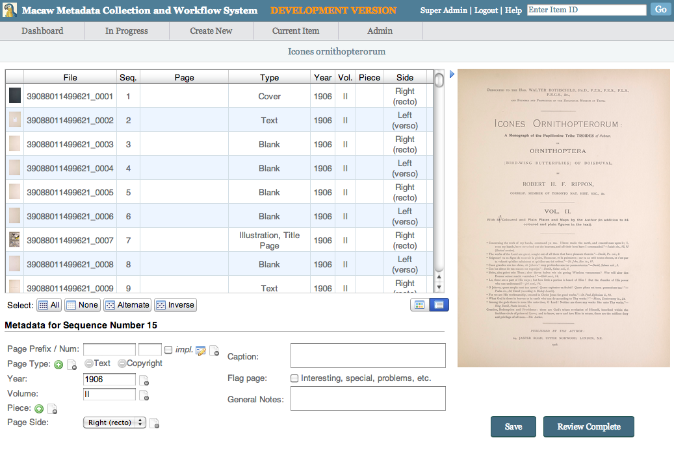
Reviewing Metadata
Notes:
Reviewing Metadata
Thumbnail view of the pages (06-enter-metadata.png)
Large version of the image has a magnifier
List view to see more metadata at once (07-metadata.png)
Standard Metadata is suitable for BHL use
No additional metadata modules are needed
Uploading to the Archive
Need to get set up with an account at IA first
Account at IA needs access to the biodiversity collection
Uploading of completed items is done via scheduled job or the command line
Demo Account
macaw.joelrichard.com
User: demo Password: demo

Slide 23
Uploading to the Archive
Need to get set up with an account at
IA first
Account at IA needs access to the biodiversity collection
Uploading of completed items is done via scheduled job or the command line
Notes:
Uploading to the Archive
Need to get set up with an account at IA first
Account at IA needs access to the biodiversity collection
Uploading of completed items is done via scheduled job or the command line
Demo Account
macaw.joelrichard.com
User: demo Password: demo

Slide 24
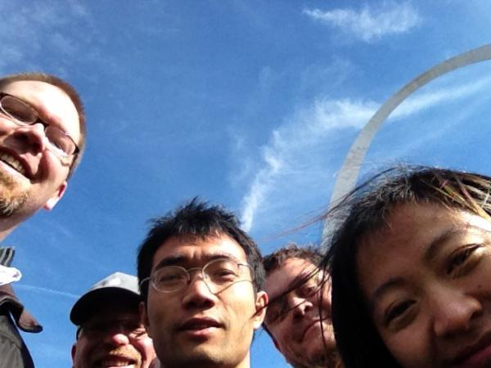

Thank you
  William Ulate
  Global BHL Coordinator
  BHL US/UK Technical Director
  Sr. Project Manager, Missouri Botanical Garden
  william.ulate@mobot.org
  Skype: william_ulate_r
  Credits:
  Martin Kalfatovic, Chris Freeland, BHL-Europe,
  BHL-Australia and so many other BHL Colleagues whose valuable contributions make BHL what it is!
Notes:
Include picture of BHL China and BHL Australia in the Arch.
This picture shows the diversity of … how BHL works together when we are together.

Slide 25
US/UK
Australia
Brazil
China
Egypt
Europe
Africa?

Slide 26
BHL-Europe
Different technologies
Mirroring data from US/UK
New content: BHL-Europe developed
their own portal, which aggregates
content from multiple European library members

Slide 27

Vision and mission
European biodiversity knowledge freely available globally to everyone.
BHL-Europe mission statement
Mobilising and preserving digital European biodiversity heritage literature and facilitating the open access to this literature through
  a multilingual community portal,
  the Global Reference Index to Biodiversity,
  the Biodiversity Library Exhibition,
  Europeana.
BHL-Europe vision statement

Slide 28




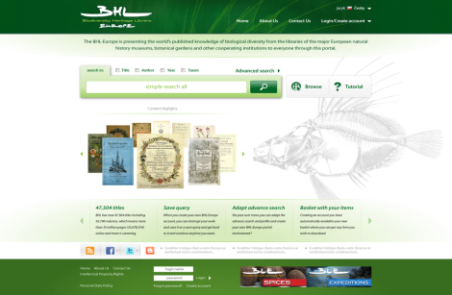





BHL-Europe organisation
BHL-Europe server

Slide 29
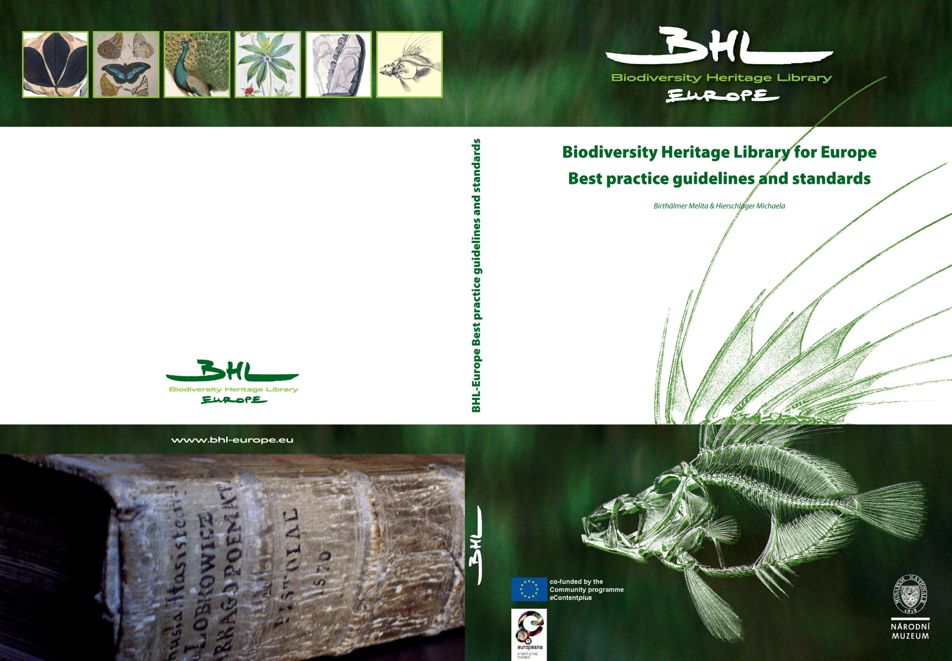
Best Practice Guide

Slide 30
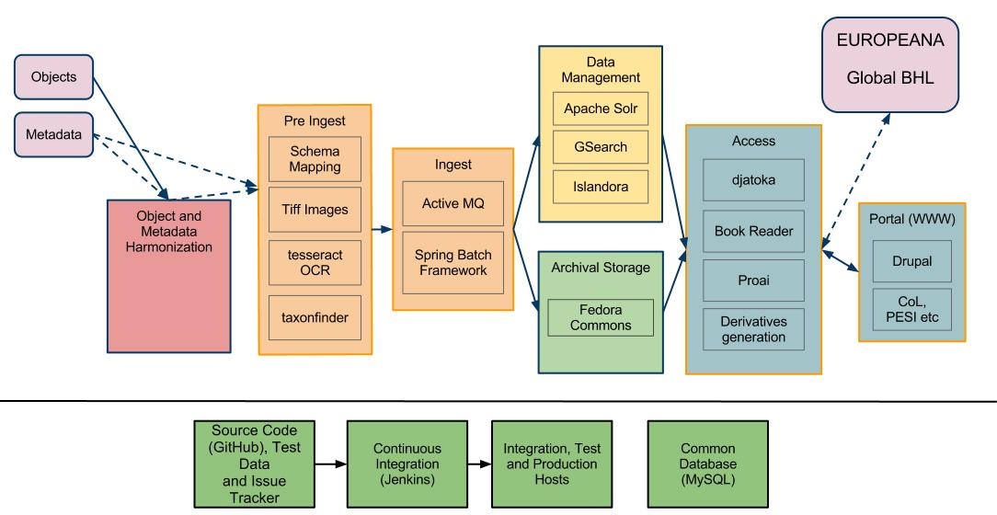
Architecture simplified

Slide 31
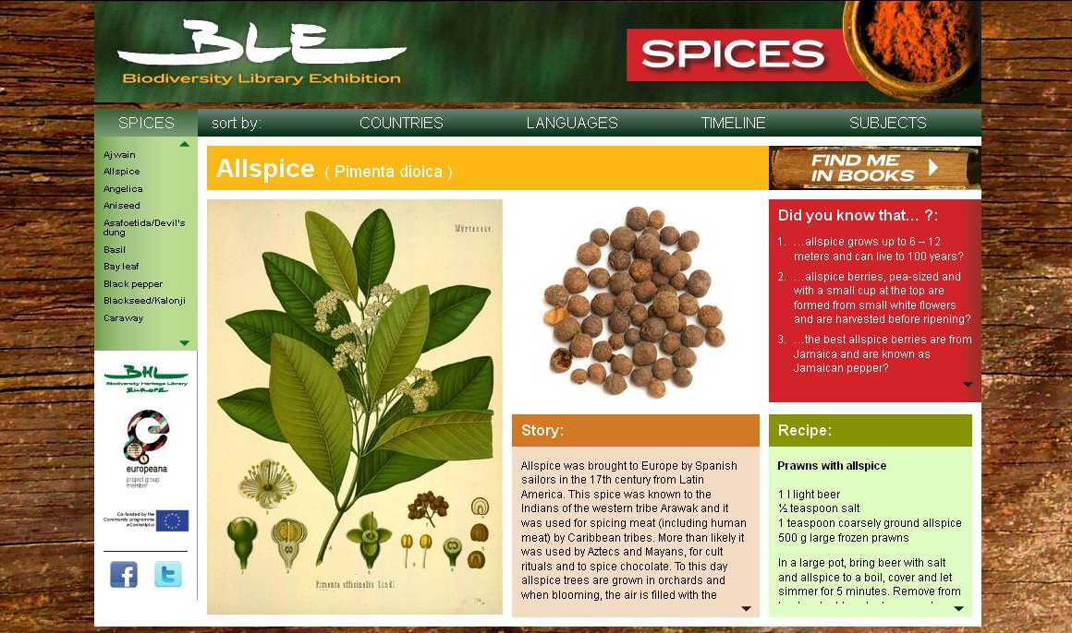
http://www.biodiversityexhibition.com/

Slide 32
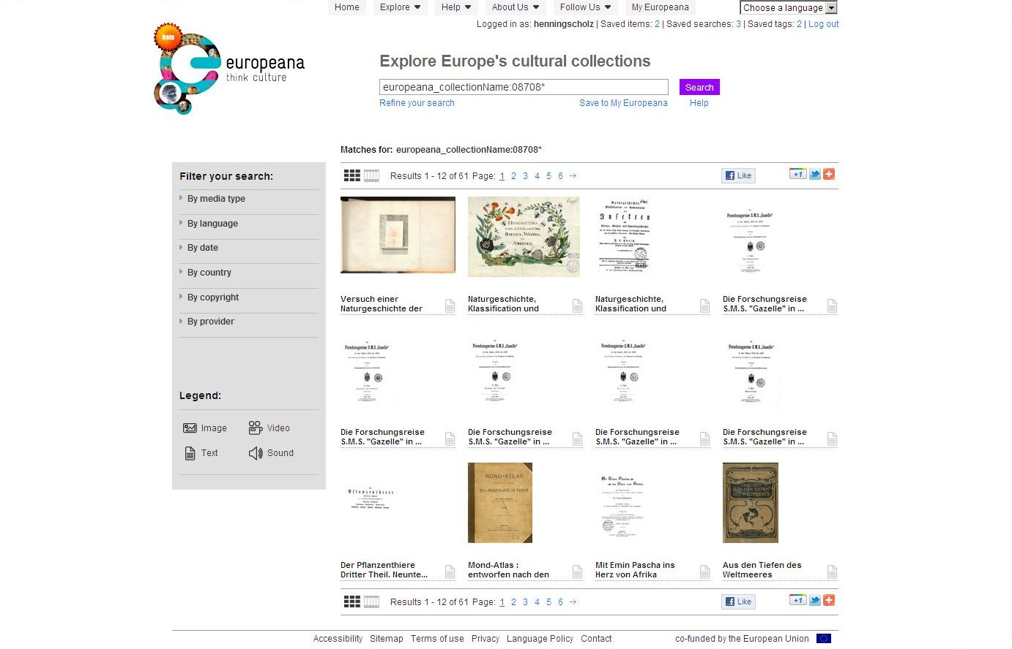
Europeana

Slide 33
OCR - IMPACT
Standard tools not suitable for heterogeneous content
Page type separation helpful to improve performance (SCAPE)
High quality scanning operations and good QA is important
Language information important to be in the metadata
Font type information important to be in the metadata
Tesseract 3.0x competitive OCR tool
Crowdsourcing options still to be investigated

Slide 34
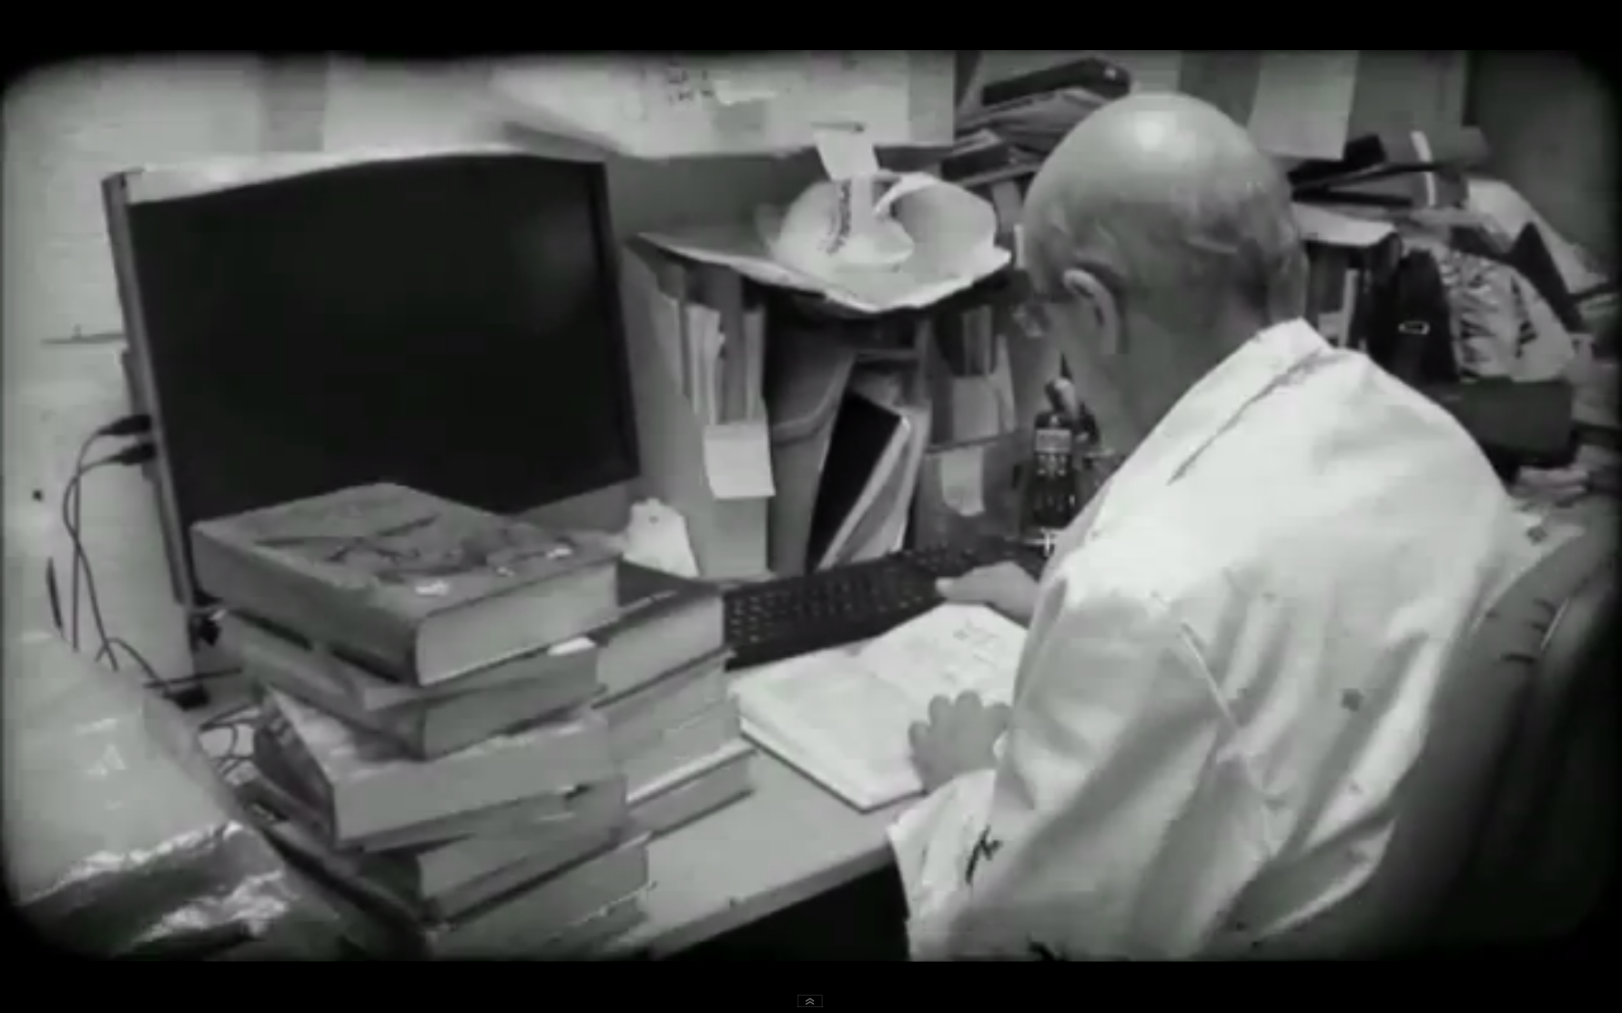
What is BHL?
Access to literature is particularly important to taxonomic researchers
Source: Biodiversity Heritage Library for Europe
, http://www.youtube.com/watch?v=bJUMH9z91UQ
Notes:
Access to literature is particularly important to taxonomic researchers. It does not matter whether the original description of a species was published a year ago or a hundred years ago, the taxonomist must still consult the literature in the process of identifying and naming new species.
The Biodiversity Heritage Library (BHL) is a consortium of natural history and botanical libraries that cooperate to digitize and make accessible the legacy literature of biodiversity held in their collections and to make that literature available for open access and responsible use as a part of a global “biodiversity commons.”

Slide 35
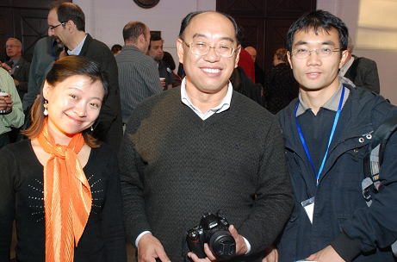
BHL-China
BHL-China staff visited SIL and MOBOT on early November last year to discuss project status and future collaborations and development
Continued digitization of Chinese materials
and has now 900 books
available in Internet
Archive - 5,000 pending
Copied content sent
from Cluster in Woods
Hole.
Notes:
Chinese Biodiversity Heritage Library (BHL-China), funded by the Biodiversity Committee, Chinese Academy of Sciences, is aiming to, through collaboration with BHL (Biodiversity Heritage Library) and in conjunction with other institutes (colleges) on biological research, jointly build a network platform for BHL-China; through the comprehensive collection, scanning, extraction of the essential biodiversity related literature and the systematical arrangement of the important biodiversity (early focus on botany) literature, to establish an easily-searchable and communitive network platform, while to make the data API compliant and therefore provide documentation data services to biodiversity (including EOL China nodes, Chinese Virtual Herbrium, etc.) and other related research fields.
The project is currently under construction. Relying on the project of digital library funded by Institute of Botany, the Chinese Academy of Sciences, the digitalization has started with the documentation of plant biodiversity, and will gradually extend to other fields of biology.

Slide 36
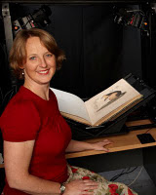
BHL-Australia
Museum Victoria in Melbourne & other Libraries later
Improved User Interface.
Visited MOBOT in November last year
Share Metadata DB between systems

Slide 37
BHL-Australia
Joined development of Macaw with BHL
to accommodate needs of institutions.
Accessing content from Internet Archive
Started to digitize and upload content
to Internet Archive.
Joint portal development with US
Will keep using a team of volunteers to do the scan.

Slide 38
Bibliotheca
Alexandrina
The Digital Assets Repository (DAR) is a system developed at the Bibliotheca Alexandrina, the Library
of Alexandria, to create and maintain the Library's
digital collections.
Bibliotheca Alexandrina has copied content from disks and downloaded the rest (serving 15,938 today). Will download the rest from Internet Archive.
Currently determining what books they can
contribute to BHL through Internet Archive.
A team has started to setup a BHL portal (Arabic).
Promoted synchronization and tools in Global BHL Technical Meeting last week in Berlin.
http://edition.cnn.com/video/#/video/bestoftv/2012/06/06/inside-middle-east-alexandria-library.cnn

Slide 39
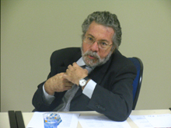
BHL-SciELO Brazil
Has been contributing content to BHL
via the citation & article repository Citebank
Has now installed two digitization out
of 5 stations
Visited US to familiarize with tools and determine
best
practices.

Slide 40
BHL-SciELO Brazil
A network of ten libraries with some major content on biodiversity will have 5 scanners moving to another location after they have scanned their collections.
Some of them, would even get 2 scanners, because of their collection sizes. One held at SciELO facilities.
5 people, one with each scanner hired by
BHL-SciELO project will work 8 hours per day.
Notes:
Our Brazilian colleagues explained how a network of ten libraries with some major content on biodiversity will have 5 scanners moving to another location after they have scanned their collections. Some of them, would even get 2 scanners, because of their collection sizes. One of these scanners will be held at the SciELO facilities to test and document the experience on the digitization process that is developed and improve the digitization process. There will be 5 people, one working in with each scanner hired by the BHL-SciELO project and they will work 8 hours per day, with a technician at SciELO to receive the images and a librarian to work out the bibliographic metadata and pagination. Jose Eugenio Grillo will be supervising the whole operation. The librarians within the participant Units will be supporting the process.

Slide 41
BHL-SciELO Brazil
Initial plan: a technician at SciELO would receive
images and a librarian would work out the
bibliographic metadata and pagination.
There will be a supervisor the whole operation. The librarians within the participant Units will be
supporting the process.
Equipment owned by FAP UNIFESP from the
University of Sao Paulo.
FAPESP, the Foundation for Research Support in São Paulo provides some of the funding to FAP UNIFESP at the Federal University of São Paulo, to execute the BHL-SciELO project.
Notes:
Our Brazilian colleagues explained how a network of ten libraries with some major content on biodiversity will have 5 scanners moving to another location after they have scanned their collections. Some of them, would even get 2 scanners, because of their collection sizes. One of these scanners will be held at the SciELO facilities to test and document the experience on the digitization process that is developed and improve the digitization process. There will be 5 people, one working in with each scanner hired by the BHL-SciELO project and they will work 8 hours per day, with a technician at SciELO to receive the images and a librarian to work out the bibliographic metadata and pagination. Jose Eugenio Grillo will be supervising the whole operation. The librarians within the participant Units will be supporting the process.

Slide 42
BHL-SciELO Brazil
Biodiversity Journals Collection. Starting with SciELO
Brazil and all methodology and program development is done considering the applicability and migration to other countries.
Article Repository development. Initially populated with the contents developed by the BIOTA project, another project
financed by FAPESP.
Biodiversity Thesaurus development. There are already
several thesaurus available that will support the Biodiversity Thesaurus development. One of the subproducts related to
this point is the creation of a list of species, starting with
snakes.
Identification and markup of relevant scientific terms within the content.
Notes:
Our Brazilian colleagues explained how a network of ten libraries with some major content on biodiversity will have 5 scanners moving to another location after they have scanned their collections. Some of them, would even get 2 scanners, because of their collection sizes. One of these scanners will be held at the SciELO facilities to test and document the experience on the digitization process that is developed and improve the digitization process. There will be 5 people, one working in with each scanner hired by the BHL-SciELO project and they will work 8 hours per day, with a technician at SciELO to receive the images and a librarian to work out the bibliographic metadata and pagination. Jose Eugenio Grillo will be supervising the whole operation. The librarians within the participant Units will be supporting the process.

Slide 43
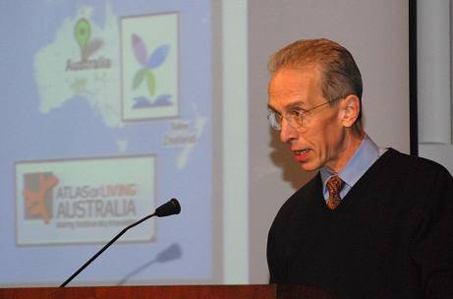
Outreach
Life and Literature, Nov. 2011
Notes:
Sustainable: Open software, Open Data,

Slide 44
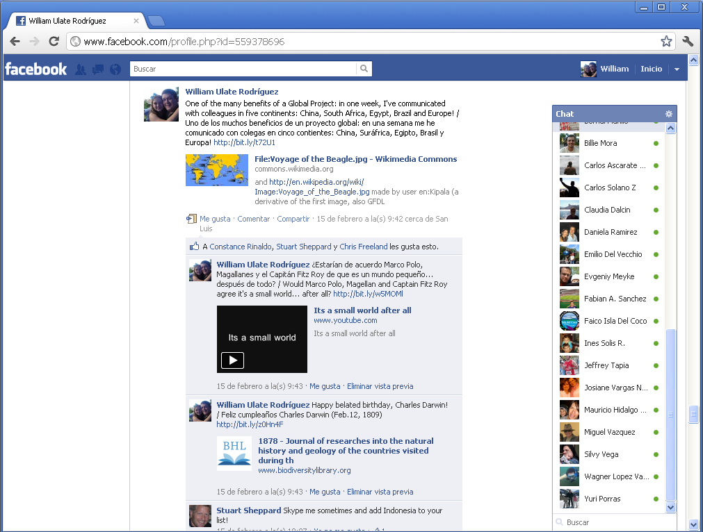
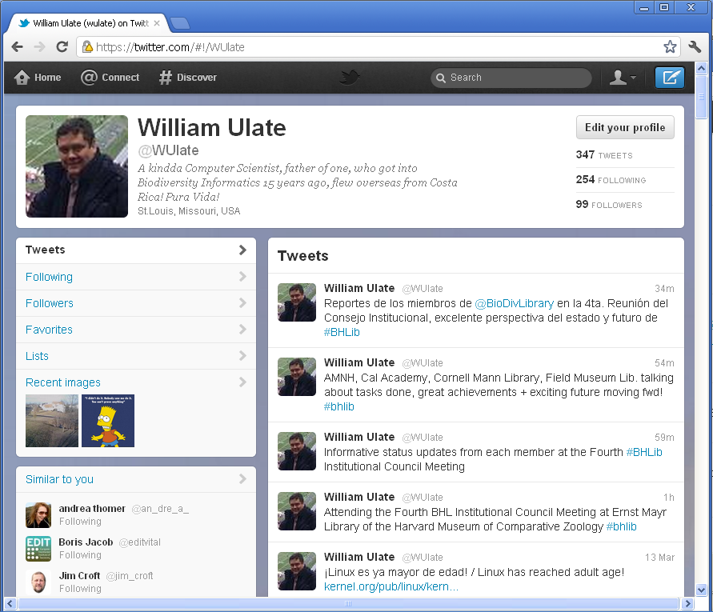
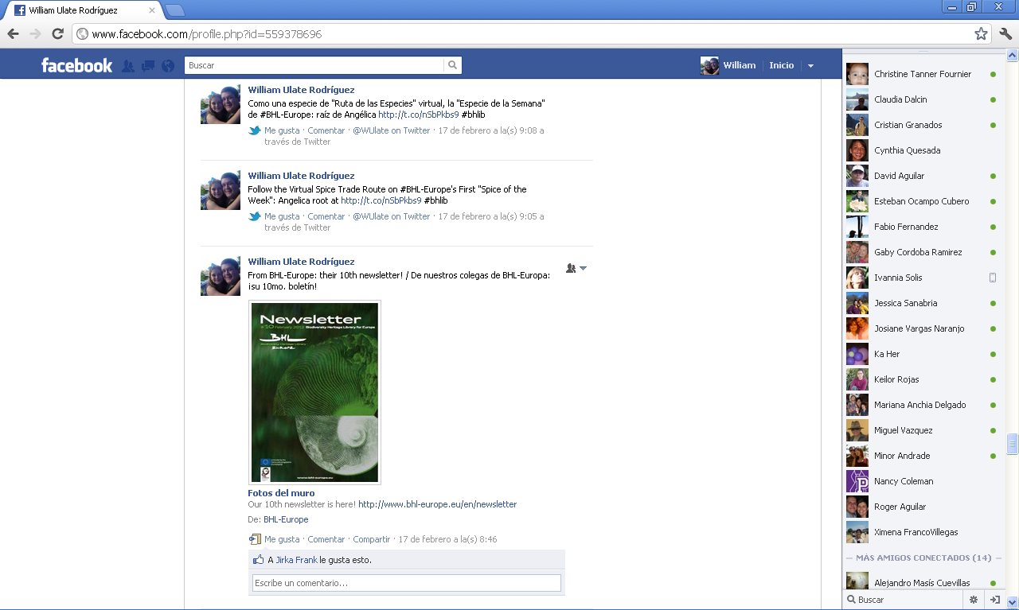
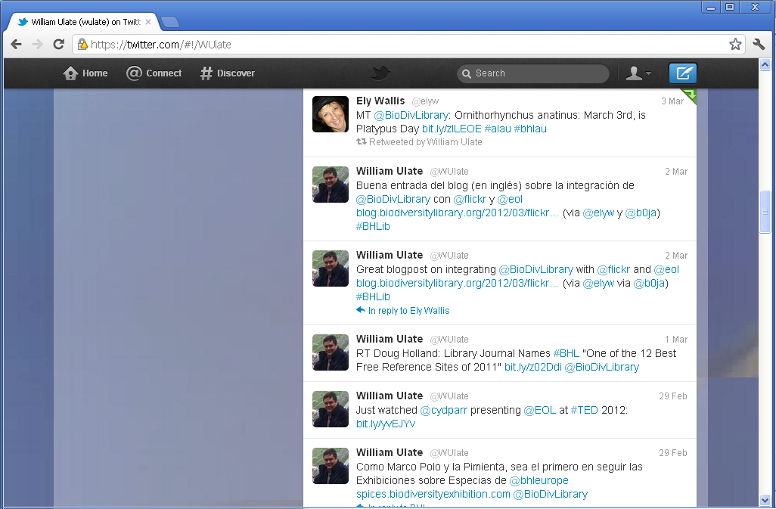
Multilingual Outreach
Notes:
20: The use of social media (Tweeter, Facebook, Flickr) to unlock and disseminate the knowledge, art and even curiosities contained within the BHL corpus has proven a valuable and effective way of engagement, as shown by this twitter message by Canadensis (https://twitter.com/#!/Canadensys/statuses/149226346017595392) that exemplifies how the material made available, in this case, one of the illustrations from a book in BHL (http://www.flickr.com/photos/biodivlibrary/6002339160/in/set-72157627215966771/), is being re-used and re-purposed by others through social media channels, acknowledging and appreciating our open data policy.
William Ulate has tweeted on major Global BHL related events and news from most BHL Programs translated into several languages thanks to complimentary collaboration from other colleagues (see examples on Appendix 2).

Slide 45
Multilingual Outreach
For BHL-Europe Coordinator interview:
In English:
  For those wondering what's Global BHL project about, check this interview to our colleague, Dr. Henning Scholz, BHL-Europe Coordinator! http://www.bhl-europe.eu/webfm_send/113
In Spanish:
  Para quienes se preguntan ¿de qué se trata el proyecto BHL Global? ¡Vean esta entrevista a nuestro colega, el Dr. Henning Scholz, Coordinador de BHL-Europa! http://www.bhl-europe.eu/webfm_send/113
In French:
  Pour ceux qui se demandent ce que c'est le projet "BHL Globale", consultez l'interview de notre collègue, le Doc. Henning Scholz, coordinateur de BHL-Europe! http://www.bhl-europe.eu/webfm_send/113
In Portuguese:
  Pra quem esta se perguntando o que é o projeto BHL Global? Olhem esta entrevista ao nosso colega, o Dr. Henning Scholz, Coordinador BHL Europa http://www.bhl-europe.eu/webfm_send/113
Notes:
20: The use of social media (Tweeter, Facebook, Flickr) to unlock and disseminate the knowledge, art and even curiosities contained within the BHL corpus has proven a valuable and effective way of engagement, as shown by this twitter message by Canadensis (https://twitter.com/#!/Canadensys/statuses/149226346017595392) that exemplifies how the material made available, in this case, one of the illustrations from a book in BHL (http://www.flickr.com/photos/biodivlibrary/6002339160/in/set-72157627215966771/), is being re-used and re-purposed by others through social media channels, acknowledging and appreciating our open data policy.
William Ulate has tweeted on major Global BHL related events and news from most BHL Programs translated into several languages thanks to complimentary collaboration from other colleagues (see examples on Appendix 2).

