Slide 1
BHL Marketing & Outreach
2012 Annual BHL Institutional Council Meeting
Cambridge, MA, 15 March, 2012
Grace Costantino
Chris Freeland
Martin Kalfatovic

Slide 2
Marketing & Outreach So Far
New Logo
Notes:
Tell who’s keeping what stats on the spreadsheet; click on public doc link; pic for reports wiki page

Slide 3
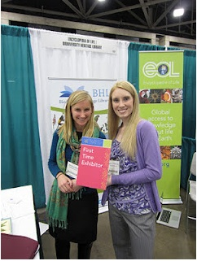
Marketing & Outreach So Far
BHL Banner
Notes:
Tell who’s keeping what stats on the spreadsheet; click on public doc link; pic for reports wiki page

Slide 4
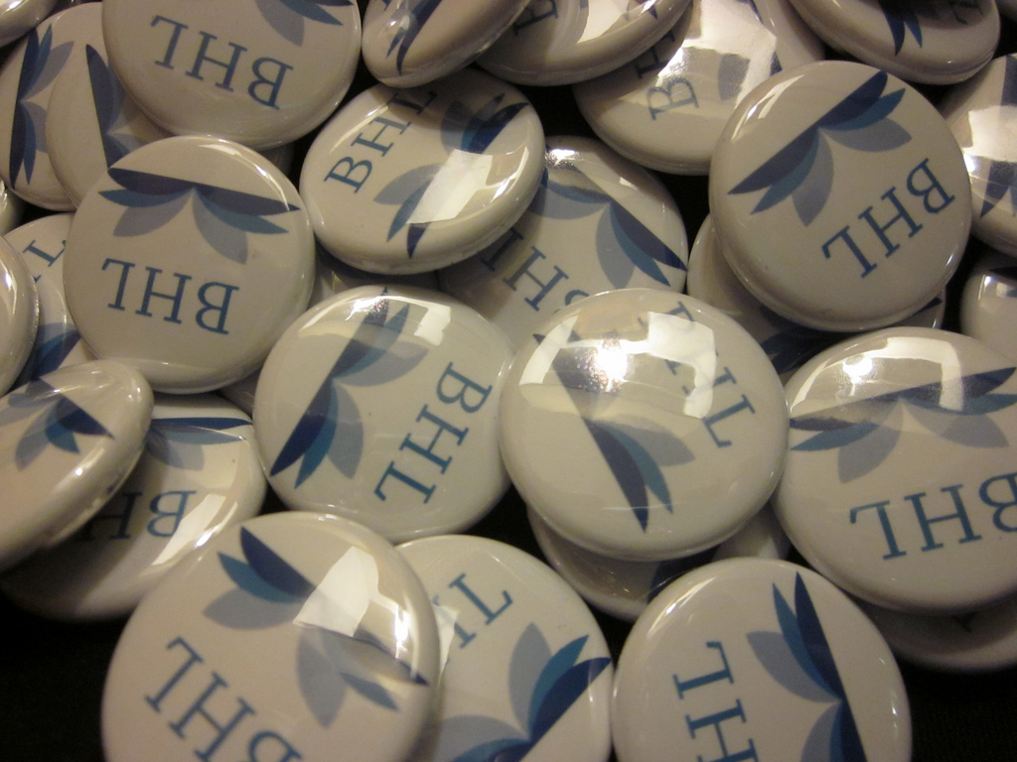
Marketing & Outreach So Far
BHL Buttons
Notes:
Tell who’s keeping what stats on the spreadsheet; click on public doc link; pic for reports wiki page

Slide 5
Marketing & Outreach So Far
BHL Business Cards
Notes:
Tell who’s keeping what stats on the spreadsheet; click on public doc link; pic for reports wiki page

Slide 6
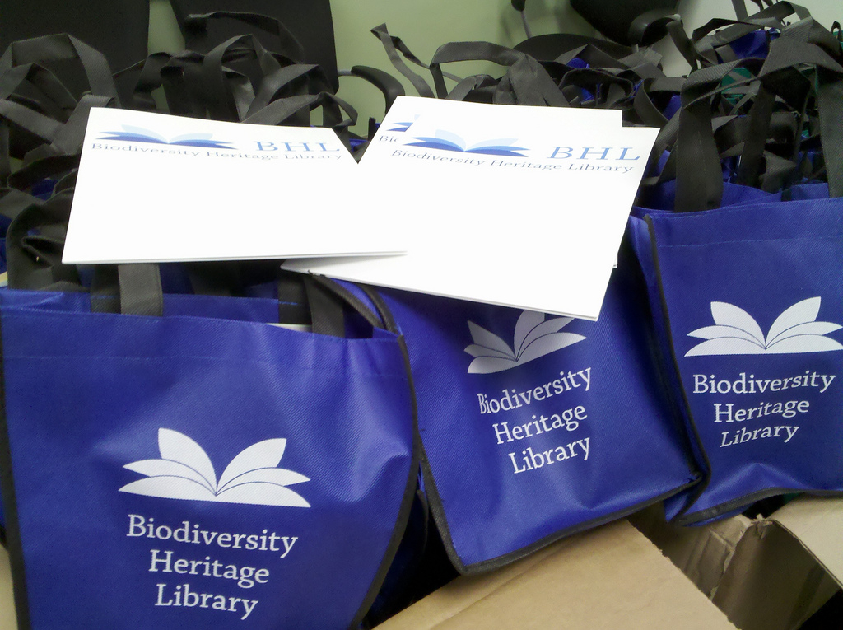
Marketing & Outreach So Far
BHL Conference Swag
Notes:
Tell who’s keeping what stats on the spreadsheet; click on public doc link; pic for reports wiki page

Slide 7
Marketing & Outreach So Far
Others:
BHL Pens
BHL Brochures
Facebook Campaigns for Life & Literature
BHL at Conferences & in Papers
Blog post at NMNH
Tweets w/ NMNH & BHL Partners
NMNH Print & Online Calendar
Notes:
Tell who’s keeping what stats on the spreadsheet; click on public doc link; pic for reports wiki page

Slide 8
Marketing & Outreach:
What’s Next?
Brainstorming New Ideas
Wiki Page: https://bhl.wikispaces.com/BHL+Marketing+%26+Outreach+Ideas
Notes:
Tell who’s keeping what stats on the spreadsheet; click on public doc link; pic for reports wiki page

