Slide 1
Collection Analysis from the Point of View of Content
Antonio G.Valdecasas , Marian Ramos, Manuel Sanchez Ruiz
Museo Nacional de Ciencias Naturales, CSIC
Madrid. Spain

Slide 2
Collection/Content Analysis
Before we write our contribution we would like to constrast our view with you.
There are, at least three possible view of Collection Analysis:
The technical (librarian) view –what is already written in green in deliverable D.2.6
Thematic via Content Analysis (the researchers approach)
Mixed
We are active professional researchers and we see Collection Analysis from the point of view of Content: To identify Biodiversity works relevant for BHL-Europe

Slide 3
Content Analysis
1.- Different meanings of Content Analysis within the Information System field, depending on applications.
INDUSTRY: strategies, processes, skills and technologies provideng the means for an efficient management of digital content (Brocke & Simons, 2008).
WIKIPEDIA: content analysis is a methodology in the social sciences for studying the content of communication. Earl Babbie defines it as “the study of recorded human communication, such as books, websites, painting and laws. Content analysis is also considered a scholarly methodology in the humanities by which texts are studied as to authorship, authenticity or meaning.
ACADEMIC: content analysis is a research tool used to determine the presence of certain words or concepts within text or sets of texts.

Slide 4
Content Analysis
OUR OPERATIONAL DEFINITION: Analyze which content is relevant for BHL-E objectives.
How may we delimit what should be included within a BHL-E digital library?
Not a very easy question to answer: simply subject matter terms are frequently not the best way to find works of relevance.
For example: words like ‘evolution’ sent to a generalist database may recuperate diverse material as ‘evolution of custom’, ‘evolution of dress’, etc.
‘Galapagos’ is another good example. In Spanish may refer to some islands and a special kind of turtle.
This is one of the main reasons why we build dedicated databases, to restrict results to a certain area of human activity or knowledge.

Slide 5
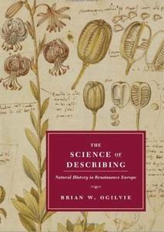
Content Analysis
GENERAL ANSWER: We understand that the ‘relevant content’ for BHL-E is exemplified with the resources used by historians to recover the activity of a discipline in a certain period:
the materials inherited,
the items produced,
the meanings associated to terms and
the tools employed to produce those results
In this regard, we find that “Brian W. Ogilvie: The Science of Describing” may perfectly illustrate the kind of content required.

Slide 6
Content Analysis
As zoologist we may exemplify this with the best general data base on zoological matter: the Zoological Record
What they include:
all zoological publications including from pure taxonomic work to more applied and experimental studies.
Examples of what they exclude:
Fringe areas dealing with animals solely from an agricultural, pharmacological, pathological, toxicological or inmunological point of view or when the animal is mentioned because of medical or veterinary research on another species.

Slide 7
Content Analysis
So, how spread should be the selection of works for BHL-Europe?
The answer may depend on search system used.

Slide 8
Content Analysis
Specific
(semantic)
Impose no limit
Then, size and variety of content
If search system is
Generalist
(key words)
Should be controlled

Slide 9
Content Analysis
Besides search system…
What are the admission criteria to be included in BHL-Europe?

Slide 10
Content Analysis
1.- Full Biodiversity content:
- Single monographic books
- Series like Fauna Iberica, Faune de France, etc
- Serials: Graellsia, Eos, etc
Tentative Taxonomy of works by specificity of Biodiversity content
2.- Partial Biodiversity content:
- Books
- Series like Encyclopedia
- Serials: Estudios Geologicos (Geology/Paleontology)
3.- Anecdotal and atypical Biodiversity content:
- Almanacs, statistical annuaries, etc

Slide 11
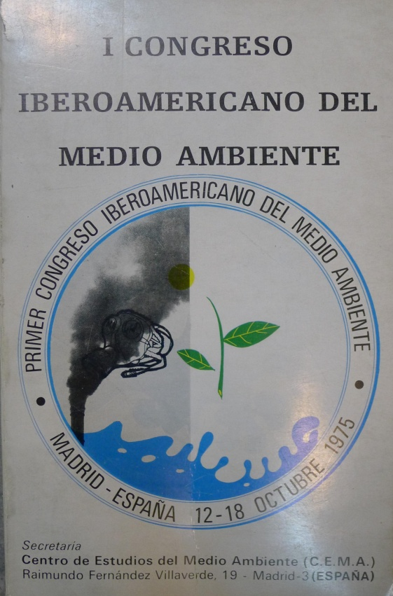
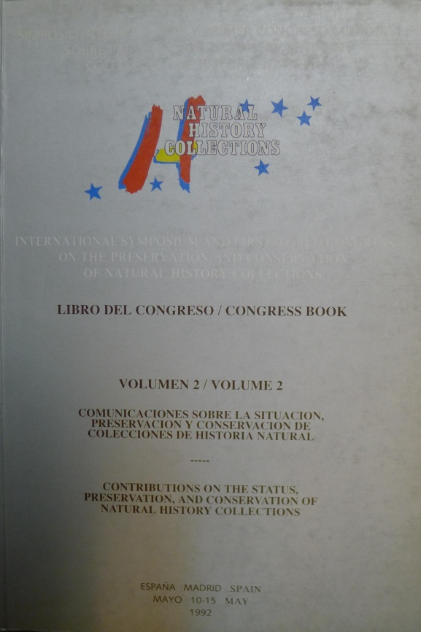
Content Analysis
Examples

Slide 12
Content Analysis
Useful references like:
Carolina Albadalejo: Entomological Bibliography of Spanish authors, 1758 - 2000

Slide 13
Content Analysis
Comments…

