Slide 1
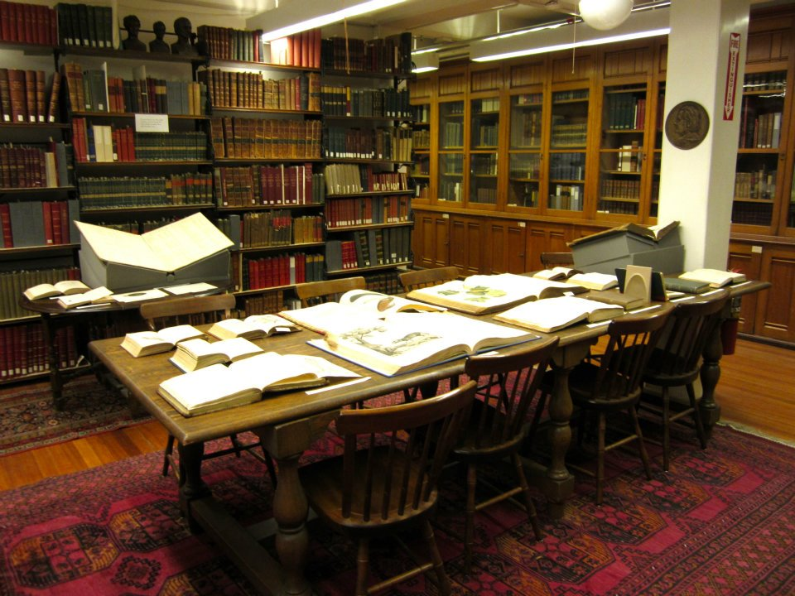
BHL & the MCZ Ernst Mayr Library
5 Years of Digitization

Slide 2

Total Numbers
344 Boutique scanned items ($674/item)
6855 scanned by Internet Archive ($39/item)
TOTAL: 7199 items ($69/item)

Slide 3
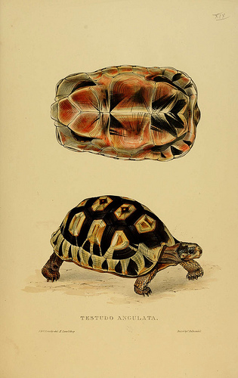
2011
Staff costs for 3.1 FTE $212,550
Other costs (travel, boutique scanning, transport) $115,704
Primarily Gemini request responses in 2011
50 boutique, 875 Internet Archive

Slide 4
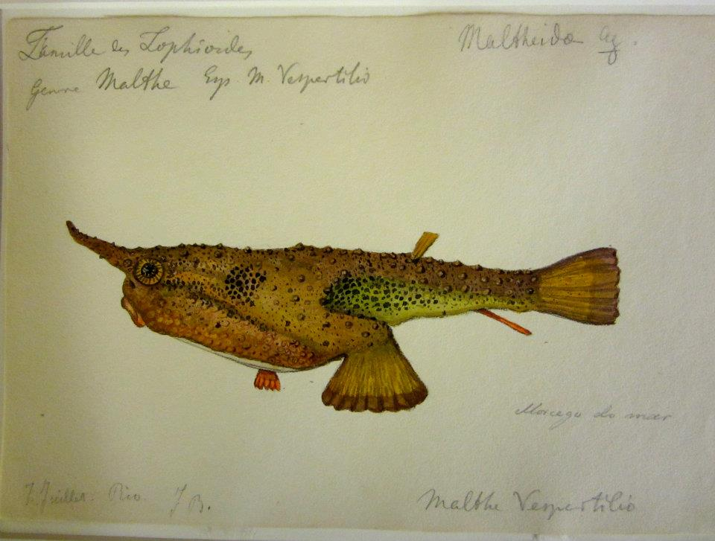
Other Accomplishments
Hired 2 fulltime BHL Assistants for metadata management, QA, local catalog enhancement & processing
Ernst Mayr Library Flickr page
Exhibits using EML scans
Many presentations in & outside of Harvard
IMLS National Leadership grant Connecting Content contribution
Published results from IMLS Planning grant “Retooling Special Collections Digitization in the age of Mass Scanning”
Joe, in addition to his day job…..manages all aspects of BHL work
Notes:
Chris-metadata librarian: pagination (85 vol), local bib records enhanced, gemini requests added 1689 holdings locally
JJ-BHL assistant: closing stale gemini requests of 241 issues, 134 losed and 52 flagged for followup, 55 in progress; eliminated dupe bib records, 431 bids reviewed and resolved, QA (186 titles since May), prescanning review, basic repairs, worked on UA/AU portal usability study, blogged, Staff reac to landl
Thank you Gilbert and JJ
DISH, Berlin 9, Harvard tech librarians

Slide 5

Solution needed
Harvard boutique scanned items (usually Gemini requests) cannot be directly ingested into IA. They must be processed through MOBOT, taxing their limited staff. This can take up to 2 years.
Of 344 items in this category, more than 200 have yet to be ingested.
Notes:
Others are ingested meanwhile
EXPENSIVE

Slide 6
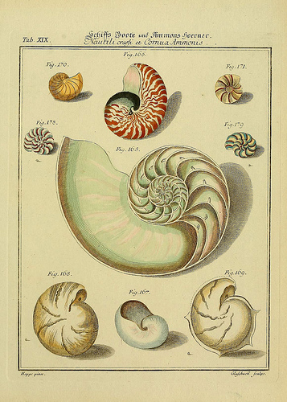
Thank you
Jim Hanken/MCZ for vision & support
Ernst Mayr Library staff, especially Joe deVeer, for never saying no
BHL & Harvard Colleagues for inspiration & support & being willing to talk endlessly about BHL
Notes:
Catherine for taking care of all the logistics!

