Slide 1
Collections Coordinator Updates
Bianca Crowley
crowleyb@si.edu
202-633-2239

Slide 2
Collections Coordinator Focus
Mind Map of BHL Work Areas
Notes:
[30 seconds]
My personal overview of BHL program work areas
Helps me manage big picture of BHL activities
Found this helpful in communicating BHL overview with new BHL members & staff

Slide 3
Collection Management Cycle
Backend Tools
Monographic Deduper
Serials Scanlist
Gemini Issue Tracking Software
SCANNING
POST-SCANNING
Backend Tools
BHL Administrative Dashboard
Gemini Issue Tracking Software

Slide 4
Selection
ACTIVE /HIGH PRIORITY
High-yield taxonomic materials
Unique & rare materials
Permissions titles
User requested titles & gap-fills
Discipline specific subject matter
Non-BHL member materials ingested from the Internet Archive
PASSIVE /LOW PRIORITY
Notes:
[2 min]
Our selection process is based on the following selection criteria
Collections Committee has completed work to identify high-yield taxonomic materials - many of these titles have been scanned to BHL and others are still in progress
Permissions titles = in-copyright content for which we obtain explicit permission via a signed license agreement to include their content in the BHL
We receive requests from our users and fulfill these as we can, especially in the case of filling gaps within a serial run or series
In the early days of BHL US/UK, each institution selected a discipline specific subject area (Entomology, Botany, etc.) to start scanning
Like the BHL, many libraries across the world scan materials with the Internet Archive and the majority of the content is open access. We benefit from those other libraries by using a set of subject headings and call numbers to regularly harvest biodiversity-related materials from the University of Toronto, or the California Digital Library for example, into the BHL collection

Slide 5
User Feedback is Critical
General feedback form
Scan request form
http://biodiversitylibrary.org/contact
Notes:
[30 sec]
User feedback is critical to driving our curation activities,
BHL relies on our users to be the many eyes we need to help us catch issues/problems with our 40 million + page collection
We receive feedback from users in 2 ways: general issues/problems (Grace), scanning requests (Bianca, Jackie, Adriana)
If you notice a problem with something in BHL, send us your feedback!

Slide 6
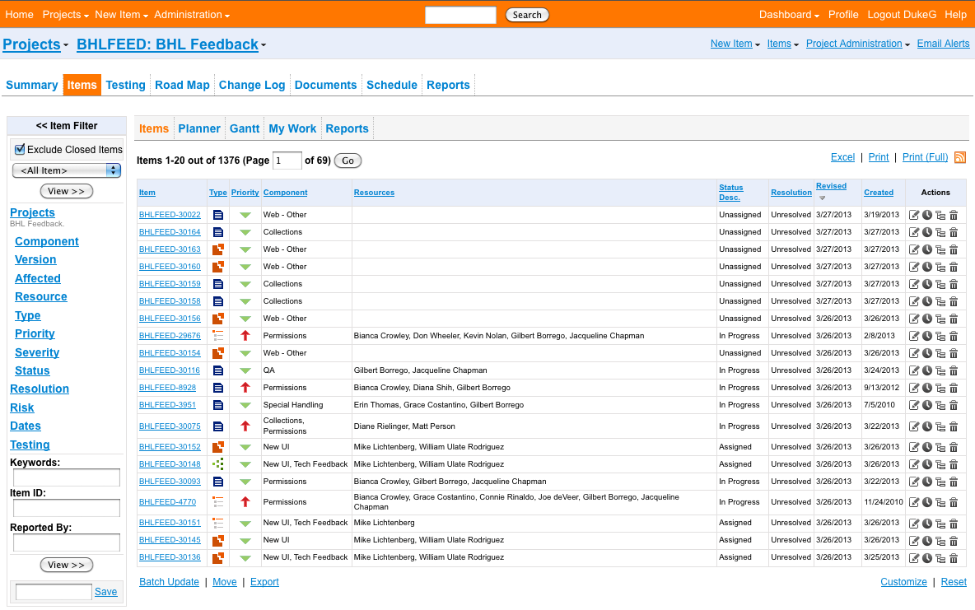
Gemini Issue Tracking System
Notes:
[30 sec]
BHL uses an issue tracking system, known as Gemini, to manage the feedback we receive from users
Nearly all BHL member libraries are represented in the Gemini system
Essential to BHL day-to-day work
Key to communicating at level of granularity we need
Excellent documentation tool

Slide 7
Gemini Overview
Current stats
Over 5300 issues submitted from users to date
75% of issues have been closed
40% of issues are scanning requests
22% of scanning requests are for rare, folio, &etc
Strategy for management
Scan requests (Jackie, Bianca, Adriana)
All other issues (Grace)
Participation
Encouraging staff to follow up or reassign
Notes:
[1 min]
Much needed help for processing scan requests w/ Jackie Chapman (newest SIL BHL FTE) and Adriana Marroquin (1st BHL Virtual Reference Intern)
Grace handles all other issues that come in on a daily basis on top of her other duties as well as regularly corresponds with users!
Even with help managing scanning requests, the 4 of us cannot manage all Gemini issues.
It is up to BHL Staff to follow up on issues assigned to them and if they cannot fulfill the issues, we are asking Staff to reassign issues to another BHL library
Training

Slide 8
Collections Committee
Members:
Bianca Crowley, Gilbert Borrego, Joe deVeer, Robin Everly, Becky Morin, Matt Person, Connie Rinaldo, Trish Rose-Sandler, Marty Schlabach, Diana Shih, William Ulate, Judy Warnement, Don Wheeler, (Grace Costantino, Christine Giannoni)
Calls every other Monday at 2pm ET, everyone welcome!
Transparency https://bhl.wikispaces.com/Collection+Development
Many discussions since Feb 2010

Slide 9
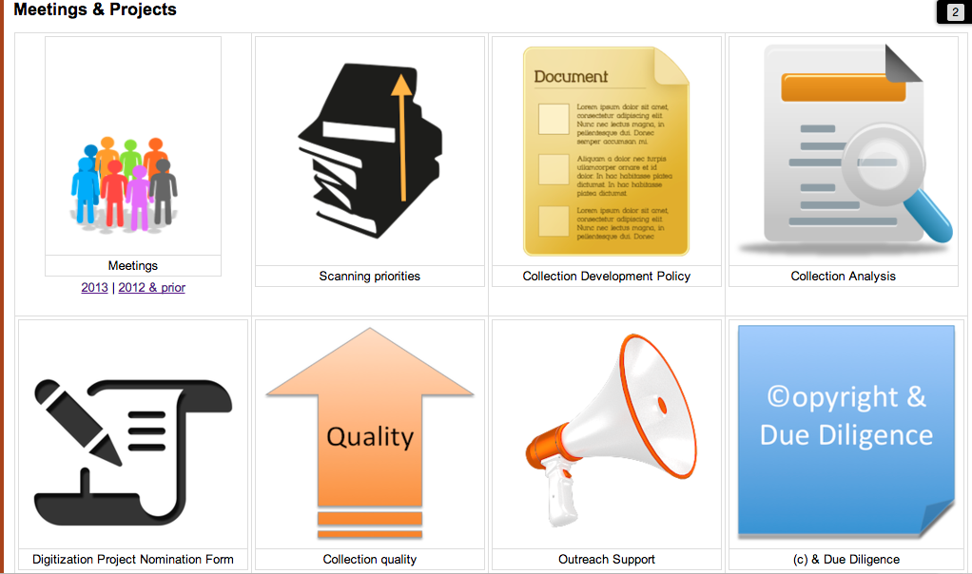
Collections Committee Work Areas

Slide 10
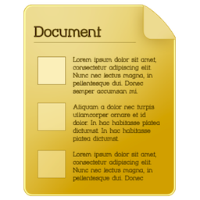
Internal Collection Development Policy
Policy for public: http://bit.ly/o6mF3t
Purpose:
detailed information on all aspects of BHL collection development for staff, esp. new members
Highlights of additions:
Types of Materials: No frankenbooks; Book-like objects; Link outs to 3rd party websites
Google Books
Microform
ILL

Slide 11
Digitization Project Nomination Form
Form created in response to 2012 IC Mtg
Purpose
Form available on bhl wiki
Ideas for possible digitization projects?
Seed catalog project form in progress
Notes:
[1 min]

Slide 12
Collection Analysis
Strategies for analysis
Need for resources to perform analysis
More Viable | Less Viable
LC Subject & Call Numbers | ILL Analysis
Discipline specific analysis | Google analytics
Subject bibliographies | Analyze scanning requests
Rod Page’s list of high impact titles | Anecdotal observations
PDF Download analysis | OCLC Number analysis
EOL LifeDesk Bibliographies & priority taxa lists
Notes:
[2 min]
Collections committee has identified various strategies for collection analysis
More viable strategies include…(and describe ea. in a nutshell)
Biggest issue is the need for dedicated resources to perform analysis ➔ poss. Application for a CLIR fellow, other suggestions?

Slide 13
©opyright Metadata
Copyright Status | Status language | License
Permissions | In copyright. Digitized with the permission of the rights holder. | Creative Commons Attribution, Non-Commercial, Share-Alike (CC-BY-NC-SA)
Due Diligence | No known copyright restrictions as determined by scanning institution. | NA
Public Domain | Public domain. The BHL considers that this work is no longer under copyright protection. | NA
All known permissions & due diligence items should have appropriate metadata
Public domain items under review for metadata consistency
All future BHL member scanning must comply with metadata rules: http://bhl.wikispaces.com/copyright
Notes:
[1 min]

Slide 14
Permissions Plan
Permissions request form letter – subgroup (Becky, Joe, Tomoko, Bianca) to address
Potential contacts to solicit requests – everyone can help
Funding? To date, all permissions scanning has been at no cost to copyright holder
What about copyright holders that have already digitized content in PDF form? (LOTS of these!)
Protocol in development (Bianca w/ SIL group) for scanning 1923-63 out of copyright materials
(Cornell has direct line to Peter Hirtle, “copyright rock star”!)
Notes:
[1 min]
BHL Staff calls are third Thursday of every month at 11am ET for 1 hour
Announcements go out via BHL staff listserv
I lead calls w/ goal to send agenda out 1 week in adv
Involves: news & updates, Round Robin, Discussion of current challenges & requests for volunteers
Everyone is welcome; this is THE opportunity to learn about BHL Staff activities and ask questions
Who in the room is both an IC/SC rep and on BHL Staff calls? Key to have IC/SC members participate in BHL Staff calls; I see these folks as conduits of communications between BHL leadership & BHL staff

Slide 15
BHL Staff Communication
BHL Staff listserv
Regular conference calls, every 3rd Thursday/mo. @ 11am ET ➔ You’re welcome to join in!
Gemini
BHL blog http://blog.biodiversitylibrary.org/
Notes:
[1 min]
BHL Staff calls are third Thursday of every month at 11am ET for 1 hour
Announcements go out via BHL staff listserv
I lead calls w/ goal to send agenda out 1 week in adv
Involves: news & updates, Round Robin, Discussion of current challenges & requests for volunteers
Everyone is welcome; this is THE opportunity to learn about BHL Staff activities and ask questions
Who in the room is both an IC/SC rep and on BHL Staff calls? Key to have IC/SC members participate in BHL Staff calls; I see these folks as conduits of communications between BHL leadership & BHL staff

Slide 16
Questions?
Bianca Crowley
crowleyb@si.edu
202-633-2239

