Slide 1
Blog Brainstorming Session
2012 BHL Staff & Technical Meeting
Cambridge, MA, 27 September, 2012
Grace Costantino

Slide 2
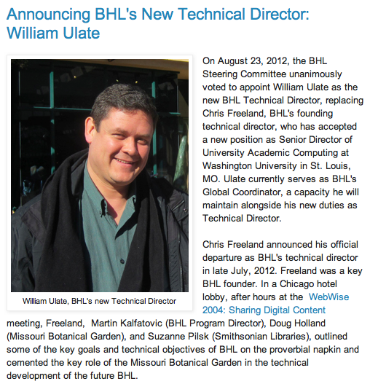
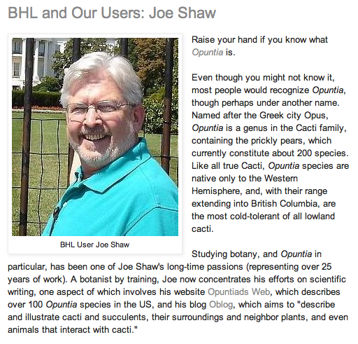
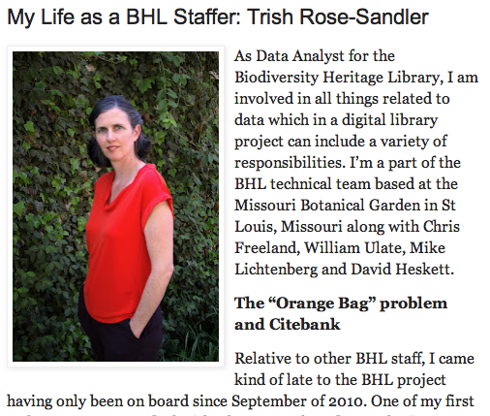
What We’re Doing Now…
Project News & Updates
Book of the Week
BHL & Our Users
My Life as a BHL Staffer
Notes:
Tell who’s keeping what stats on the spreadsheet; click on public doc link; pic for reports wiki page

Slide 3
The Stats
Visits over past year…29,153
Unique Visitors over past year…21,140
72% New Visitors over past year
28% Returning Visitors over past year
Average Visits per week over past year…539
Average Unique Visitors per week over
past year…391
Notes:
Pic for blog and tweets and ala blog post

Slide 4
Where We’re Going…
Campaign Driven Activities!

Slide 5
Shark Week
Website: 4.5% Increase in traffic to website
Facebook: 46% Increase in traffic to website originating from Facebook
Twitter: 125% Increase in traffic to website originating from Twitter
Flickr: 50% Increase in traffic to website originating from Flickr
iTunes U: Shark Week collection on iTunes U had:
314% more downloads than single collection receives on average
446% more subscriptions than single collection receives on average
357% more browses than single collection receives on average
Blog: 20% Decrease in traffic to website originating from blog
Pinterest: 56% Decrease in traffic to website originating from Pinterest
Notes:
Click on first link then navigate through three pages

Slide 6
American Trails
Website: 24% Increase in traffic to website
Facebook: 2.5% Increase in traffic to website originating from Facebook
Twitter: 1.6% Increase in traffic to website originating from Twitter
Flickr: 26% Increase in traffic to website originating from Flickr
Blog: 83% Increase in traffic to website originating from blog
Pinterest: 56% Increase in traffic to website originating from Pinterest
Notes:
Click on first link then navigate through three pages

Slide 7
Blog Brainstorming
What sorts of topics are you interested in for the blog?
What are your favorite books on BHL?
Who are your favorite authors on BHL?
What are some major events upcoming at your institutions?
What are some upcoming biodiversity or library-related conferences?
What are some pop culture events with large followings that might relate to BHL?
What users/patrons do you know that use BHL regularly?
Notes:
Tell how much time spent on BHL social media: me 40%; Bianca 20%; Gilbert 30%; pics for blog, twitter, daily quizzes, flickr

