Slide 1
BHL Survey 2010
Presented by Bianca Crowley
Data Analysis performed by Francisco Welter-Schultes

Slide 2
Overview
Collaboration between BHL partners in US and Europe
Survey Monkey in 6 different languages
Targeted & broad dissemination strategies
March 15 – May 03, 2010
Average number of successful responses per question = 1020
Some questions had fewer responses, some had more
16 total questions

Slide 3
Goals
To understand current user groups
To attract new user groups
To discover how BHL services are being used
To inform collection and technical development priorities for the future
To develop a core set of questions that can be reissued to track future progress

Slide 4
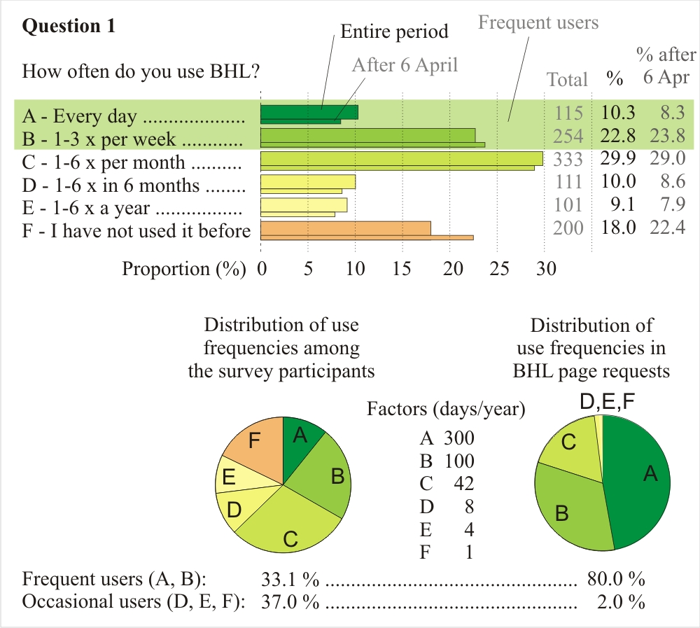
1) Use Frequency

Slide 5
How often do you use BHL for the following? [translated 5 times]

Slide 6
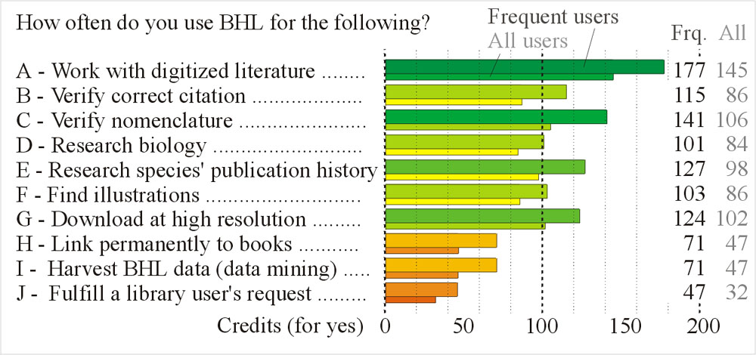
2) Use Functions

Slide 7
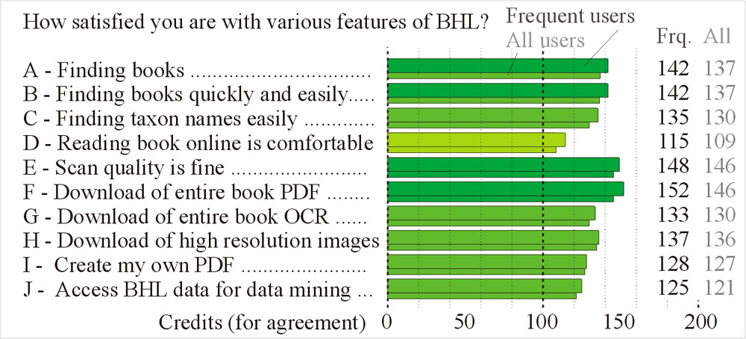
3) Levels of Satisfaction

Slide 8
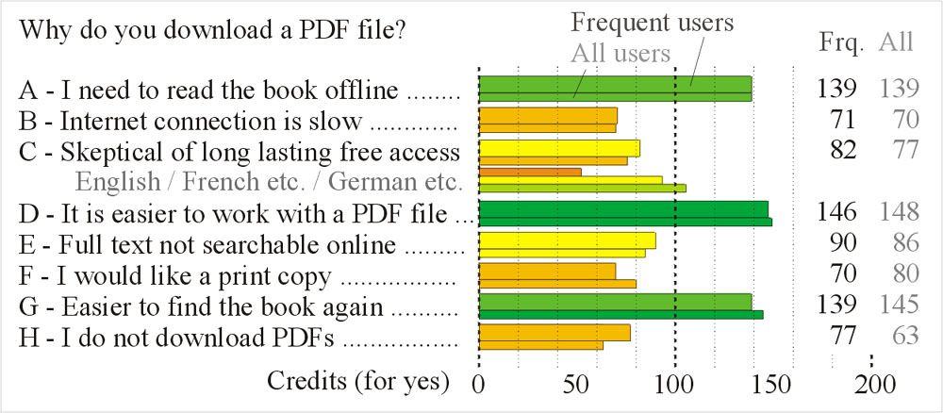
4) PDF Usage
Notes:
Decrease the need for people to download a PDF because it is “easier to find the book again on my harddisk for repeated usage” by improving the BHL search functionality.
Allow for the download of B&W PDFs for 96% of the BHL collection.

Slide 9
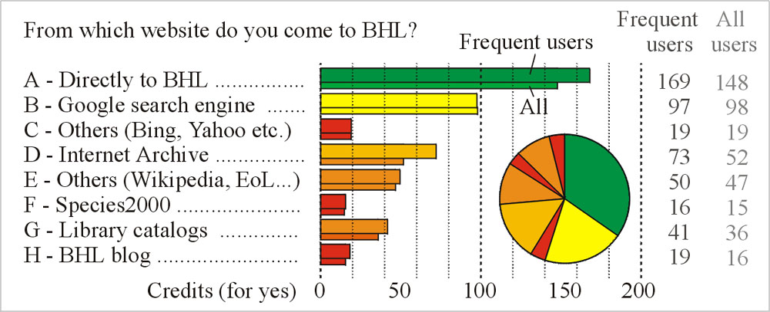
5) Referrers
Notes:
Users, especially frequent users, know the BHL homepage. Capitalize on homepage real estate by making the most effective use of the space for BHL news, documentation, links to various services, and search/browse functionality.
As BHL grows globally, ensure that the homepage serves as a central portal to various global nodes.

Slide 10
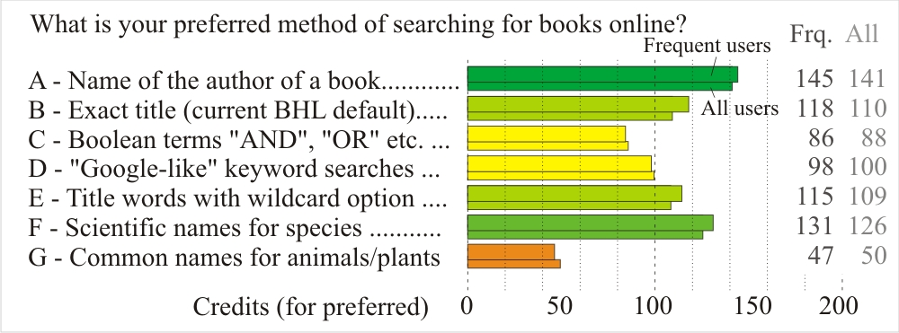
6) Search Methods
Notes:
Users reported that they most prefer searching by author name. Improve the BHL back-end author name file to reconcile duplicate entries.
Enable faceted searching to allow users the flexibility to filter search results by various bibliographic parameters such as title, date, author and subject.

Slide 11
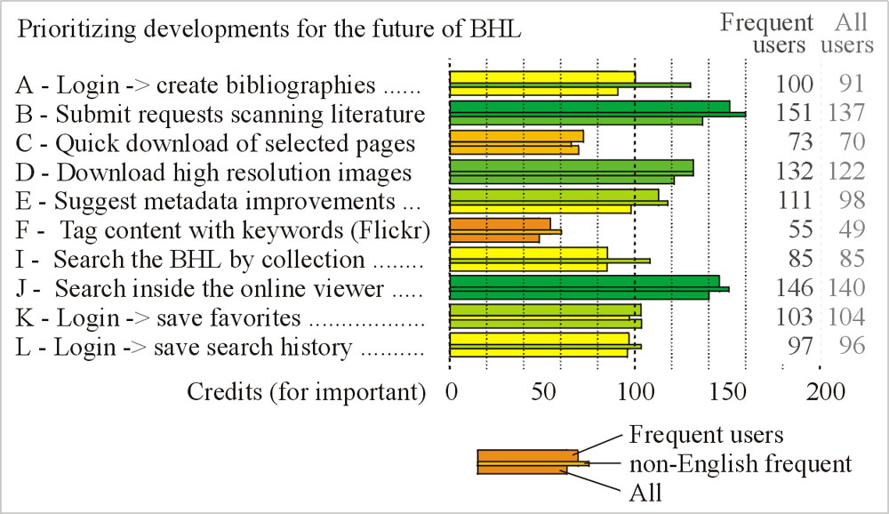
7) Future Developments

Slide 12
Implications
Allow users to request a book for scanning. Completed June 2010.
Enable the ability for users to “search inside the book”, requiring the full text indexing of all BHL content.
Improve the high resolution image download tutorial for users and make the link more obvious/accessible. In progress.

Slide 13
Implications
96% of the collection is available for download as high resolution images. ➔ Increase the percentage of the collection that is available for download.
Allow users to quickly download/print single pages of BHL books/volumes. Completed June 2010.
Allow users to download selected high resolution images from a BHL book/volume.

Slide 14
Implications
Crowd-sourcing: extend the ability for users to “suggest improvements to BHL book information” beyond the current feedback mechanism.
Bibliographic metadata
OCR text
Book pagination
Enable the ability for users to log-in and save books/volumes or articles to their favorites
BHL website should remain in English as the default with the option to change the language

Slide 15
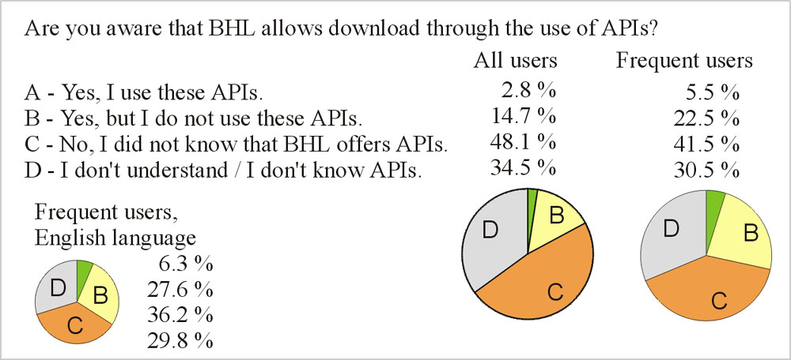
8) APIs
Notes:
Better advertise and explain the importance of BHL APIs through dissemination activities and documentation.

Slide 16
9) & 10) Free Text
9) What features do you find most helpful to use in other digital library websites such as Google Scholar, Google Book Search, Gallica, Botanicus, AnimalBase, etc.?
10) Please provide any additional comments you may have about the Biodiversity Heritage Library.
Majority of users commented that they want:
Improvements to the BHL search functionality
The ability to “search inside the book”
More content, especially for missing volumes of a series (“gap-fills”)
Improvements to the UI
Improvements to the PDF downloading functionality (B&W PDFs)

Slide 17
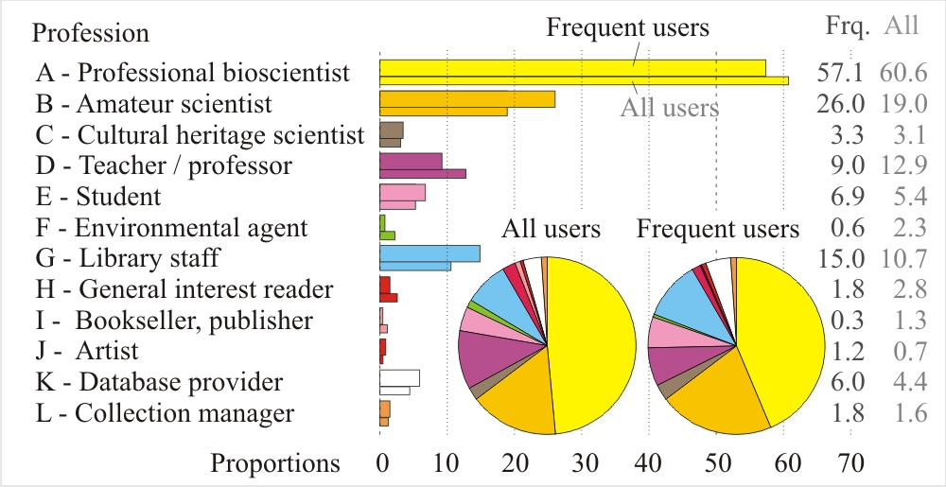
11) Profession

Slide 18
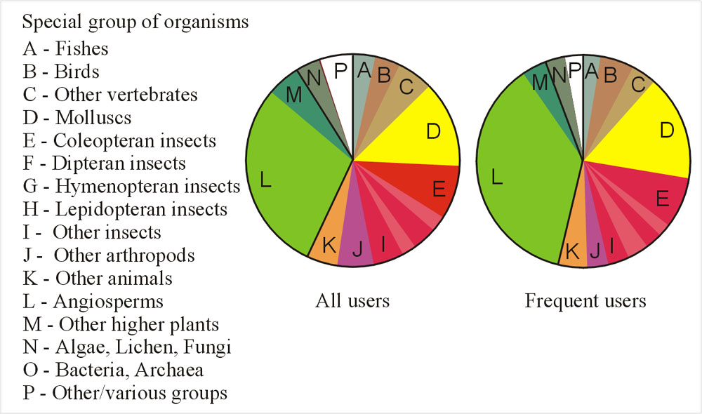
12) Specialization
IPNI example

Slide 19
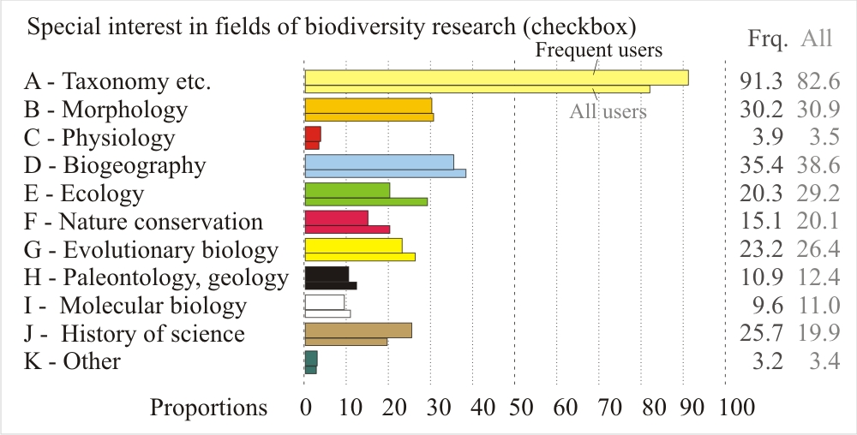
13) Disciplines

Slide 20
Implications
Collection development should prioritize content that support scholarship for the following subjects, in ranked order:
Taxonomy, systematic & nomenclature
Biogeography
Morphology
Ecology & Evolutionary biology
History of Science
Provide access to as many major Botany and Zoology taxonomic works as possible. How?!

Slide 21
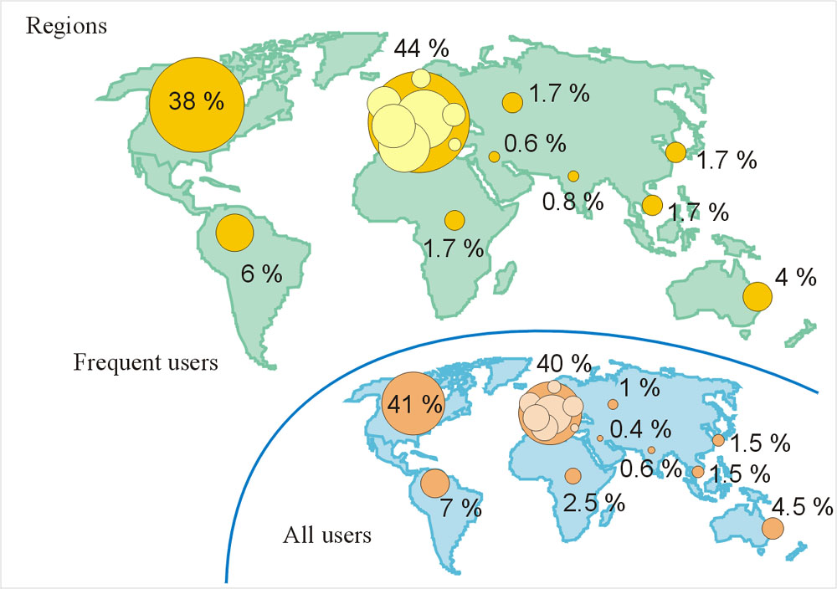
14) Regions
Notes:
We managed to get responses from many parts of the globe but of course the major respondent sets were from the US and Europe

Slide 22
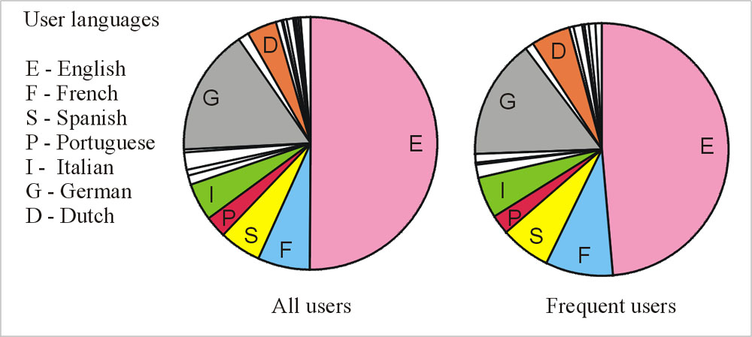
15) Languages

Slide 23
16) Language : Country

Slide 24
Users: Our Common Denominator
Each BHL node will have its own goals/funders/stakeholders/priorities…but for the most part, we share the same global audience
Flexible, agile development model, drawing on collaborative inputs of BHL member institutions, global partners, and user feedback.
Once local collections for local users, now shared collections on a global scale for a global audience
Notes:
So how can we make BHL better for everybody?! My recommendation is that we do what we do best for those closest to us, whether geographically, administratively, interactively/personally
Capitalize on the strengths of each node. Focus on the users within your node’s reach. Trust the hive.

