Slide 1
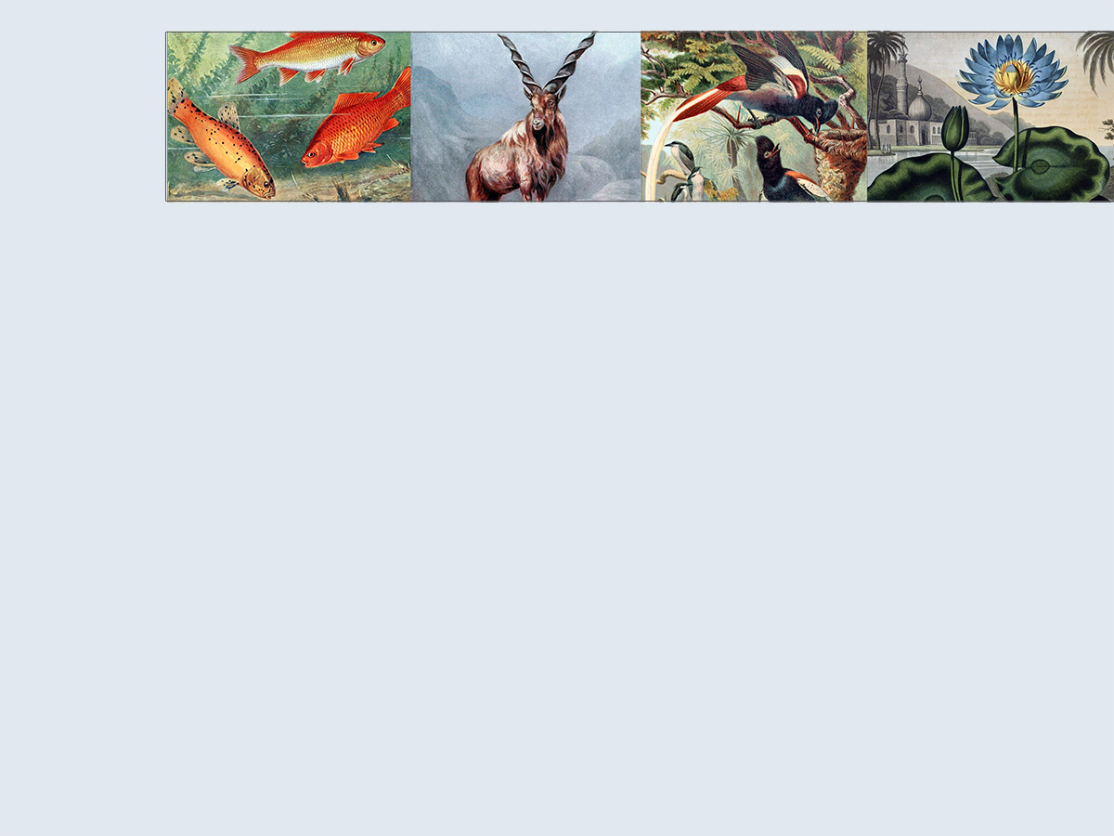
BHL US/UK
Collection Management Overview
Bianca Crowley, Collections Coordinator
Biodiversity Heritage Library
Smithsonian Libraries
Notes:
Total 11 min
[30 sec]
Hello everyone, I am Bianca Crowley, the Collections Coordinator for the BHL US/UK working out of the Smithsonian Libraries in Washington DC.
2 things: What are your needs? Understanding this can help us improve our documentation in an effort to shorten the time it may take for you to fulfill your needs; my impression from yesterday is that BHLA is at step 1.5, this accurate?, I can appreciate full well how daunting steps 2-1000, this is where everyone is when they get started but with a shared vision of what you want for BHL Africa there are nothing but possibilities ahead of you;
BHL US/UK has taken many many steps over past 8 years, today overview of Collection Development and Digitization workflow paths.
Confirm idea that BHLA will contribute content into the BHL website?

Slide 2
Collection Management Cycle
PRE-SCANNING
POST-SCANNING
Notes:
[1 min]
Collection mgmt to me is a continuous cycle of pre-digitization and post-digitization workflows
Getting the content scanned is 1 thing and managing the content after it’s been scanned is just as important
Among our consortium libraries we have staff that dedicate themselves to different aspects of the cycle; some focus on pre, some post, most both!
You’ll notice that our users play a key role in the cycle

Slide 3
Selection
ACTIVE /HIGH PRIORITY
High-yield taxonomic materials
Unique & rare materials
Permissions titles
User requested titles & gap-fills
Discipline specific subject matter
Non-BHL member materials ingested from the Internet Archive
PASSIVE /LOW PRIORITY
Notes:
[2 min]
BHL US/UK process is based on the following selection criteria
Our collective strength is that we are able to aggregate our unique and rare materials in one place
Unique materials from your collections would be a fantastic addition to the collection
Permissions titles = in-copyright content for which we obtain explicit permission via a signed license agreement to include their content in the BHL
We receive requests from our users and fulfill these as we can, especially in the case of filling gaps within a serial run or series
In the early days of BHL US/UK, each institution selected a discipline specific subject area (Entomology, Botany, etc.) to start scanning
Like the BHL, many libraries across the world scan materials with the Internet Archive and the majority of the content is open access. We benefit from those other libraries by using a set of subject headings and call numbers to regularly harvest biodiversity-related materials from the University of Toronto, or the California Digital Library for example, into the BHL collection

Slide 4
What is Biodiversity Content?
Notes:
[30 sec]
We actively collect content within these core (blue) and supporting (green) subject areas
We have materials beyond this central scope but when prioritizing what to scan, we rely on these guidelines
Visual diagram a part of our collection development policy
I encourage you to think about what is core to your institution to develop a collective sense of core collections for BHL Africa

Slide 5
Deduplication
We try to avoid duplication where possible
Tools
Serials = Scanlist
Monographs = Monographic deduper
Check the BHL before you send for scanning
We do our best but duplication happens
Post-digitization, we merge titles as necessary
Notes:
[1 min]
Duplication is a difficult issue
Back-end db

Slide 6
BHL US/UK Principles: Digitization
Mass-digitization scanning operation
Scan books, cover-to-cover
To the best we can, we seek to provide an exact digital copy of the original physical object
We are experimenting with field note books
Infrastructure supports book-like objects
We do not (yet) have maps, art-works, photographs
Workflow designed around scanning physical books
We are working on solutions to incorporating born-digital materials

Slide 7
BHL US/UK Principles: Digitization
Most BHL US/UK libraries scan directly through the Internet Archive
We pay the Internet Archive to provide us with full digitization services
Each BHL US/UK member library has its own workflow:
Sending the books from our shelves
And the bibliographic metadata from our library catalogs
To the digitization station
And returning the books back to our shelves

Slide 8
BHL US/UK Principles: Metadata
Our baseline standard is MARC
We derive the metadata that displays on the BHL website from the MARC records
We aggregate the bibliographic records from each of our library catalogs into the BHL database AS IS
We edit the metadata displayed on the BHL website manually as necessary
BHL Digitization Specifications documentation currently being updated

Slide 9
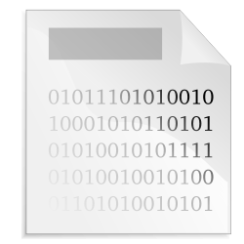
Digitization Workflow
Insert Smithsonian Macaw software here
Notes:
[30 sec]

Slide 10
Digitization workflow
Titles vs. Items vs. Segments
Metadata we need:
MARC for book and journal titles
Volume information
Page data
BHL Term | Titles | Items | Segments
Library Term | Book or Journal Titles | Volume, Piece | Articles, Book chapters,
Meaning | Conceptual unit | Object | Section of consecutive pages
Notes:
[1 min]

Slide 11
Digitization workflow
Scanning method:
Via an Internet Archive “Scribe” machine
Via your own in-house equipment
Content integration:
Via IA Scribe machine
Via Smithsonian “Macaw” software into IA
BHL harvests content from IA into a database managed by the Missouri Botanical Garden
Notes:
[1 min]

Slide 12
User Feedback is Critical
General feedback form
Scan request form
http://biodiversitylibrary.org/contact
Notes:
[30 sec]

Slide 13
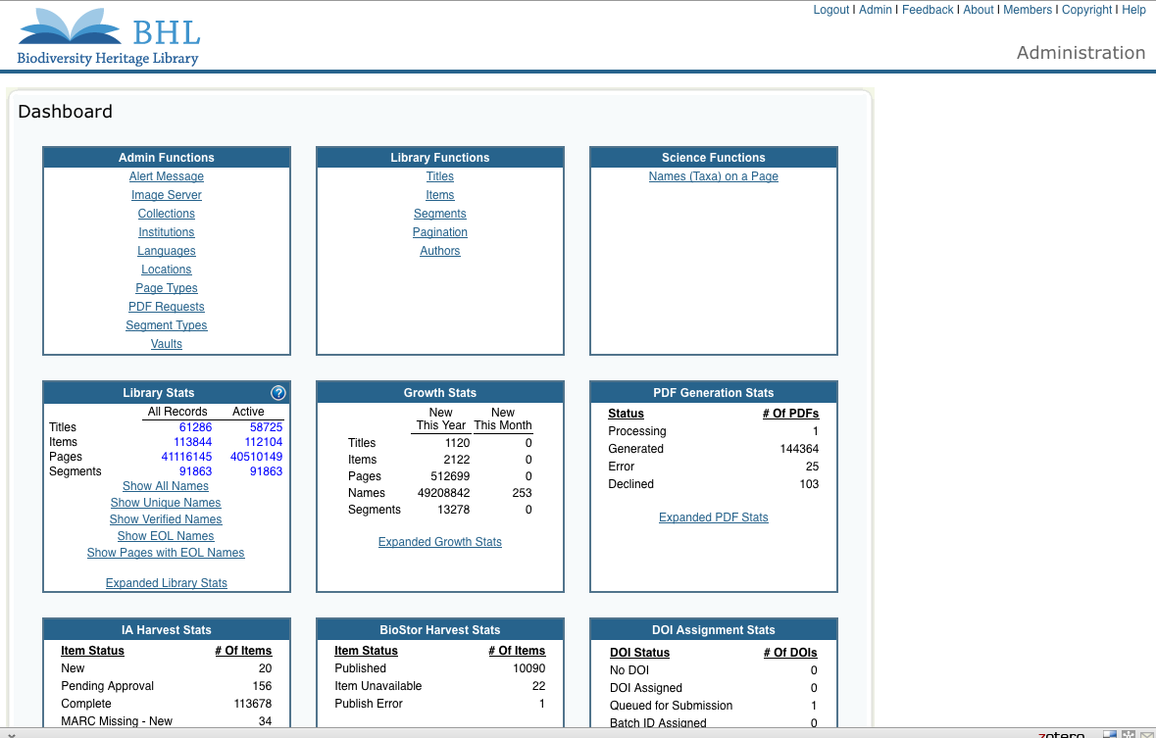
BHL Administrative Dashboard allows access to backend database
Notes:
Requires login
Web-based Administrative interface to access the backend BHL database so that we can make corrections to our collection as necessary.
Only correct as users indicate errors

Slide 14
…and repeat
Notes:
[30 sec]

Slide 15
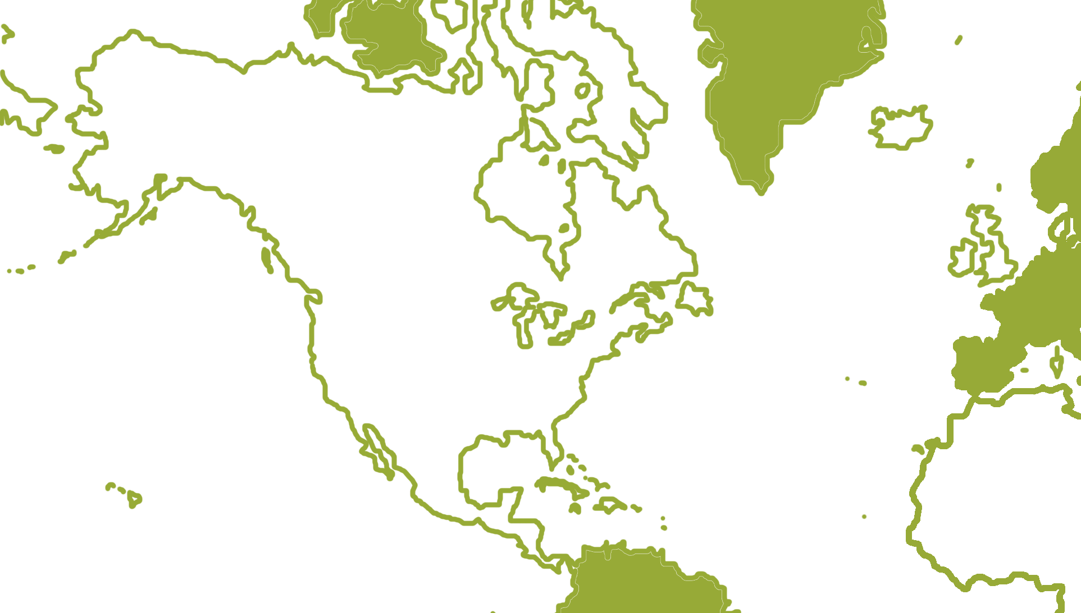
Work Autonomously
Notes:
[30 sec]
BHL Collections Committee
Trust
Shared vision – get as much biodiversity literature accessible, for free, online as possible

Slide 16
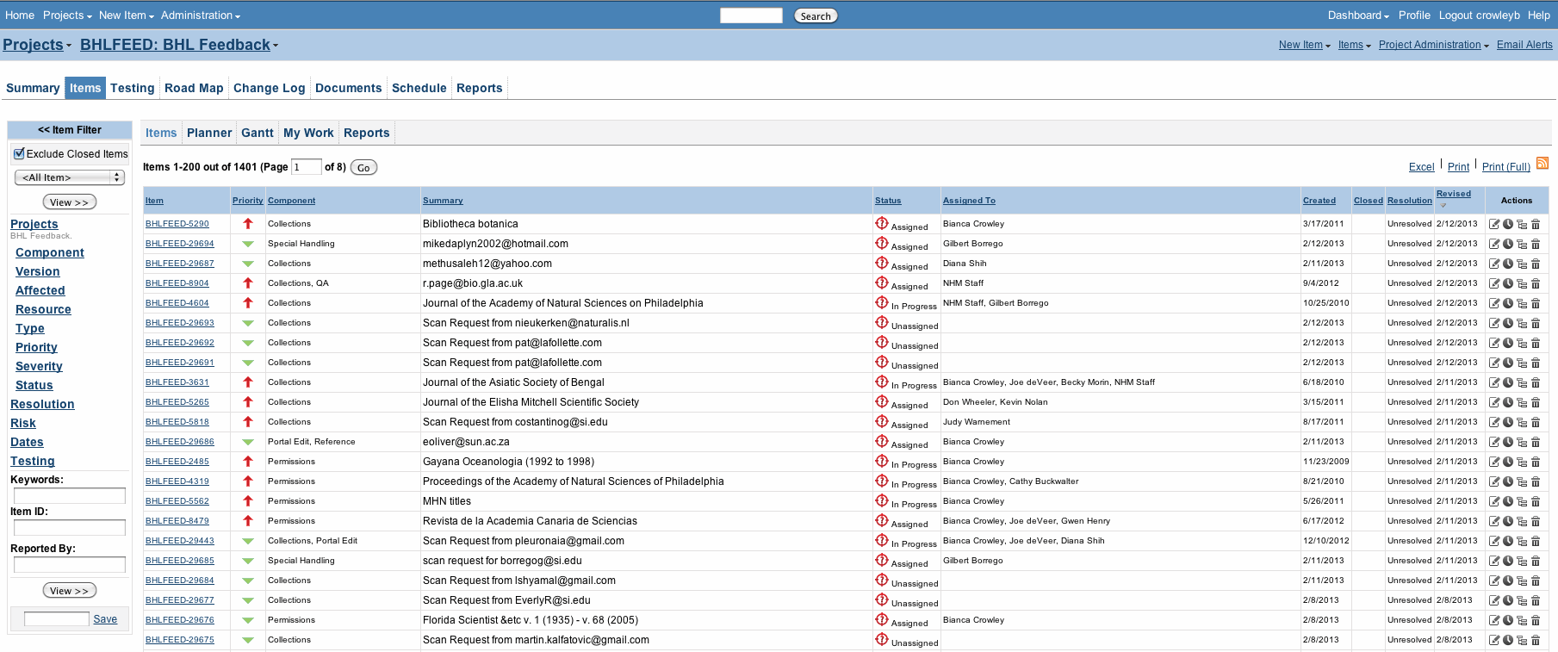
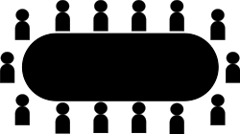
Communicate & Document Regularly
Issue Tracking
Software
Vols. 6, 8, 10
Vols. 1-5
Vols. 7, 9, 11-21
Notes:
[30 sec]
COLLABORATION!
We could not do what we do without the tools to collaborate and communicate effectively across institutions and timezones.
Only a few institutions have full time staff that can dedicate themselves to BHL project work and most of our institutions donate a portion of there staff's time in addition to their regular duties. I like to think of it as working with a team of skilled volunteers. They do fantastic work but at different rates and times. This means finding the right tools for the tasks (and there are many!). You can see that we use as many free tools as possible. One tool that we do pay for however, is our issue tracking system which is the best tool we have for following up on feedback from our users and supporting the kind of detailed
communication and documentation we need.

Slide 17
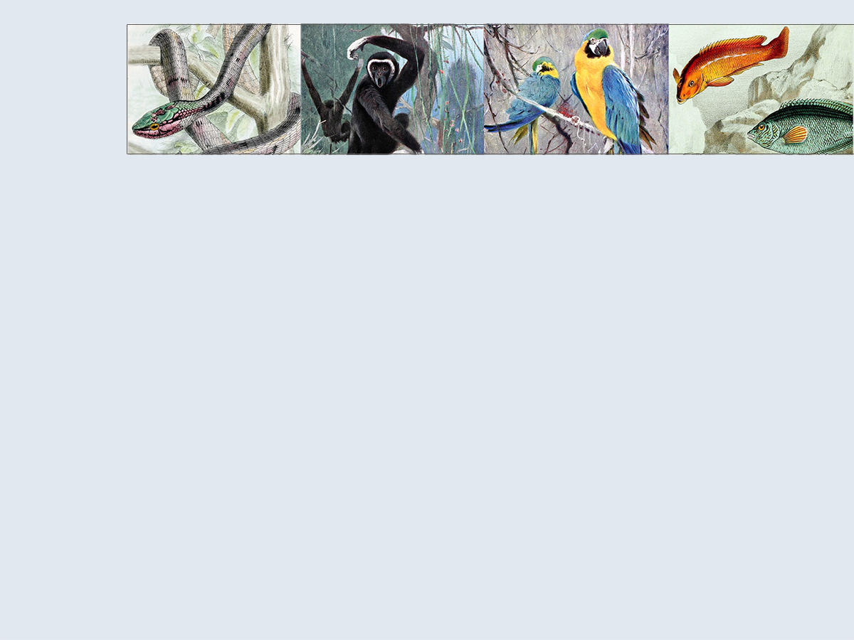
Questions?
Collection Development Policy:
http://biodivlib.wikispaces.com/collection%20development%20policy
Bianca Crowley
crowleyb@si.edu
Skype: bianca.lipscomb
Thank you

Slide 18
Post-digitization Curation Workflow
User describes error in BHL webform
Moderators assign issue to appropriate librarian(s)
Error submitted to issue tracking system
Error in BHL
Follow up via Scanning Workflow
Is it a scanning request?
Yes
Consortium librarians document progress in issue tracking system
No
Follow up with users when possible
Follow up via Administrative Dashboard
Notes:
[30 sec]

Slide 19
Virtual Collections
No space restrictions
In a way, the collection is only as large/small as search results list
Importance of good quality metadata – if it cannot be found, it does not exist
Number of search results
⬅ More generic More specific ➔
Notes:
[1 min]

