Slide 1
BHL–SciELO Network
<<< BHL– SciELO Brazil
<<< BHL– Brazil
Update – 2012, Abel L. Packer
FAPESP São Paulo Research Foundation
SciELO Biodiversity
Digitization of essential works in Biodiverstiy
MMA Ministry of Environment
EOL Brazil
Pilot Project
SciELO – Scientific Electronic Library Online - Program
gBHL – Global Biodiversity Heritage Library
- Network development and operation
- Open Access
- Common Web Portal – integrated search
- Common Governance - Advisory Committee

Slide 2
SciELO Program
SciELO Brasil
journals
247 journals, 1,2 mi downloads per day
journals
SciELO Network
16 countries 950 journals
books
SciELO Books
Just launched – 220 books
Journals, books, etc
BHL- SciELO

Slide 3
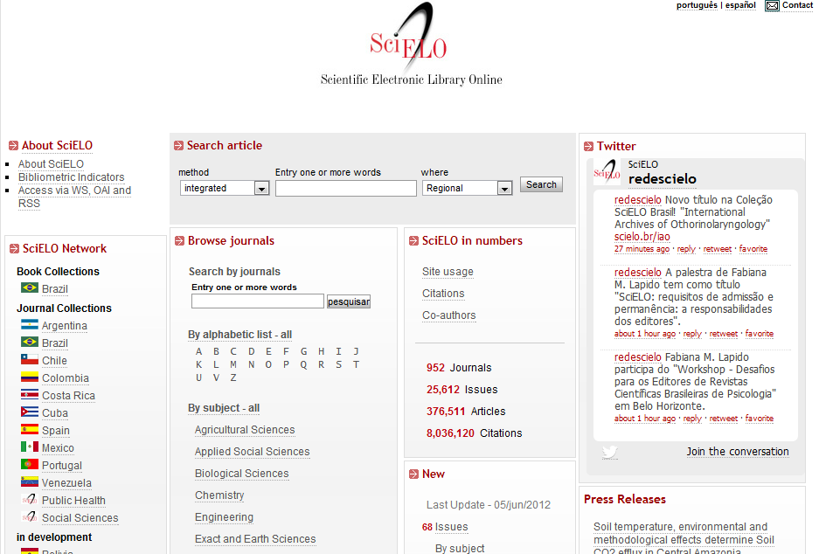

Slide 4
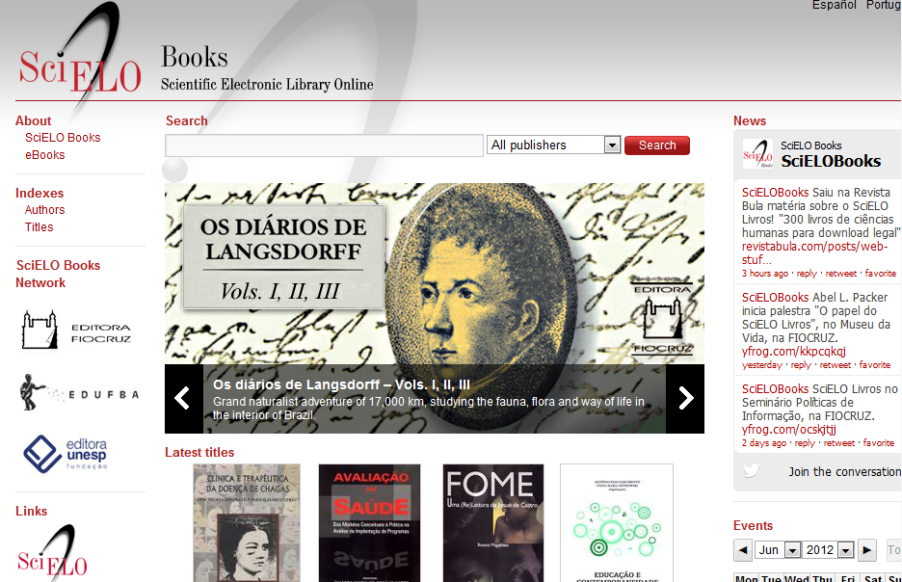

Slide 5
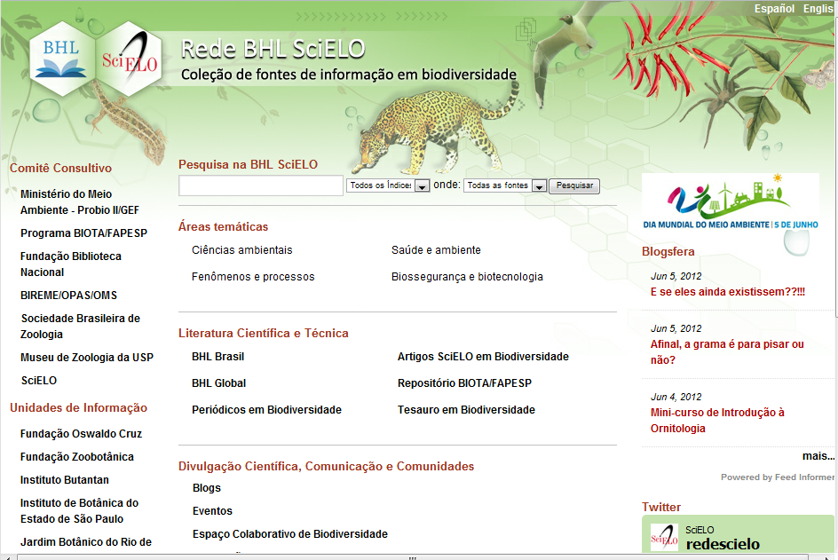
v
v
v

Slide 6
BHL–SciELO Network - biodiversity contents
Journal collection– full text SciELO journals – open access

Slide 7
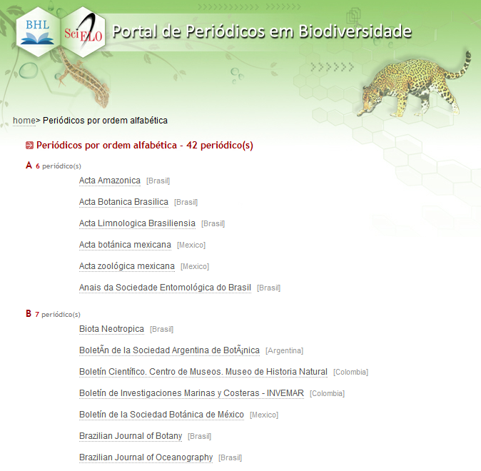
v

Slide 8
BHL–SciELO Network - biodiversity contents
Journal collection– full text SciELO journals – open access
Articles from SciELO Journals
FAPESP Biota Program – repository of scientific production

Slide 9
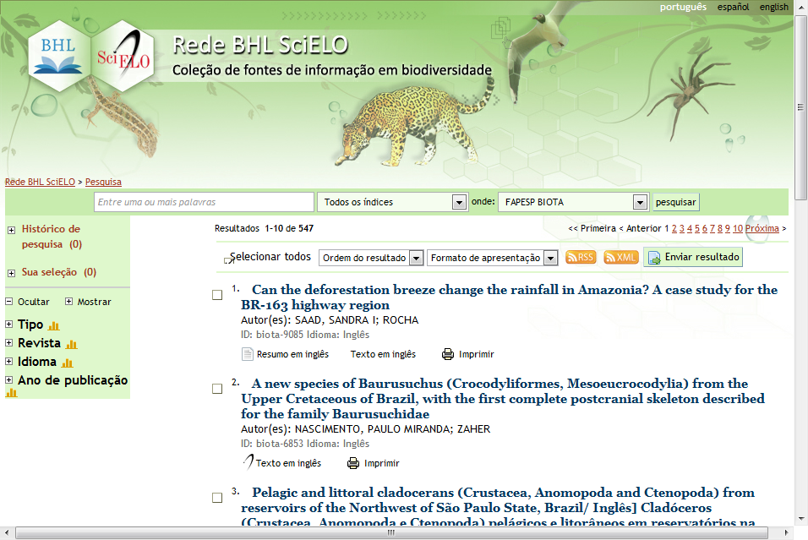
v

Slide 10
BHL–SciELO Network - biodiversity contents
Journal collection– full text SciELO journals – open access
Articles from SciELO Journals
FAPESP Biota Program – repository of scientific production
Legislation
Blogs RSS feeding
News, events

Slide 12
BHL–SciELO Network - biodiversity contents
Journal collection– full text SciELO journals – open access
Articles from SciELO Journals
FAPESP Biota Program – repository of scientific production
Legislation
Blogs RSS feeding
News, events
Thesaurus on biodiversity

Slide 14
BHL–SciELO Network - biodiversity contents
Journal collection– full text SciELO journals – open access
Articles from SciELO Journals
FAPESP Biota Program – repository of scientific production
Legislation
Blogs RSS feeding
News, events
BHL – imported contents related to Brazil
BHL – Brazil digitized collection from Brazilian library
gBHL access to all indexed contents
EOL Brazil

Slide 15
BHL–SciELO Network - institutions, libraries members
Biblioteca Nacional Fundação Oswaldo Cruz
Fundação Zoobotânica
Instituto Butantan
Instituto de Botânica do Estado de São Paulo
Instituto ... Impa
Jardim Botânico do Rio de Janeiro
Museu Nacional
Museu Paraense Emilio Goeldi
Universidade Federal do Paraná
Universidade de São Paulo – Museu de Zoologia, ...

Slide 16
BHL–SciELO Network - governance – main stakeholders
FAPESP – SciELO Program FAPESP - Biota Program Ministry of Environment – Secretary of Forests and Biodiversity
Museu de Zoologia – Universidade de São Paulo
BIREME / PAHO / WHO Biblioteca Nacional
Sociedade Brasileira de Zoologia
Jardim Botânico do Rio de Janeiro National Science Council – National Biodiversity System

Slide 17
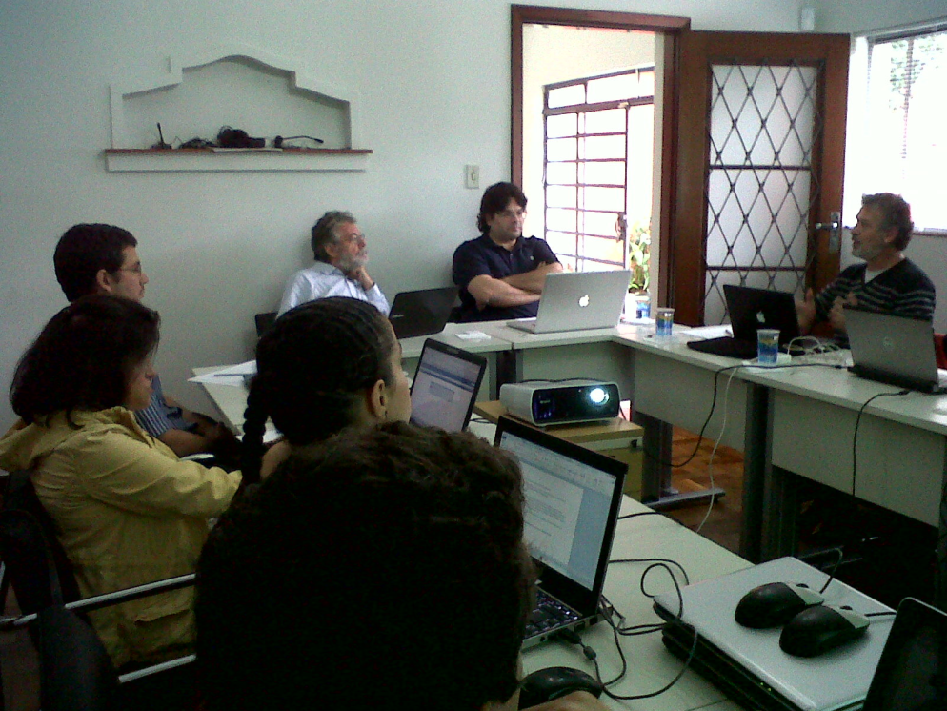
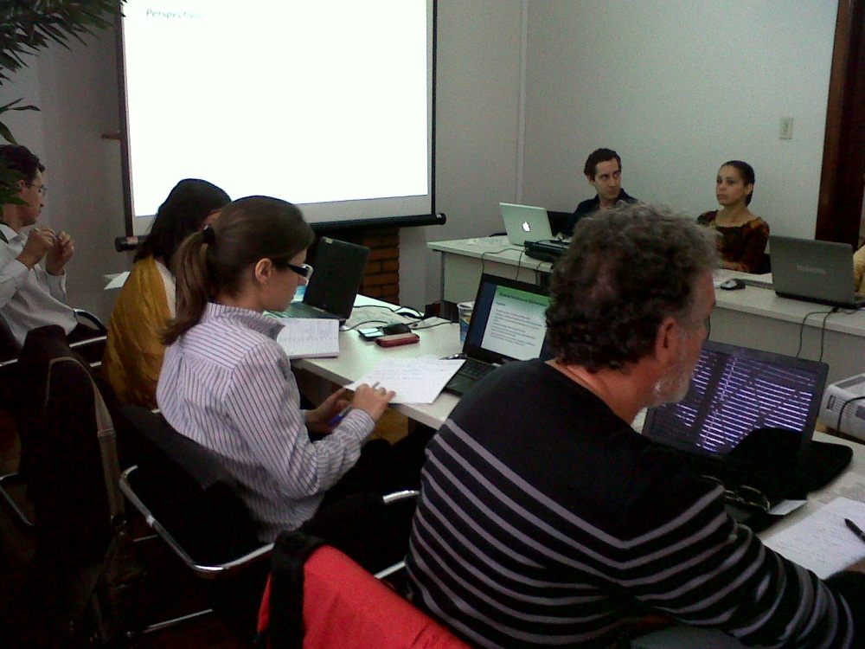
BHL-SciELO Adivisory Committee May 31 2012

Slide 18
Highlights, Challenges and Conclusions
BHL – SciELO - reference – convergence - common - space
Capacity building – BHL- gBGL methodology, solutions, technology
Variety of information sources – integration
Network operation and expansion
Digitization – libraries cooperation – it infrastructure
Journals – impact – professionalization - internationalization
Political support – sustainability – public and institutional policies

Slide 19
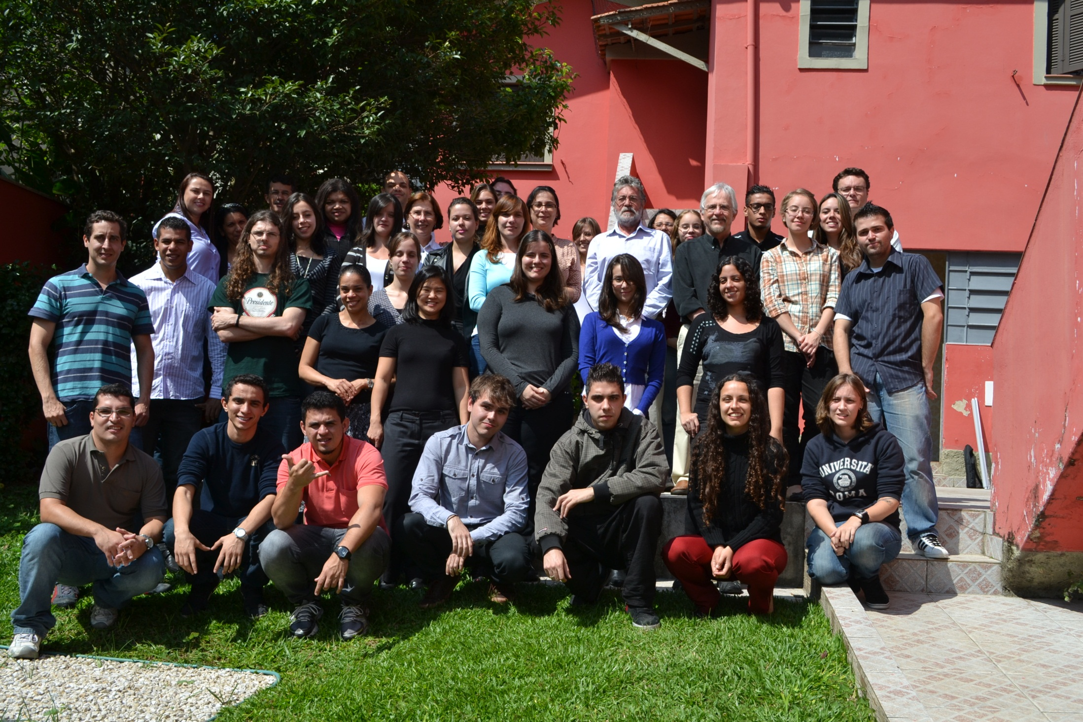
SciELO team. Thank you!

