Slide 1
The Field Museum Library & The Biodiversity Heritage Library Project

Slide 2
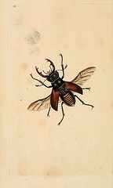
The Field Museum Library
Worked with the University of Illinois Urbana-Champaign in 2006 to scan Field Museum publications and select publications related to Hymenoptera.

Slide 3
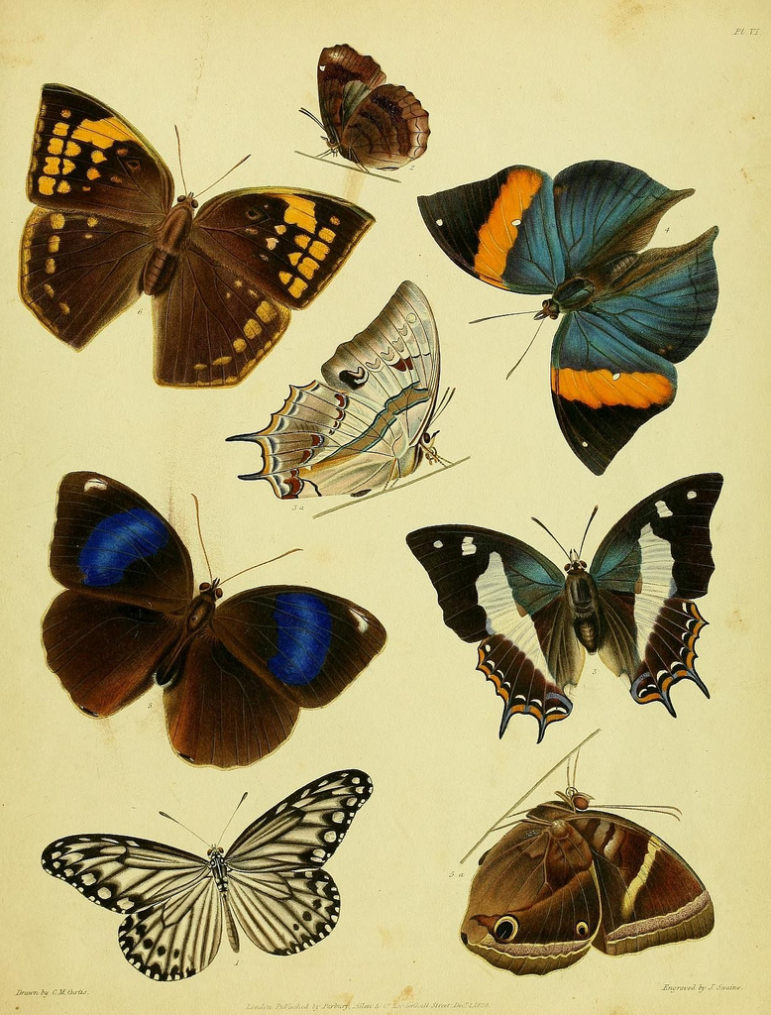
2009-present....
Send materials for scanning to Smithsonian-fill Gemini requests, fill-in's, etc....

Slide 4
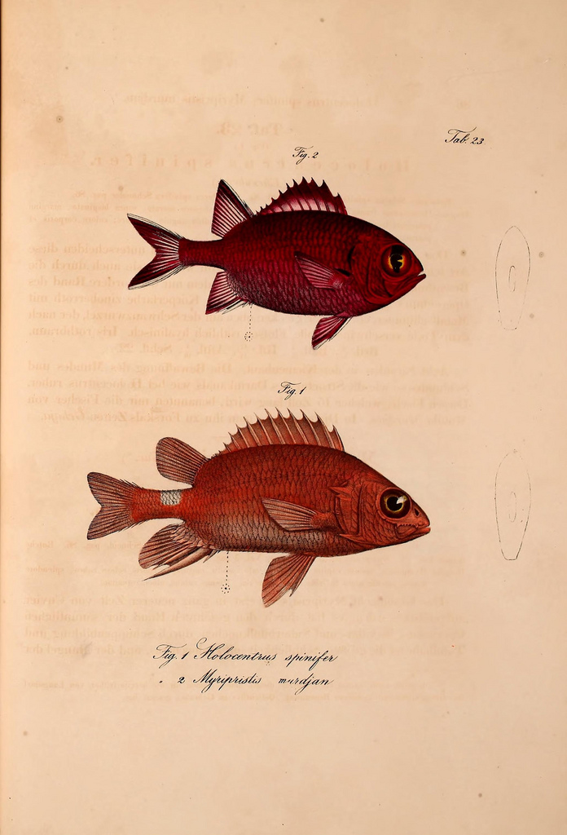
2011 Field Museum's Africa Council
Funding received from Africa Council allowed us to scan 62 items related to African Biodiversity.
Scanning completed at Internet Archive center, Ft. Wayne, IN

Slide 5
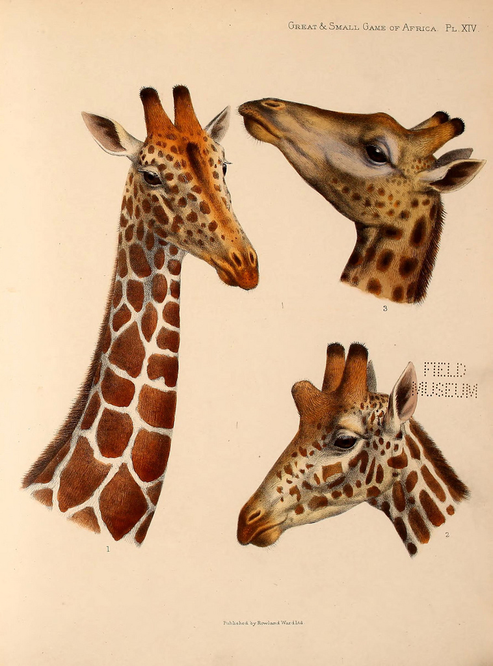
2012 & Beyond…
Will submit another Africa Council proposal for additional scanning
Will continue to send materials for scanning at SIL
Initiating a volunteer/intern "program" to complete more pagination.

