Slide 1
The Biodiversity Heritage Library: Liberating the World’s Biodiversity Literature
Thomas Garnett
Pan Arab Biodiversity Conference
14 December 2009

Slide 2
BHL History
Library and Laboratory Conference in Feb. 2005 demonstrated the growing need for digital biodiversity literature.
Several libraries began meeting and planning for a grand digitizing plan.
Encyclopedia of Life (EOL) was funded to integrate species level information and used BHL as the literature and scanning component
Though BHL has is composed of libraries it has been a domain-specific program, not just a digital library project. It arose from and is responsive to the biodiversity community composed of the disciplines of taxonomy, systematics, evolutionary biology, ecology, conservation, and wildlife management. These are the primary audience

Slide 3
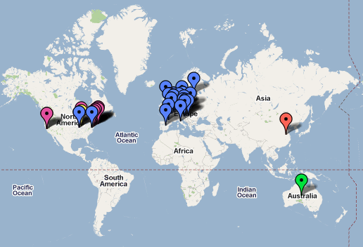
BHL Members

Slide 4
BHL Members: US/UK
Academy of Natural Science (Philadelphia, PA)
American Museum of Natural History (New York, NY)
California Academy of Science (San Francisco, CA)
The Field Museum (Chicago, IL)
Harvard University Botany Libraries (Cambridge, MA)
Harvard University, Ernst Mayr Library of the Museum of Comparative Zoology (Cambridge, MA)
Marine Biological Laboratory / Woods Hole Oceanographic Institution (Woods Hole, MA)
Missouri Botanical Garden (St. Louis, MO)
Natural History Museum (London, UK)
The New York Botanical Garden (New York, NY)
Royal Botanic Gardens, Kew (Richmond, UK)
Smithsonian Institution Libraries (Washington, DC)

Slide 5
BHL Members: BHL-Europe
Museum für Naturkunde - Leibniz-Institut für Evolutions- und Biodiversitätsforschung an der Humboldt-Universität zu Berlin
Natural History Museum, UK
Narodni muzeum NMP CZ
Angewandte Informationstechnik Forschungsgesellschaft mbH
Freie Universität Berlin FUBBGBM
Georg-August-Universität Göttingen Stiftung Öffentlichen Rechts
Naturhistorisches Museum Wien
Hungarian Natural History Museum
Museum and Institute of Zoology, Polish Academy of Sciences
University of Copenhagen
Stichting Nationaal Natuurhistorisch Museum, Naturalis
National Botanic Garden of Belgium
Royal Museum for Central Africa,
Royal Belgian Institute of Natural Sciences
Bibliothèque nationale de France
Museum national d’histoire naturelle
Consejo Superior de Investigaciones Cientificas
Università degli Studi di Firenze
Royal Botanic Garden, Edinburgh
Species 2000
John Wiley & Sons limited
Helsingin yliopisto UH-Viikki

Slide 6
Internet Archive Scanning Partnership
Internet Archive scanning centers in London, New York, Boston, Washington, etc. High-quality, non-destructive scans.
Image files and text derived from OCR.

Slide 7
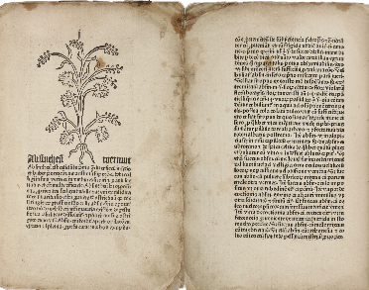
Stats: Now Online
70,630 volumes
26.4 million pages
Oldest book: Schöffer’s Herbarius, 1484.

Slide 8
Stats: Usage
Jan – Sep 2009
266,000 visitors
436,000 visits
2.1million pageviews
Daily average
970 visitors
1,600 visits / day
7,700 pageviews / day
Jan – Sep 2009
Launch to 30 Sep 2009

Slide 9
What Kinds of Texts?
Each class presents a unique set of issues to resolve:
Public Domain – pre-1923
Post-1923 monographs
some with copyright renewals
some without copyright renewals
Non-profit learned society journals with permissions
Commercial journals;
Grey literature
Archival material; field and expedition notebooks

Slide 10
Global, coordinated development
New functionality from BHL-Europe
Improved deduplication tools
Semantic interface
OAIS-compliant preservation infrastructure
Building a community of developers
Funded & volunteer
RubyBHL: http://github.com/mjy/rubyBHL
PyBHL: http://linux.softpedia.com/get/Programming/Libraries/pybhl-51612.shtml
New partners, new content

Slide 11
Open Software & Development
BHL Bits:
Portal code, utilities, services
http://code.google.com/p/bhl-bits/
Taxonomic Literature Group
Google Group for discussion of “taxonomic literature & the services required to make literature interoperable within biodiversity research and biodiversity informatics.”
http://groups.google.com/group/taxonlit

Slide 12
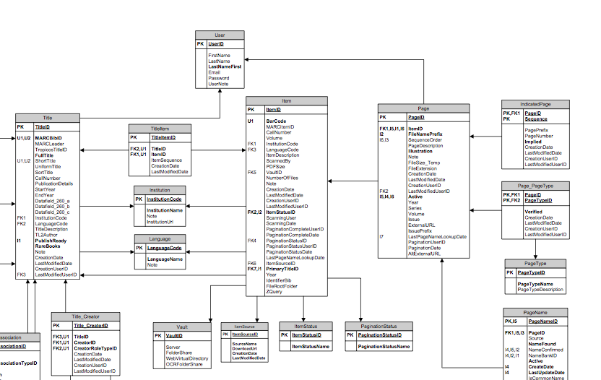
Open Data
Downloads
Simple tab-delimited exports of core data
http://www.biodiversitylibrary.org/data/BHLExportSchema.pdf
Data model
DB schema as ERD
http://bhl-bits.googlecode.com/files/20090930_BHLDataModel.pdf

Slide 13
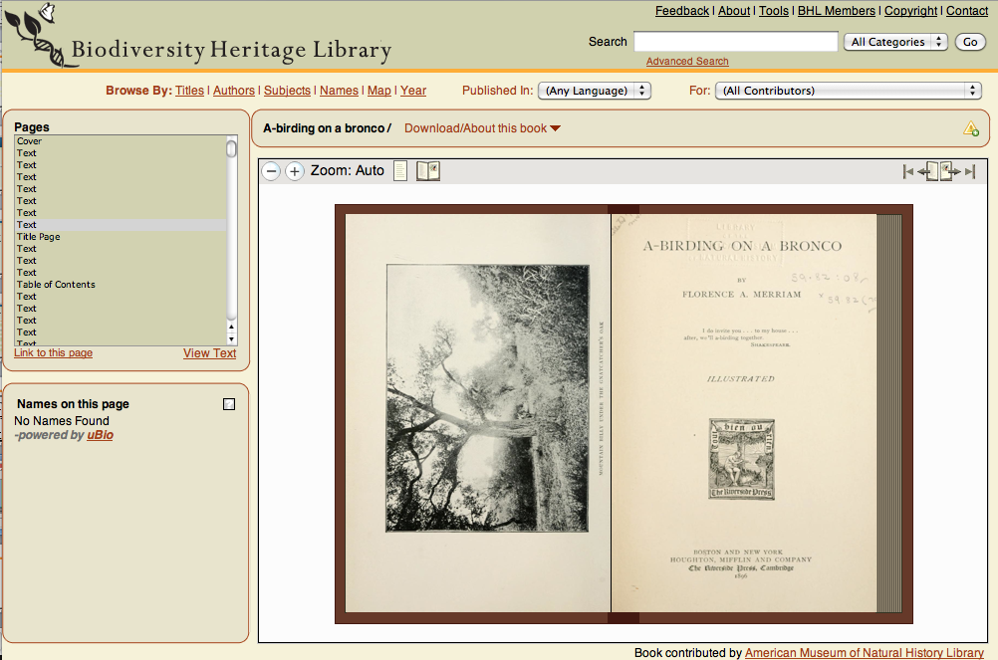
Open Source Pageturning UI
http://github.com/openlibrary/bookreader

Slide 14
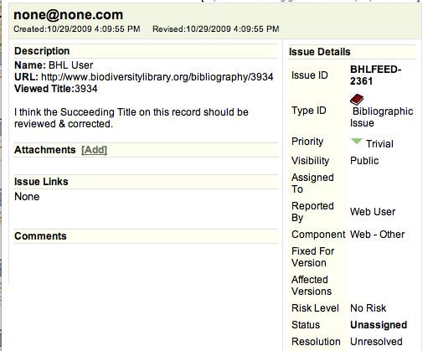
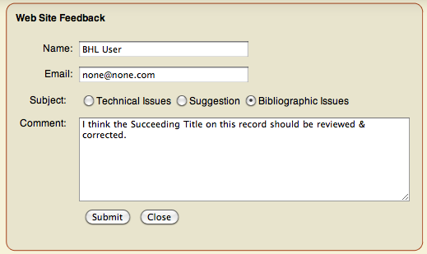
Metadata: Feedback loop
Assigned to library staff
for review & resolution

Slide 15
Services
Names Service
Return all occurrences of a name throughout BHL digitized corpus
Documentation: http://bit.ly/2e6sg9
Access to 51million name strings using TaxonFinder
1.4million unique names
Working out a strategy for obscure species
Algorithm improvements to detect nomenclatural & taxonomic acts
OpenURL
Facilitate links to citations: protologues, articles, references
Documentation: http://www.biodiversitylibrary.org/openurlhelp.aspx
Useful to Nomenclators, Reference Systems
IPNI
Tropicos

Slide 16
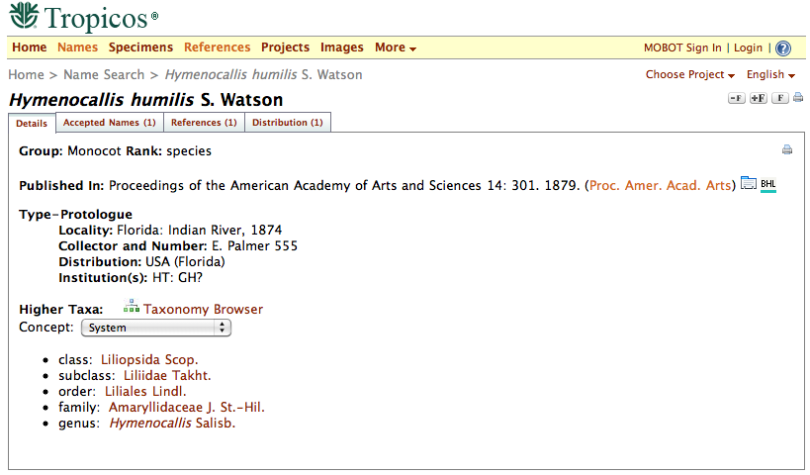
Services: OpenURL Request
http://www.biodiversitylibrary.org/openurl?
pid=title:3934&volume=3&issue=&spage=262&date=1856
http://www.tropicos.org/Name/1200408

Slide 17
Services: OpenURL Disambiguation
Looking for:
BHL returns:

Slide 18
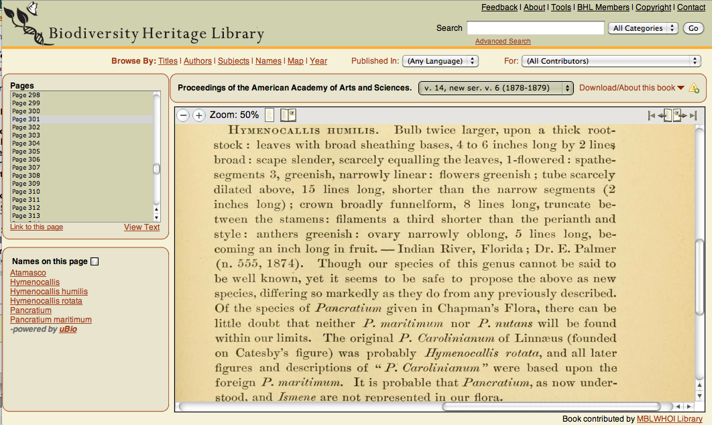
Services: OpenURL Results

Slide 19
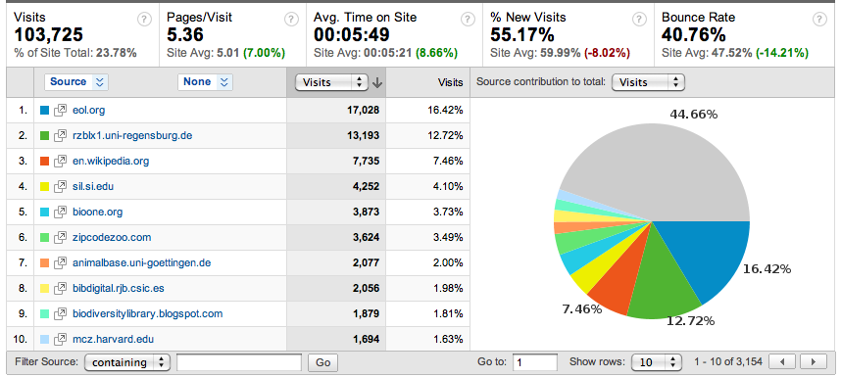
Encyclopedia of Life
522,000 species pages linked to BHL
#1 referring site

Slide 20
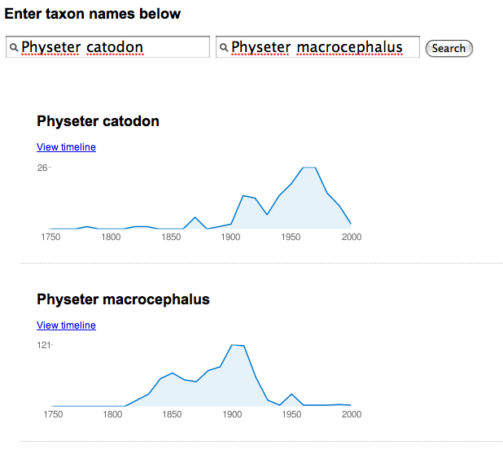
Other Consumers
EarthCape Labs
Sort/Search capabilities with harvested names
YouTube demo: http://www.youtube.com/watch?v=qw7qw87JTOs
BioGUID
BHL Name Timeline
http://bioguid.info/bhl/
BHL Name Comparison
http://bioguid.info/bhl/compare.php

Slide 21
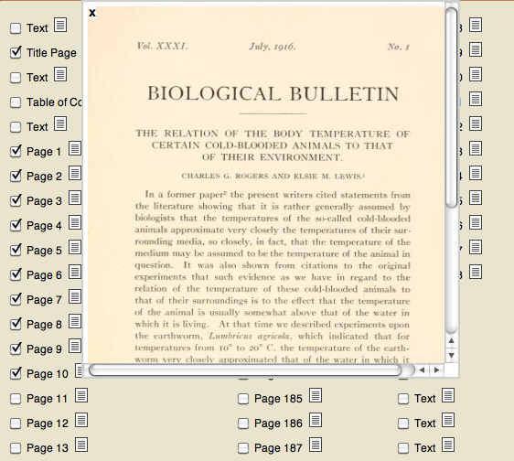
Crowdsourced Articles
http://www.biodiversitylibrary.org/pdfgen/15845
Demo: http://youtube.com/watch?v=oidf3b26jVs

Slide 22
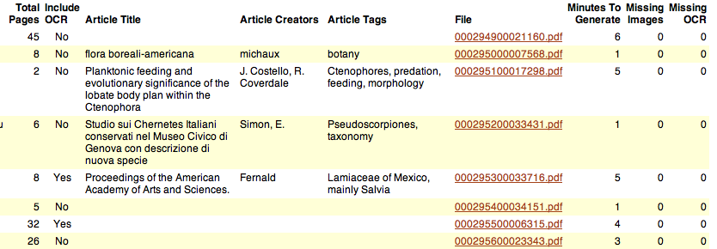
Crowdsourced Articles
12,000 PDFs generated through September 2009
4,900 submitted with article metadata
Analysis: http://bit.ly/4Jqu9

Slide 23
Great, but how…
display / manage?
meet community demands for bibliography / citation management?
build from more open source tools?

Slide 24
Development goals re: citations
Create a repository for community-vetted taxonomic bibliographies.
Ability to ingest, display, download, and index articles so that the BHL can operate as an article repository.
Build from existing community of work around Drupal / Biblio.
In use by collaborators

Slide 25
Crowdsourced Articles
PDFs from BHL pushed into Drupal/Biblio:

Slide 26
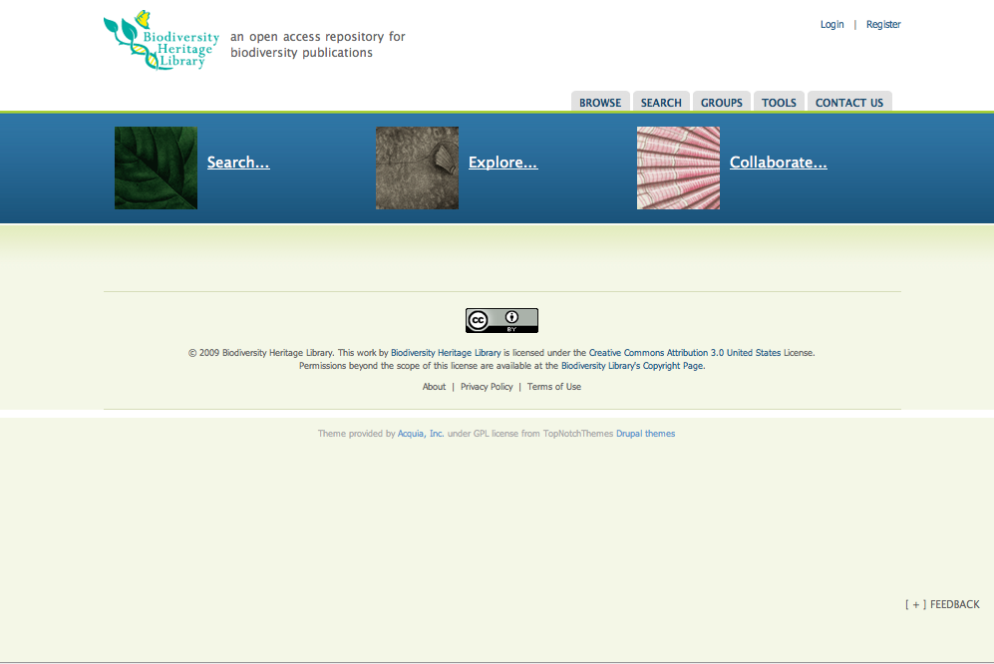
http://citebank.biodiversitylibrary.org/

Slide 27
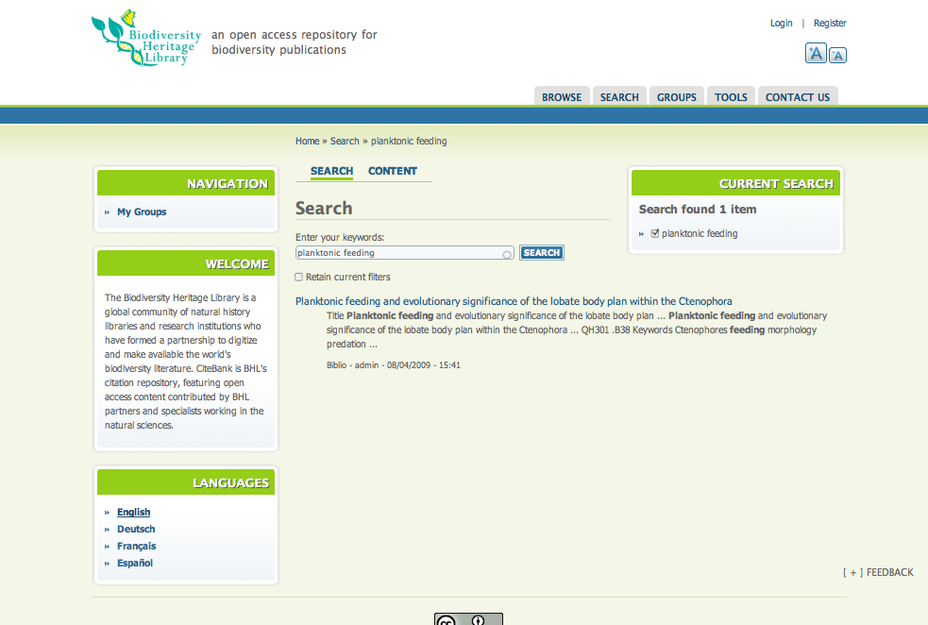
http://citebank.biodiversitylibrary.org/search

Slide 28
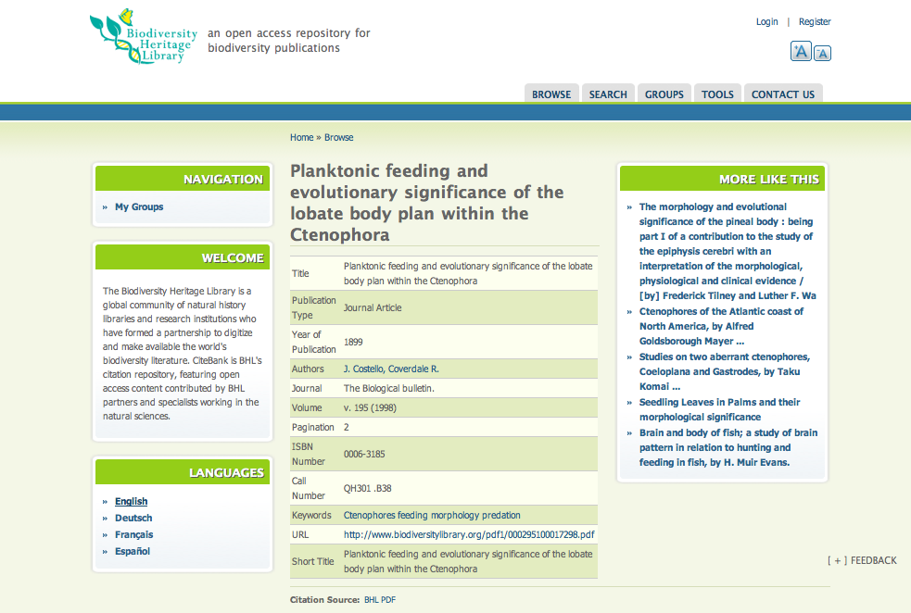
http://citebank.biodiversitylibrary.org/node/47423

Slide 29
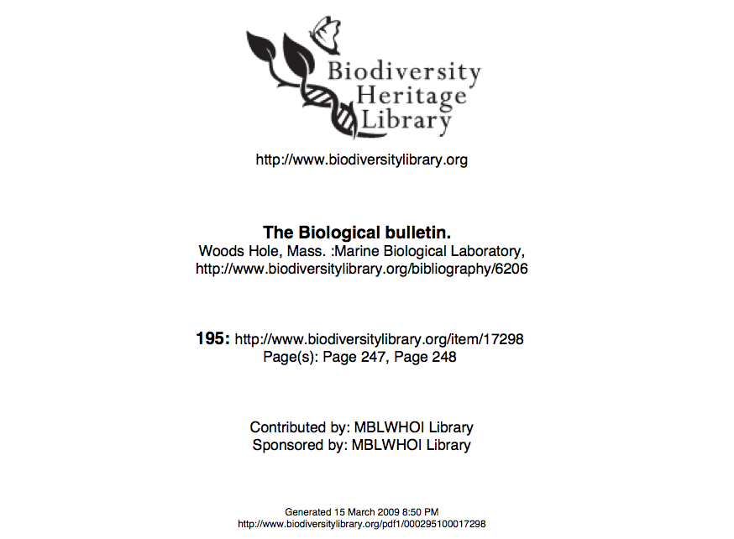
PDF
http://www.biodiversitylibrary.org/pdf1/000295100017298.pdf

Slide 30
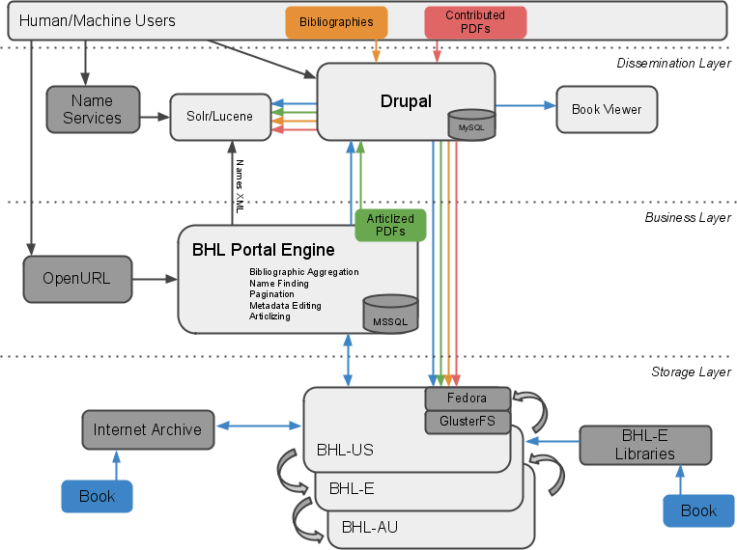
BHL Data Flow – Sep 2009

Slide 31
Storage
DuraCloud Pilot
Test of cloud storage & computing with DuraSpace Foundation & New York Public Library
Early alpha stage
More info: http://www.duraspace.org/duracloud.php
Inhouse solution demo’d by MOBOT & MBL
Redundant high performance storage on commodity hardware
http://www.tdwg.org/conference2009/program/working-sessions/

Slide 32
Next steps
Bring hardware online at MBL
Have one point of redundancy
By Q1 2010
Bring BHL-Europe & other nodes online
In conjunction with DuraCloud & other solutions
Release CiteBank for beta & sandbox testing
Production release by Q2 2010
Integration of BHL-Europe tools & content

Slide 33
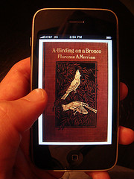
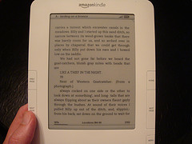
Fun: BHL In Your Pocket!
Content now available in EPUB format
Used by Stanza, transferable to Kindle
Blog post by John Mignault (NYBG):
http://john.mignault.net/blog/2009/10/28/first-bhl-e-book-experiments/

Slide 34
BHL Digital Preservation
Committed to long-term storage, curation, and preservation of digital text assets for the world-wide biodiversity community
BHL is a steward for this literature.
To keep this content available and open for the future requires careful organizational planning.
Preservation is both a technical and political/social process.

Slide 35
Collaboration is the Key
Based on trust and mutual support.
Local Control not a central command.
The heritage of biodiversity literature is the exclusive property of no one country.

Slide 36
We invite your participation at any level
• Users
• Development of Arab Language interface.
• Sharing BHL content on BA servers.
• Translation of texts into Arabic.
• Digitizing Arab language biodiversity literature in Egypt.
• Developing a full Arab Biodiversity Heritage Library to interoperate with the American, European, and Chinese BHL.

Slide 37
Thanks!
Biodiversity Heritage Library http://biodiversitylibrary.org
BHL Blog http://biodiversitylibrary.blogspot.com
Follow @BioDivLibrary on Twitter http://twitter.com/BioDivLibrary/
Become a fan on Facebook http://www.facebook.com/pages/Biodiversity-Heritage-Library/63547246565

