Slide 1
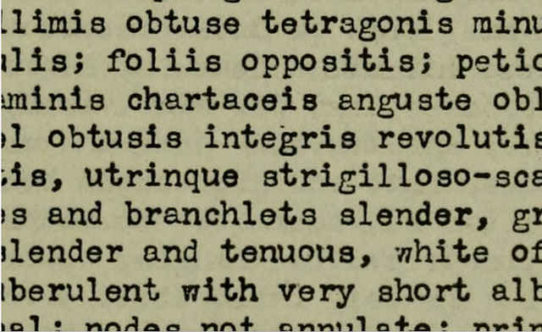
Biodiversity Heritage Library Development 2008-2012
EOL Review. 31 Jan 2010.

Slide 2
Usage

Slide 3
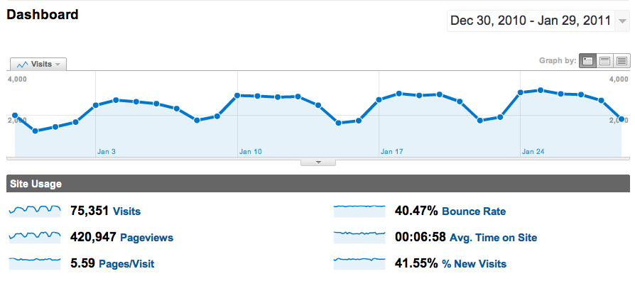
BHL Usage: By Month

Slide 4
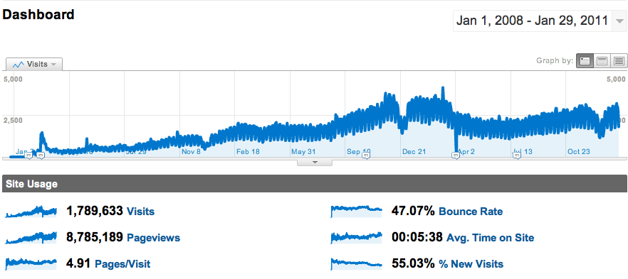
BHL Usage: Since Launch (2008)

Slide 5
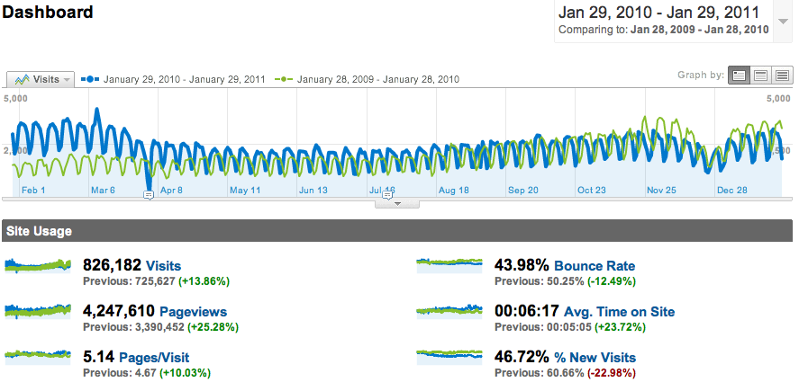
BHL Usage: Comparing 2009 & 2010

Slide 6
2010 User Survey: Frequency of Use

Slide 7
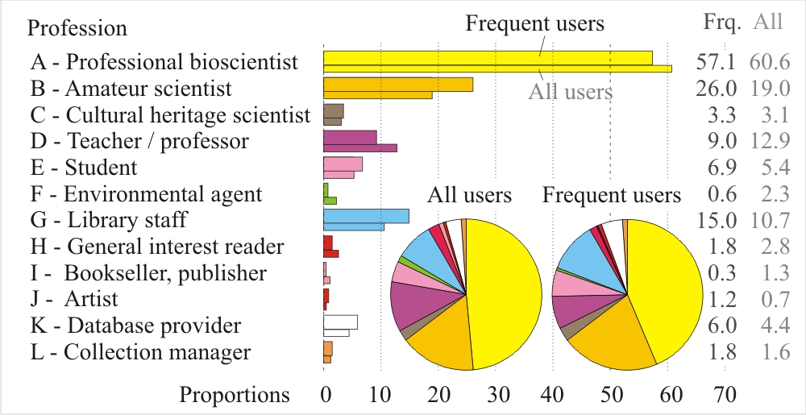
User Survey: Users

Slide 8
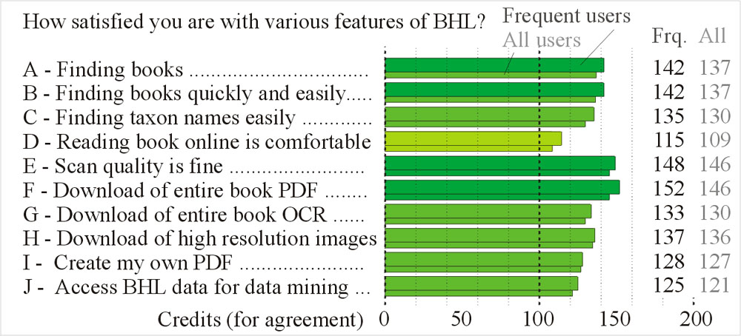
User Survey: Satisfaction

Slide 9
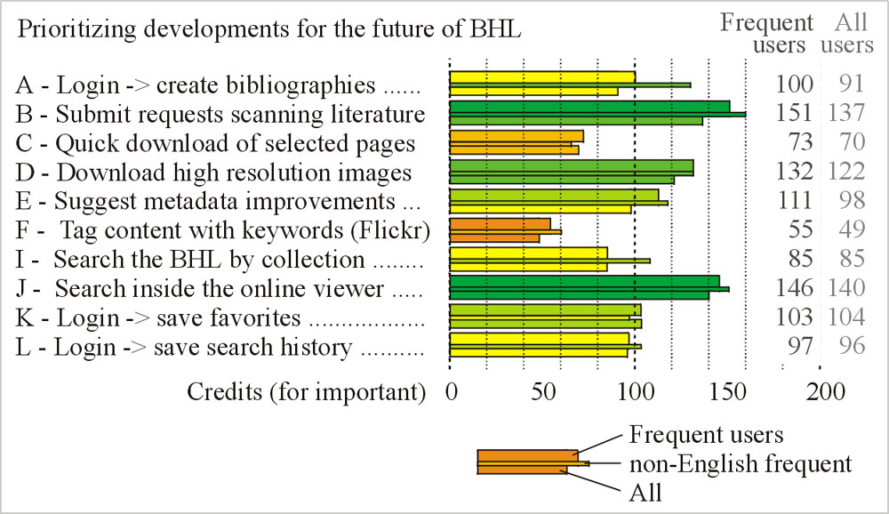
User Survey: Development Priorities

Slide 10
Development Milestones

Slide 11
Integrated digital library for science
Tools for the selection, scanning, display, and analysis of biodiversity texts
Integration of others’ tools that enhance BHL deliverables
TaxonFinder
Google API
Tens of thousands of historic publications now online
Have liberated & aggregated content of critical use to scientists all over the world

Slide 12
Open data
Transparent publication of processes & results
Minimal restrictions on scholarly use of materials
Data sharing
Custom Exports
Custom APIs & Standard Prototocols
OpenURL & OAI-PMH
RSS

Slide 13
Integration with major projects
Scholarly
Popular
Library
OCLC
Science
EOL
JSTOR Plant Science
Tropicos
IPNI
Popular
Wikipedia
Bibliodyssey
ZipcodeZoo.com

Slide 14
Global Node-based Infrastructure
Content stored & served from Internet Archive
Free service, valuable partnership
Copying content to custom cluster at MBL
Phil Cryer & Anthony Goddard working on storage & compute platform
Mirroring data from MBL to Europe, China, Africa, Australia, South America
Assisting each node in meeting their local requirements

Slide 15
BHL -> CiteBank
Article repository for the content in BHL
Platform for storage & sharing for publishers in need
Opportunity for user engagement
Scholarly crowdsourcing
Semi-automated markup & enhancement

Slide 16
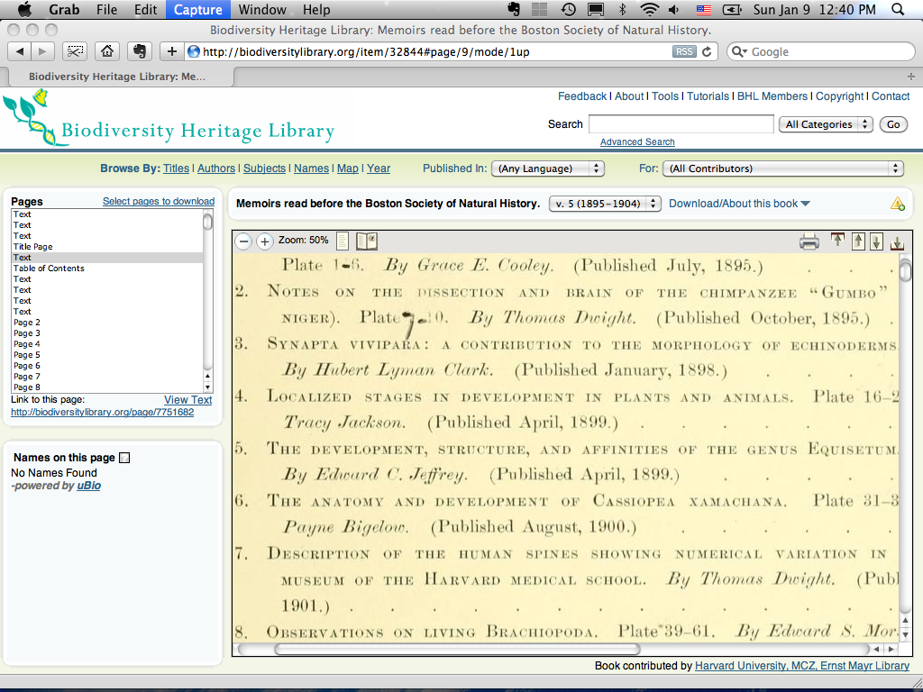

Slide 17
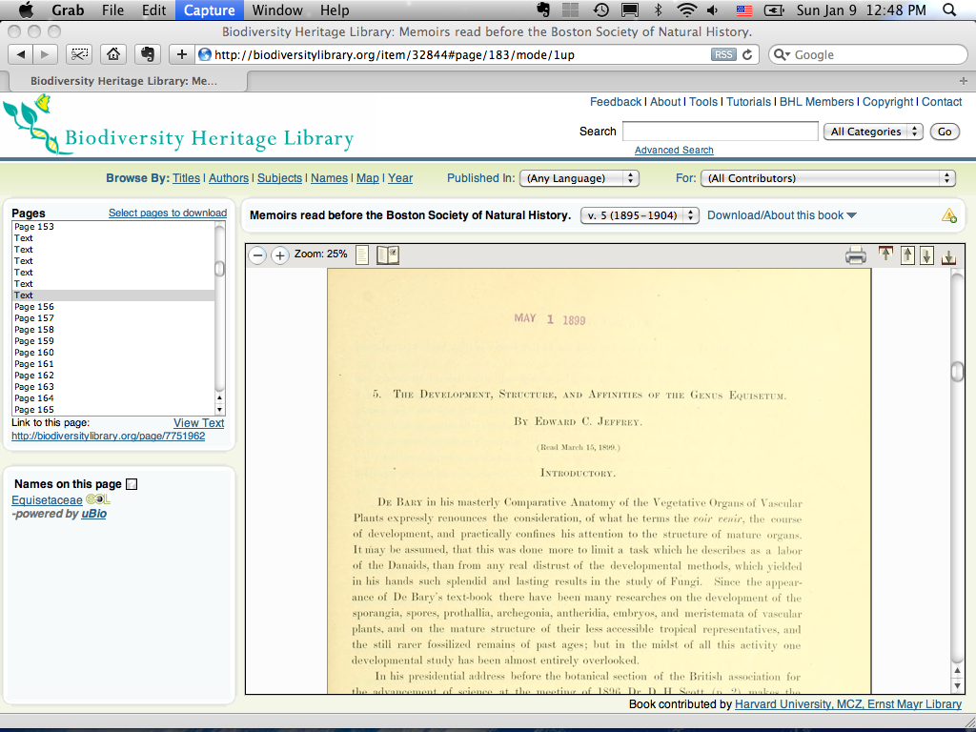

Slide 18
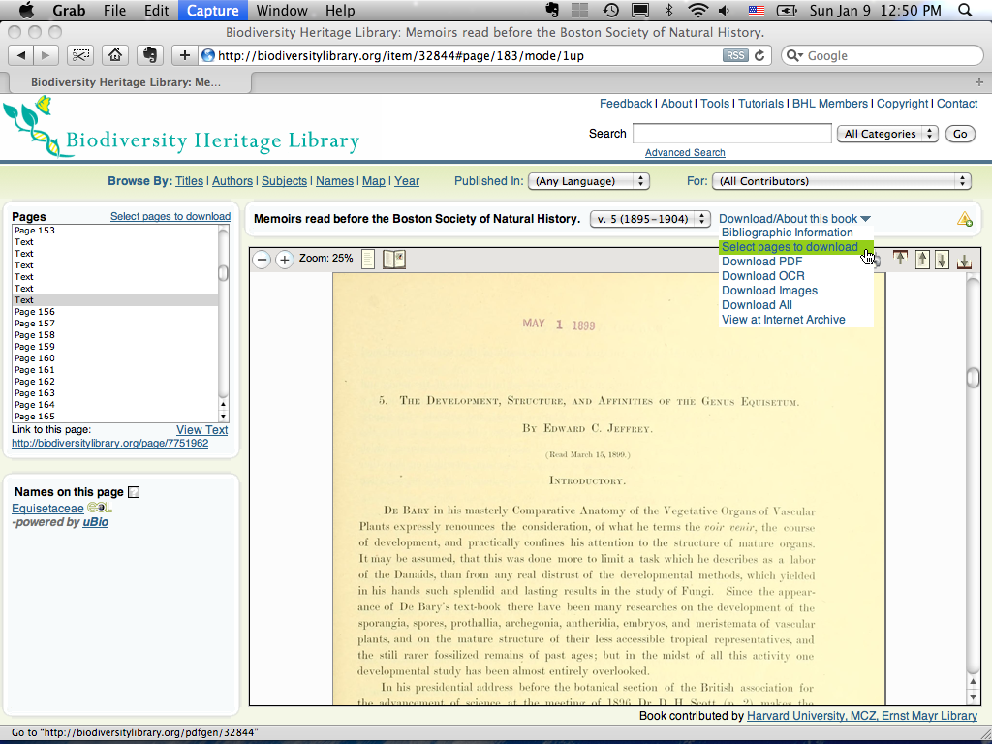

Slide 19
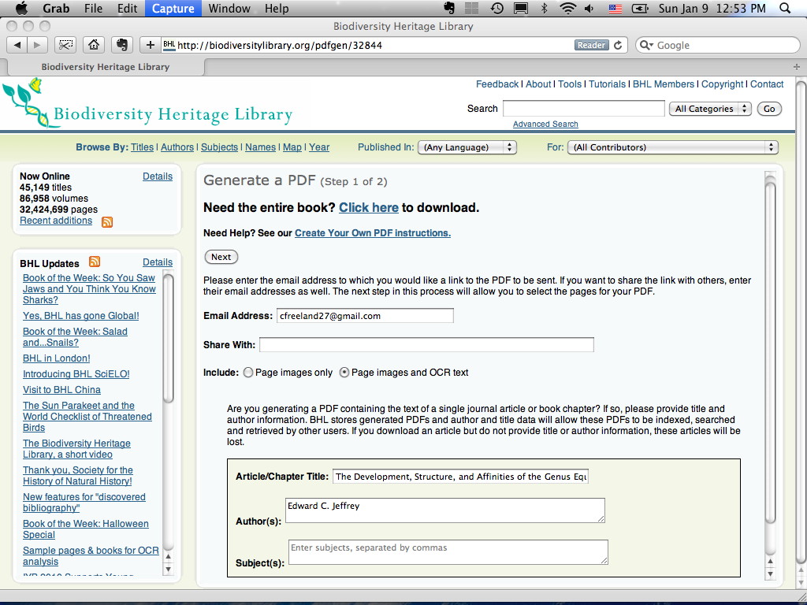

Slide 20
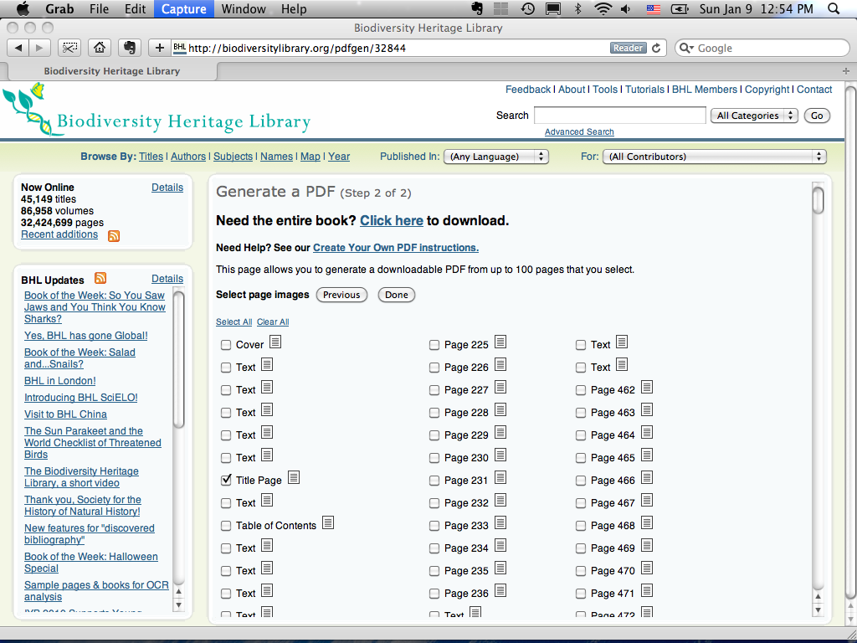

Slide 21
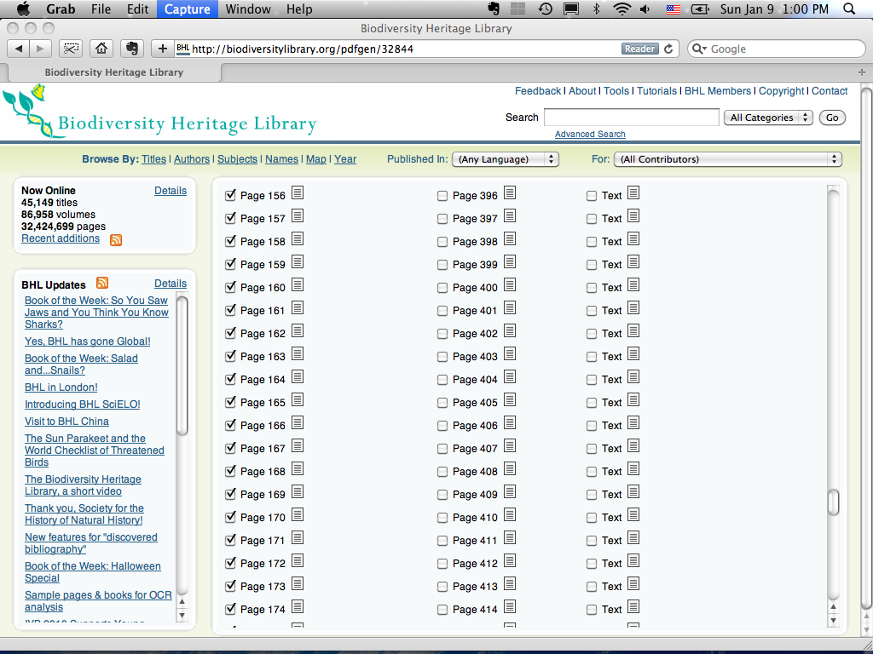

Slide 22
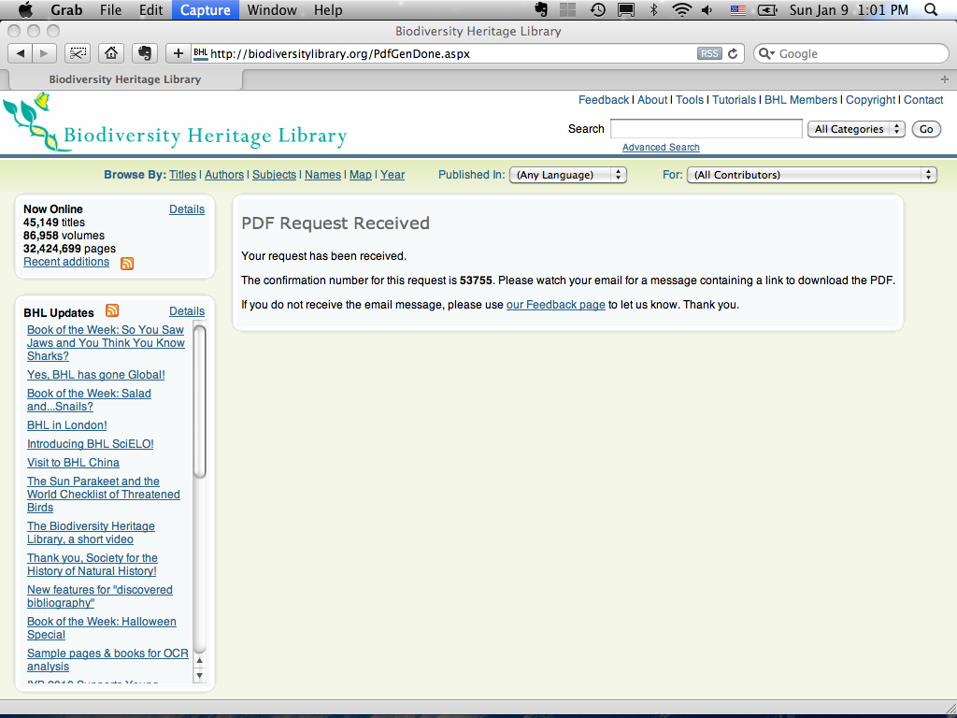

Slide 23
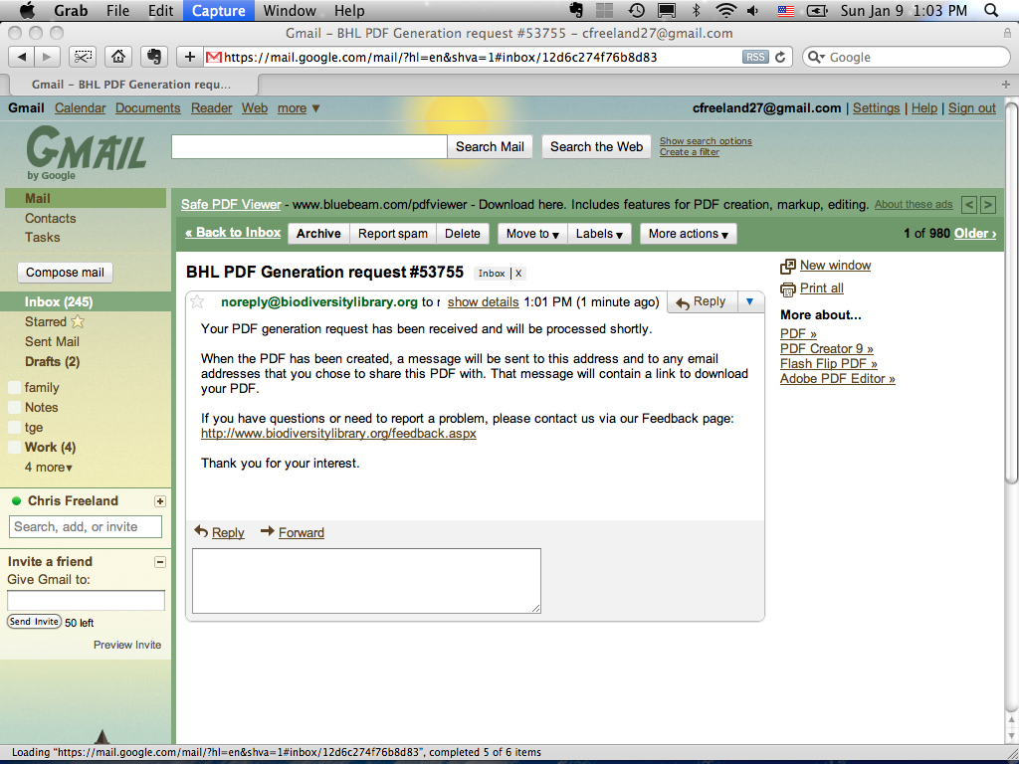

Slide 24
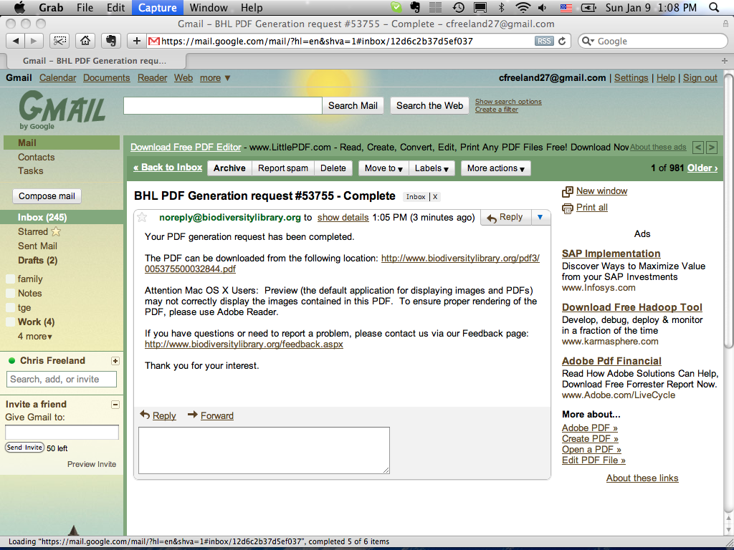

Slide 25
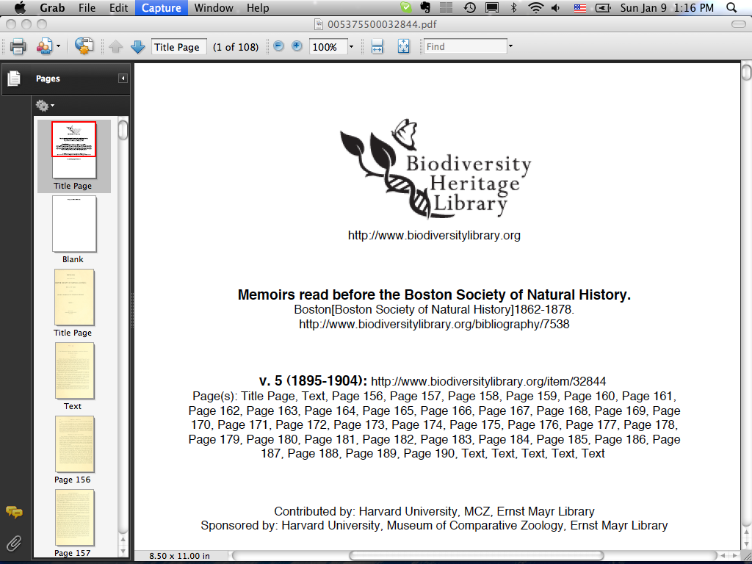

Slide 26
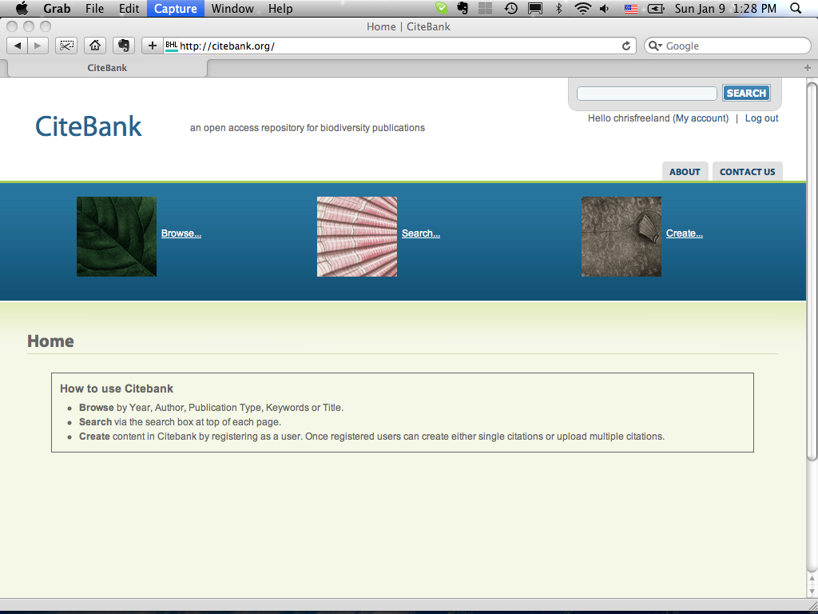

Slide 27
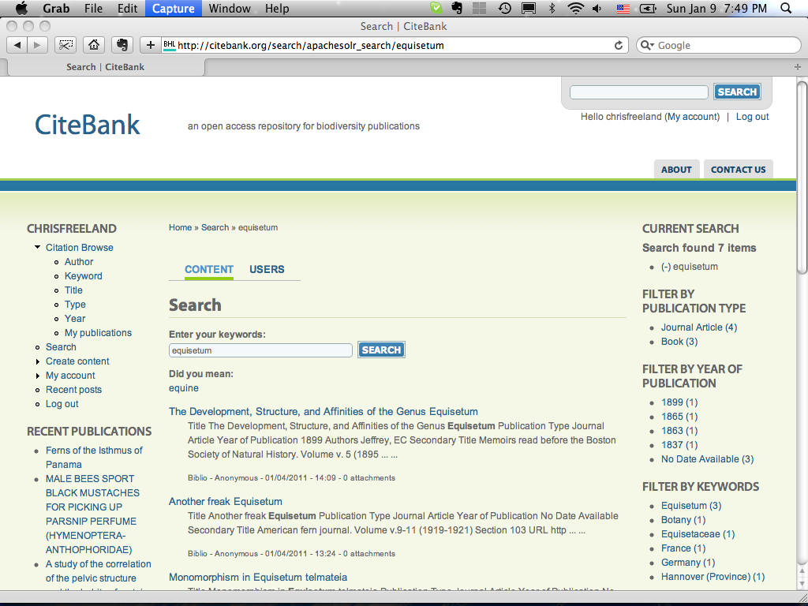

Slide 28
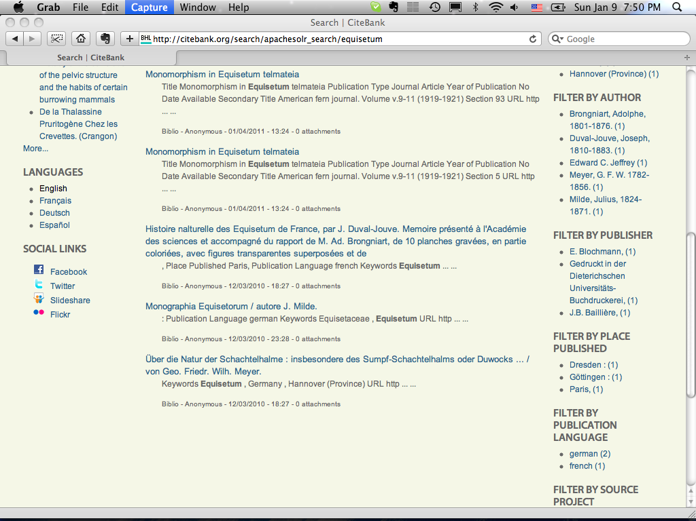

Slide 29
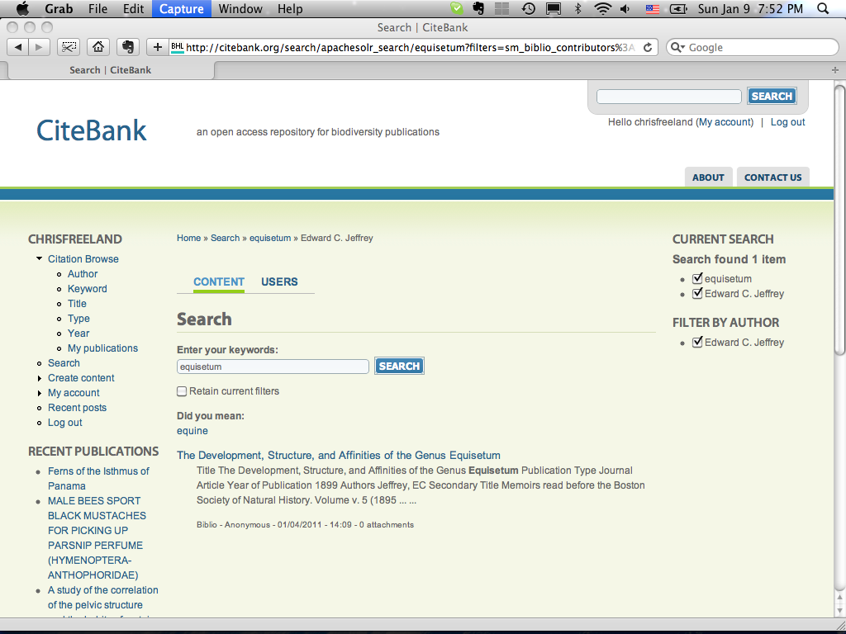

Slide 30
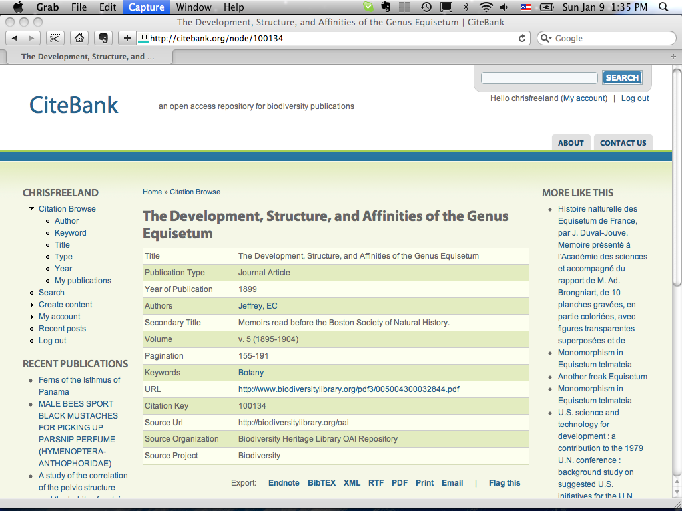

Slide 31
BHL + Citebank
Content & tools for scholarly crowdsourcing
Users can get content they need, do minor work, share results with community
More content for integration with other platforms
JSTOR Plant Science, EOL, Atlas of Living Australia
Mendeley, Zotero, RefWorks

Slide 32
Development through 2012

Slide 33
Core Tasks: 2011-2012
DOIs
API extensions
Global Redundancy
Content
Application
CiteBank expansion
OCR (?)
More Content
Darwin’s Library
Have to be realistic about timeline

Slide 34
Research projects
OCR & text correction
Automated location of article boundaries
Semiautomated markup of texts
Named-entity extraction
Place names, person names
Morphological characteristics
University of Arizona, Harvard, Umass
Nomenclatural acts improvement
Reconciliation groups
Titles, Authors, Citations

Slide 35
Lessons learned
Users are satisfied
Users want more content
Users are forgiving if content is specialized
More work needed on UI
But books are complex
OCR is a major problem without a simple solution
BHL is non-controversial
Scan old books, put them online, make users happy

Slide 36
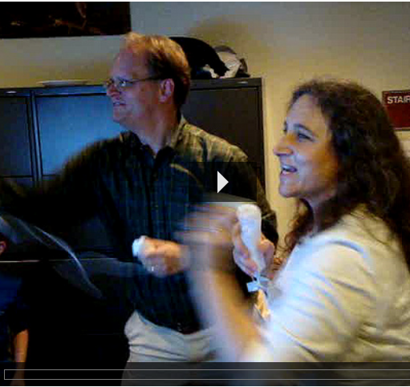
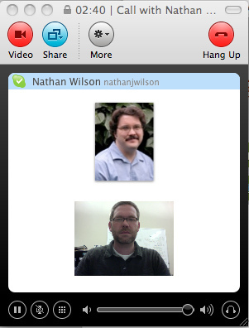
BHL & EOL

Slide 37
Current Integration

Slide 38
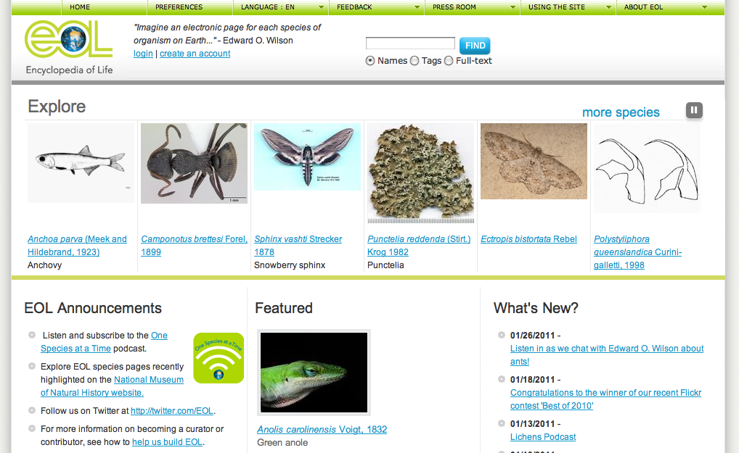

Slide 39
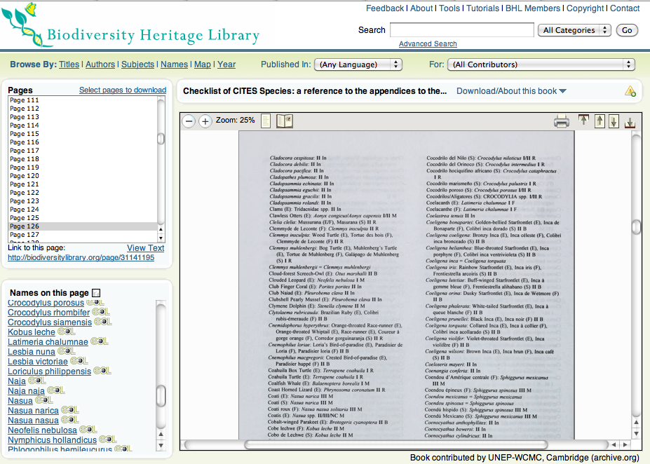

Slide 40
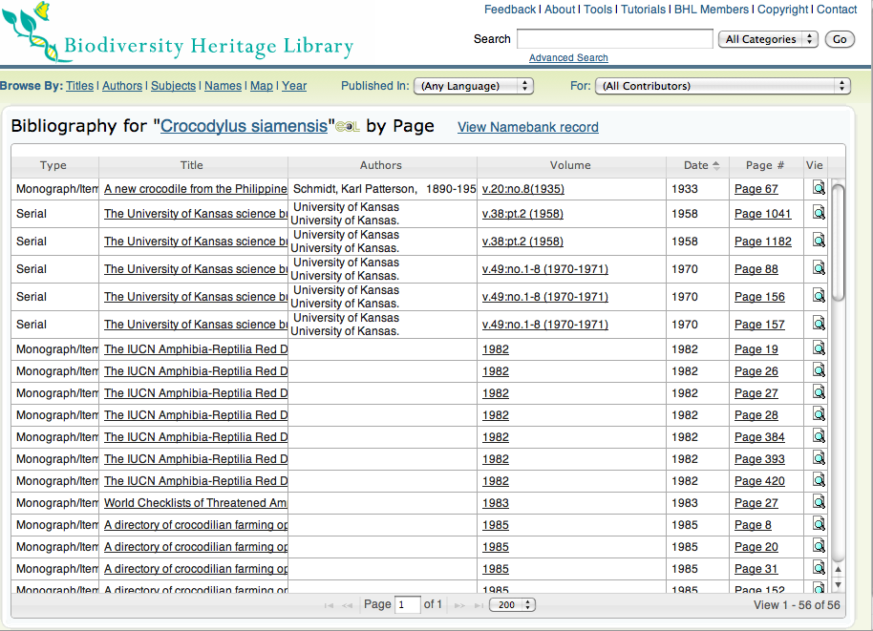

Slide 41
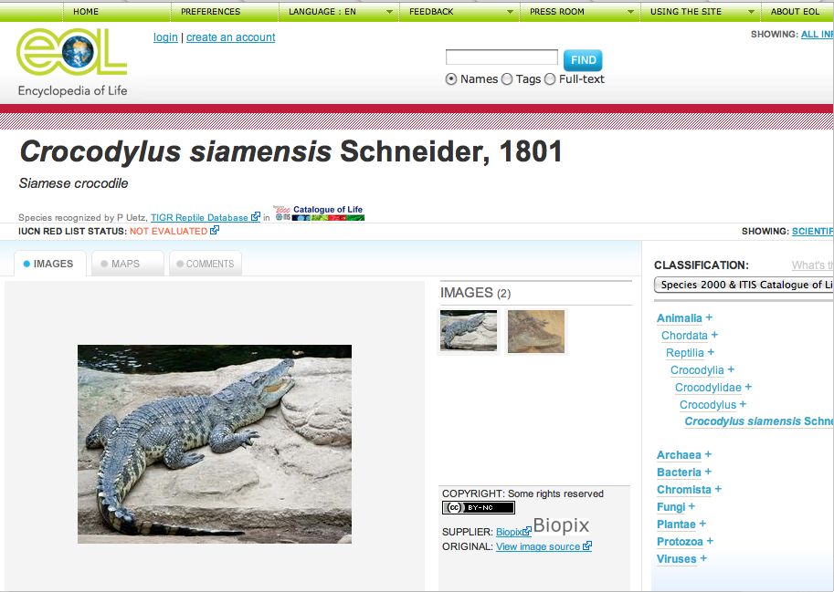

Slide 42
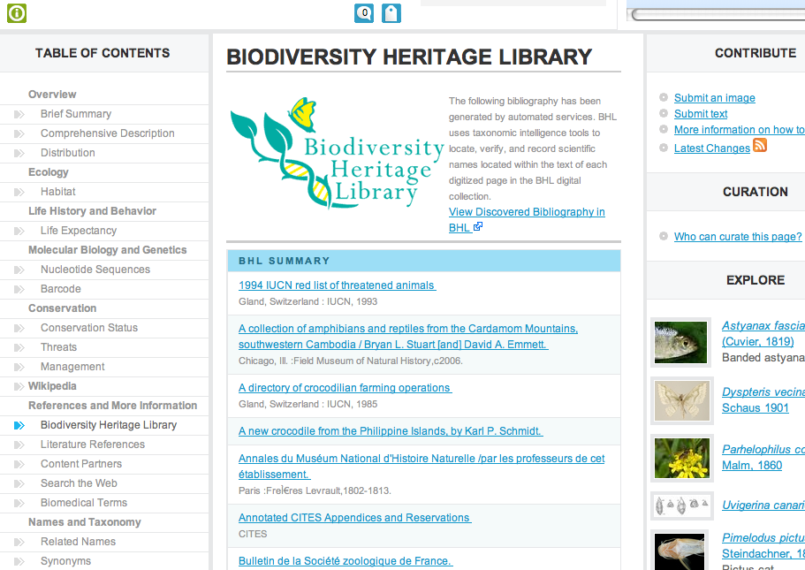

Slide 43
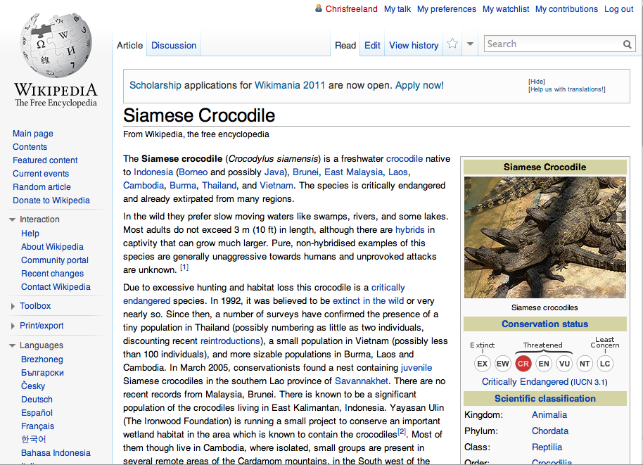

Slide 44
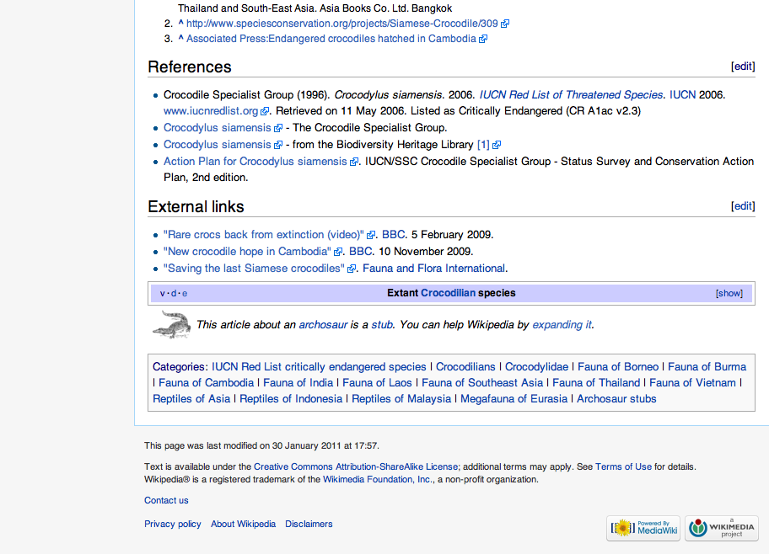

Slide 45
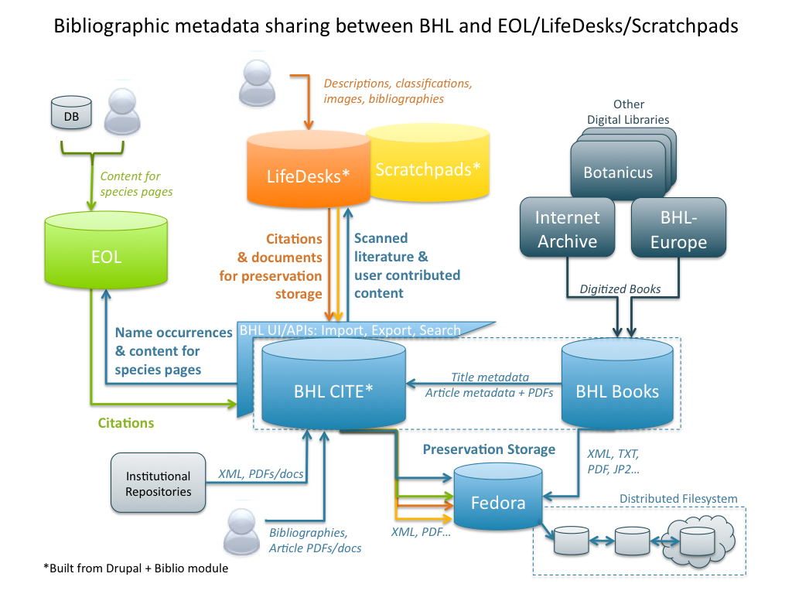

Slide 46
Data Mining

Slide 47
Name Finding: TaxonFinder
More than 70million name strings in 32 million pages
More than 1.5 million unique, verified names
Want to use “grey names” for research

Slide 48
Nomenclatural Acts: NomenFinder
Finding:
nov. sp.
nov. gen
Good starting point, showed promise
Needs more work
Academic exercise
Graduate students, code challenge

Slide 49
BHL & EOL Cooperation
Started off convergent
Fedora
Diverged
Grown independently
Different user audiences with overlap
Different requirements
Difference challenges

Slide 50
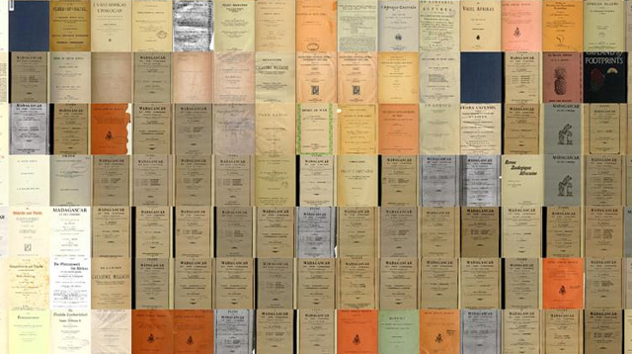
BHL as infrastructure

Slide 51
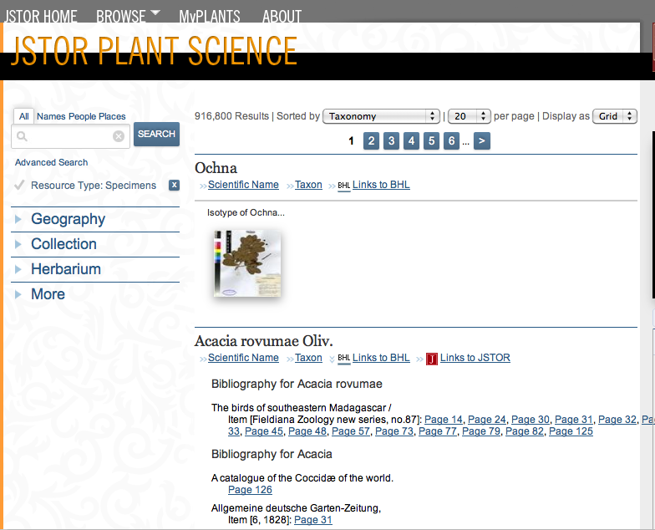
BHL & Nomenclators
Repository of articles & original descriptions
Building APIs to bridge repositories

Slide 52
BHL & GNA
CiteBank as repository
More work needed for Reconciliation Groups
Plugged into meetings, discussions, model reviews

Slide 53
BHL as Data Provider
Other International Digital Library Projects
Europeana
German digital libraries & university catalogues
Other research projects
Hong Cui in AZ
Conjecturator
Datasets for GIS / Spatial Analysis

Slide 54
BHL & ViBRANT
Data Provider
Integration with WP7

Slide 55
Thank You!
Chris Freeland
Director, Center for Biodiversity Informatics Missouri Botanical Garden
Technical Director
Biodiversity Heritage Library
Email: chris.freeland@mobot.org
Twitter: @chrisfreeland
Blog / info: chrisfreeland.com
Flickr: http://flickr.com/photos/chrisfreeland/

