Slide 1
Second Global BHL Planning Meeting
‍Chicago, IL, USA ‍Sunday 13 November 2011
BHL Brazil [and LA&C]
via SciELO BHL Network
Abel L. Packer Advisor on Information and Communication in Science SciELO – Scientific Electronic Library Online Foundation of the Federal University of São Paulo Technical support: Fabiana Montanari, SciELO Supervisor, FapUNIFESP Luis Gomes, SciELO Administrator, FapUNIFESP Fabio Batalha, SciELO Supervisor, FapUNIFESP Hussam Zaher, Director, Museum of Zoology, University of São Paulo
Institutional support Ministry of the Environment, FAPESP, BIREME/PAHO/WHO, FapUNIFESP,

Slide 2
BHL SciELO - timeline
2006 – March – 2009 - December Cop-8 – SciELO Biodiversity Project ➔ formulation, articulation, network Brasil, BHL, (2006-2009)
2010 - February
Workshop Essential Rare Works Collection in Biodiversity: governance, operation and digitization ➔ in partnership with BHL
2010 - October BHL SciELO Network Advisory Committee Meeting ➔ Foundations, Plan of Work, Recomendations
2010 - December Official launching of the BHL SciELO Network➔ Portal lauching (www.bhlscielo.org) 5 Scanners – Digitization equipment bidding --- 5 mobile Digitization Units
2011 - September
Digitization equipment ➔ 5 scanners arrived but computer, storage, human resources still incomplete
2011 - October
Provisory Digitization Units Configuration to start operation
Human resources and additional equipment bidding in process
2011 - November
First Digitization Unit mounted at Museu de Zoologia da USP
2011 - December
Biodiversity Thesaurus - first version available – Portuguese Version Updted version of BHL SciELO Network Portal
2013 - Dezembro Minimum of 2000 documents digitized and published in the BHL Collection
Expanded to LA&C countries

Slide 3
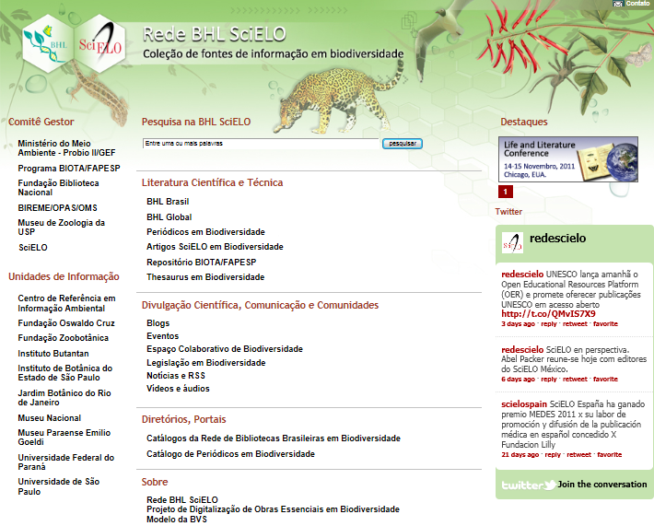

Slide 4
SciELO Network – gold open access quality journals
since 1997 to improve journal quality
2011 – 16 countries collections – 810 journals
3 thematic: public health, social sciences and biodiversty
Brazil - 1,2 million downloads per day
SciELO Books in 2012

Slide 6
BHL SciELO – collection in development
Brazilian Libraries Collections on Biodiversty digitized - BHL Brazil
Brazilian Biodiversity Related Journal Collection: SciELO and non-SciELO
Brazilian Biodiversity OA repository of articles from WoS no-SciELO journals
Biodiversity Multilingue English Portuguese SpanishThesaurus
? --- List of Species
? --- Legislation
Communication: news, blog, twitter
Directories: events, Web resources,
Information management and quality control - specific to information source
BHL SciELO – Advisory Committee

Slide 7
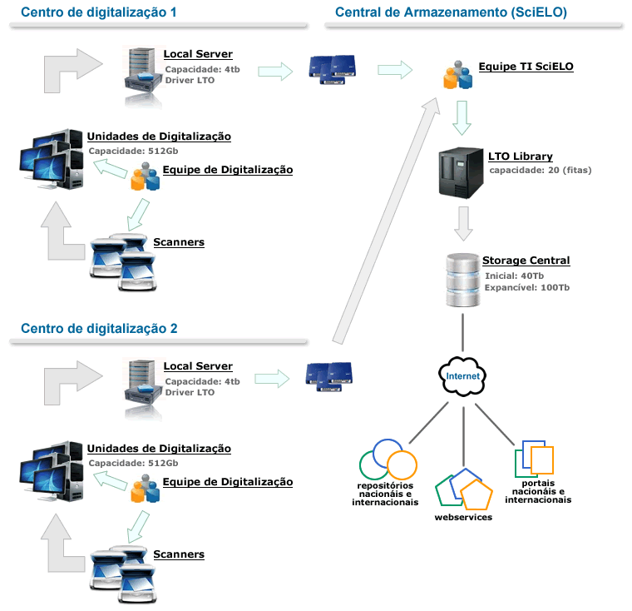

Slide 8
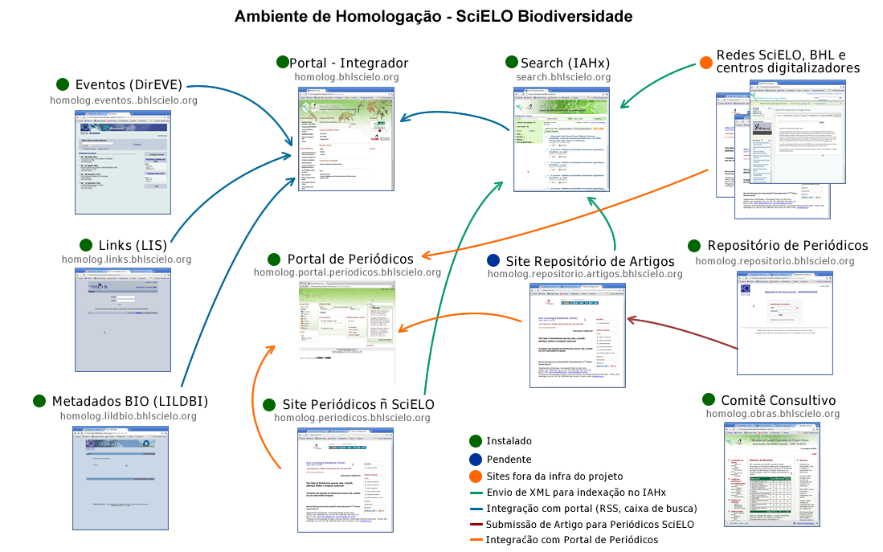

Slide 11
BHL SciELO Network Advisory Committee
Ministério do Meio Ambiente (por meio do Probio II/GEF)
FAPESP (por meio do Projeto SciELO, e com a participação da Biblioteca Virtual FAPESP, Programa BIOTA/FAPESP)
Fundação Biblioteca Nacional
BIREME/PAHO / WHO
Museu de Zoologia da USP
BHL SciELO Brazilian Biodiversity Libraries Network

Slide 12
BHL SciELO Brazilian Biodiversity Libraries Network
Biblioteca Nacional
Fundação Oswaldo Cruz
Fundação Zoobotânica
Instituto Butantan
Instituto de Botânica do Estado de São Paulo
Jardim Botânico do Rio de Janeiro
Ministério do Meio Ambiente
Museu Nacional do Rio de Janeiro
Museu Paraense Emílio Goeldi
Museu de Zoologia da Universidade de São Paulo
Universidade Federal do Paraná
Universidade de São Paulo

Slide 13
Short-term activities - up to March 2012
3 digitization units in regular operation
Museum of Zoology – USP
Instituto Butantan
Museum Emilio Goeldi
2 digitization units – to be agreed
BHL SciELO Libraries Network – meeting, courses on the operation of the network
Advisory Committee – March 2012

Slide 14
Conclusions on SciELO-BHL development
Bureaucratic barriers - slow but sustainable process
Political support – aligned with national policies --- critical to get institutional and financial support
Scientific support – aligned with research programs --- critical to get research community support
Based on existing national and international successful experiences: BHL, SciELO and VHL
Network rationality, open access, public good
Committed to BHL network
Thank you !

