Slide 1

BHL Developments
1 Jan – 30 Sep 2009

Slide 2
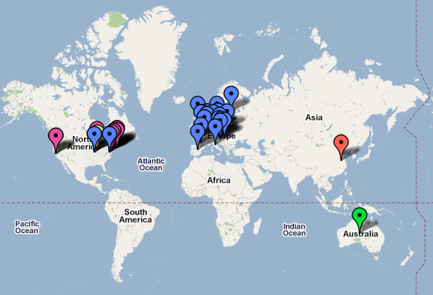
BHL Members

Slide 3
BHL Members: US/UK
Academy of Natural Science (Philadelphia, PA)
American Museum of Natural History (New York, NY)
California Academy of Science (San Francisco, CA)
The Field Museum (Chicago, IL)
Harvard University Botany Libraries (Cambridge, MA)
Harvard University, Ernst Mayr Library of the Museum of Comparative Zoology (Cambridge, MA)
Marine Biological Laboratory / Woods Hole Oceanographic Institution (Woods Hole, MA)
Missouri Botanical Garden (St. Louis, MO)
Natural History Museum (London, UK)
The New York Botanical Garden (New York, NY)
Royal Botanic Gardens, Kew (Richmond, UK)
Smithsonian Institution Libraries (Washington, DC)

Slide 4
BHL Members: BHL-Europe
Museum für Naturkunde - Leibniz-Institut für Evolutions- und Biodiversitätsforschung an der Humboldt-Universität zu Berlin
Natural History Museum, UK
Narodni muzeum NMP CZ
Angewandte Informationstechnik Forschungsgesellschaft mbH
Freie Universität Berlin FUBBGBM
Georg-August-Universität Göttingen Stiftung Öffentlichen Rechts
Naturhistorisches Museum Wien
Hungarian Natural History Museum
Museum and Institute of Zoology, Polish Academy of Sciences
University of Copenhagen
Stichting Nationaal Natuurhistorisch Museum, Naturalis
National Botanic Garden of Belgium
Royal Museum for Central Africa,
Royal Belgian Institute of Natural Sciences
Bibliothèque nationale de France
Museum national d’histoire naturelle
Consejo Superior de Investigaciones Cientificas
Università degli Studi di Firenze
Royal Botanic Garden, Edinburgh
Species 2000
John Wiley & Sons limited
Helsingin yliopisto UH-Viikki

Slide 5
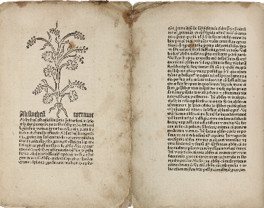
Stats: Now Online
15,000 titles
40,000 volumes
16.3mil pages
Soon:
  34,000 titles
  65,000 volumes
  24.7mil pages
Oldest book: Schöffer’s Herbarius, 1484.

Slide 6
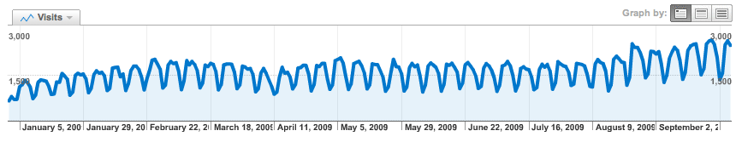
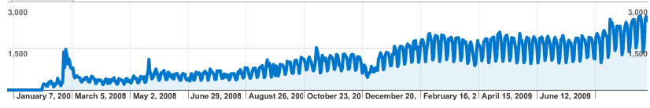
Stats: Usage
Jan – Sep 2009
  266,000 visitors
  436,000 visits
  2.1million pageviews
Daily average
  970 visitors
  1,600 visits / day
  7,700 pageviews / day
Jan – Sep 2009
Launch to 30 Sep 2009

Slide 7

Global, coordinated development
New functionality from BHL-Europe
  Improved deduplication tools
  Semantic interface
  OAIS-compliant preservation infrastructure
Building a community of developers
  Funded & volunteer
  RubyBHL: http://github.com/mjy/rubyBHL
  PyBHL: http://linux.softpedia.com/get/Programming/Libraries/pybhl-51612.shtml
New partners, new content

Slide 8

Open Software & Development
BHL Bits:
  Portal code, utilities, services
  http://code.google.com/p/bhl-bits/
Taxonomic Literature Group
  Google Group for discussion of “taxonomic literature & the services required to make literature interoperable within biodiversity research and biodiversity informatics.”
  http://groups.google.com/group/taxonlit

Slide 9
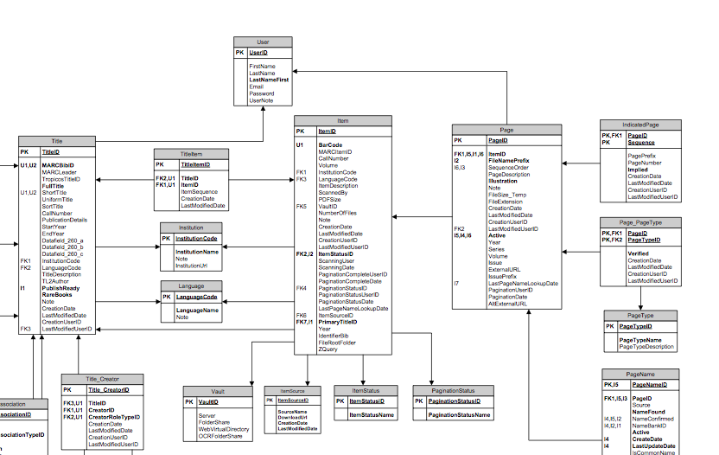
Open Data
Downloads
  Simple tab-delimited exports of core data
  http://www.biodiversitylibrary.org/data/BHLExportSchema.pdf
Data model
  DB schema as ERD
  http://bhl-bits.googlecode.com/files/20090930_BHLDataModel.pdf

Slide 10
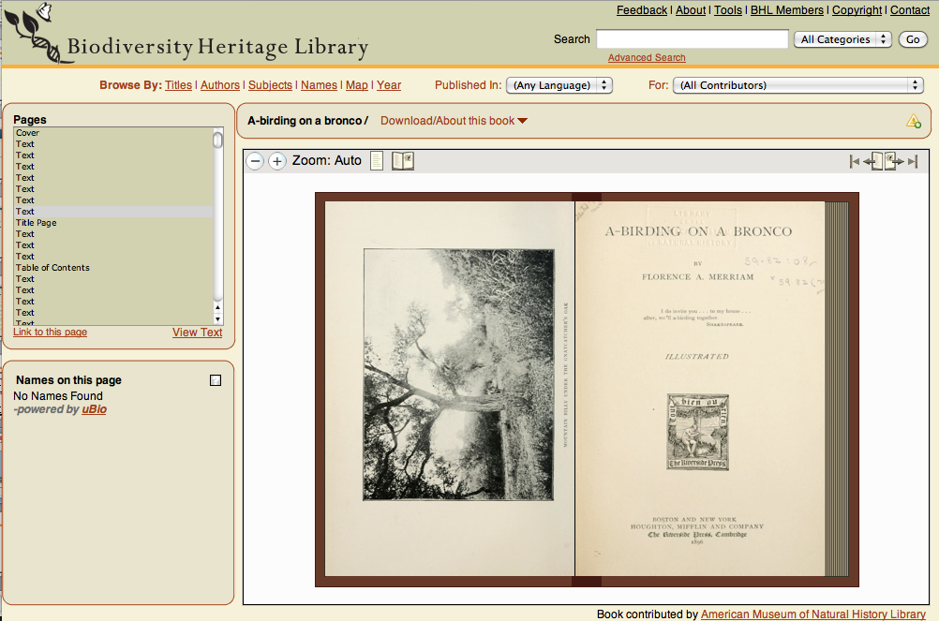
Open Source Pageturning UI
http://github.com/openlibrary/bookreader

Slide 11
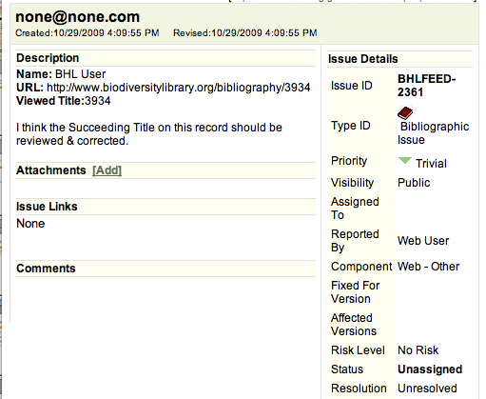
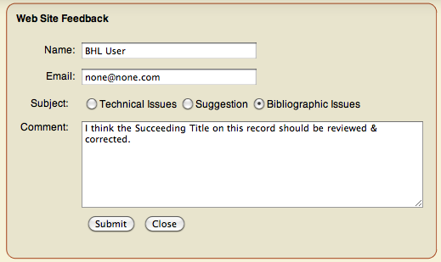
Metadata: Feedback loop
Assigned to library staff
for review & resolution

Slide 12

Services
Names Service
  Return all occurrences of a name throughout BHL digitized corpus
    Documentation: http://bit.ly/2e6sg9
  Access to 51million name strings using TaxonFinder
      1.4million unique names
  Working out a strategy for obscure species
  Algorithm improvements to detect nomenclatural & taxonomic acts
OpenURL
  Facilitate links to citations: protologues, articles, references
    Documentation: http://www.biodiversitylibrary.org/openurlhelp.aspx
  Useful to Nomenclators, Reference Systems
    IPNI
    Tropicos

Slide 13
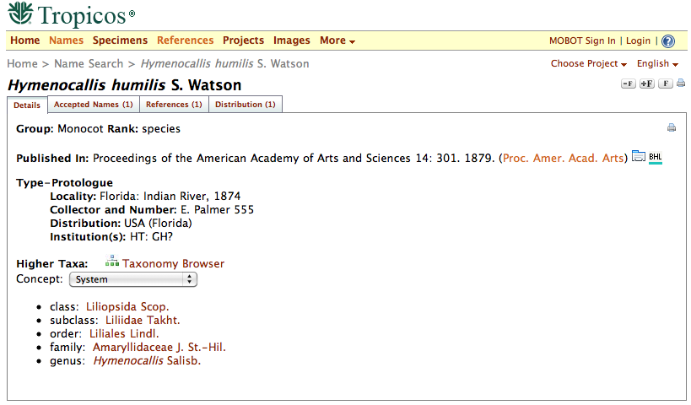
Services: OpenURL Request
http://www.biodiversitylibrary.org/openurl?
pid=title:3934&volume=3&issue=&spage=262&date=1856
http://www.tropicos.org/Name/1200408

Slide 14
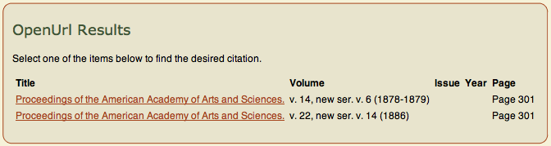
Services: OpenURL Disambiguation
Looking for:
BHL returns:

Slide 15
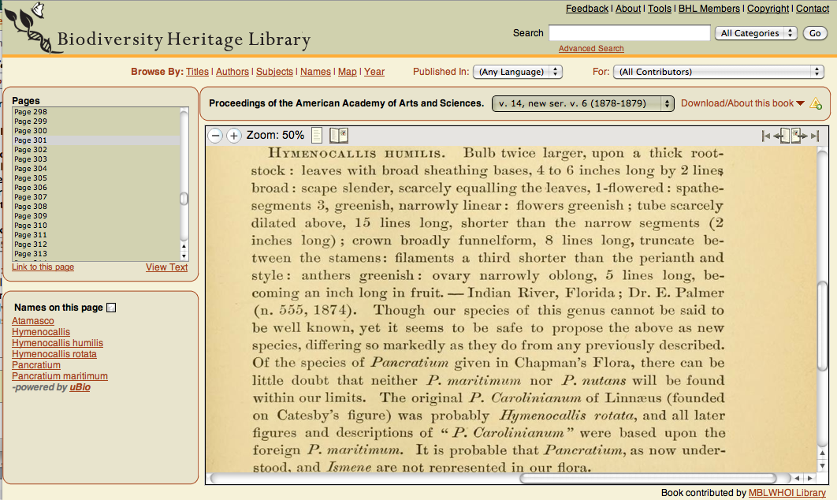
Services: OpenURL Results

Slide 16

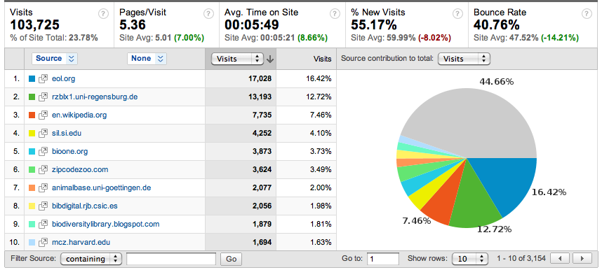
Encyclopedia of Life
522,000 species pages linked to BHL
#1 referring site

Slide 17
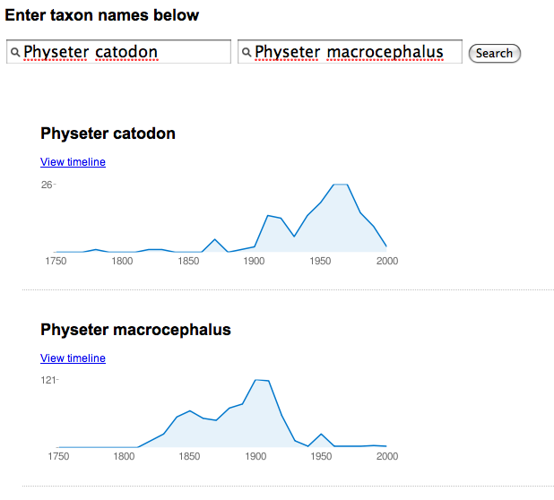
Other Consumers
EarthCape Labs
  Sort/Search capabilities with harvested names
  YouTube demo: http://www.youtube.com/watch?v=qw7qw87JTOs
BioGUID
  BHL Name Timeline
    http://bioguid.info/bhl/
  BHL Name Comparison
    http://bioguid.info/bhl/compare.php

Slide 18
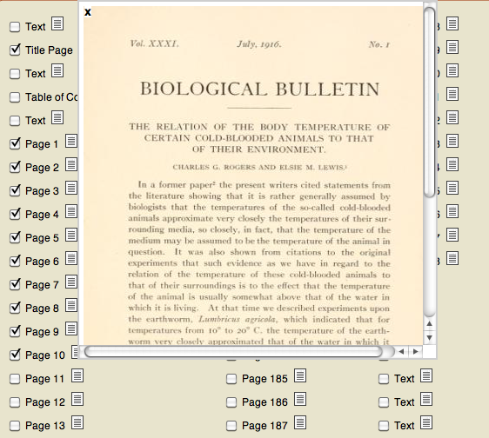
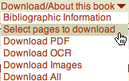
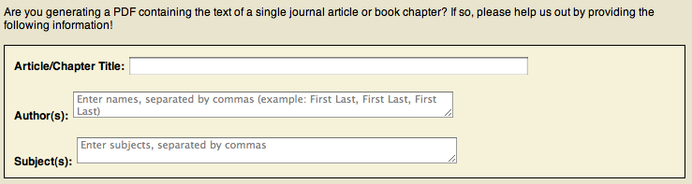
Crowdsourced Articles
http://www.biodiversitylibrary.org/pdfgen/15845
Demo:
http://youtube.com/watch?v=oidf3b26jVs

Slide 19
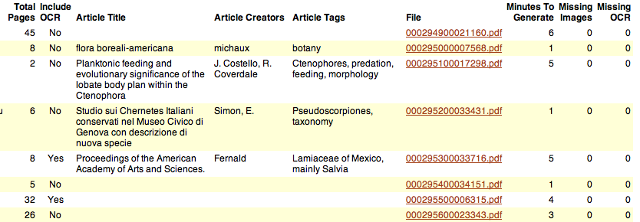
Crowdsourced Articles
12,000 PDFs generated through September 2009
  4,900 submitted with article metadata
  Analysis: http://bit.ly/4Jqu9

Slide 20
Great, but how…
display / manage?
meet community demands for bibliography / citation management?
build from more open source tools?

Slide 21
Development goals re: citations
Create a repository for community-vetted taxonomic bibliographies.
Ability to ingest, display, download, and index articles so that the BHL can operate as an article repository.
Build from existing community of work around Drupal / Biblio.
  In use by collaborators

Slide 22
Crowdsourced Articles
PDFs from BHL pushed into Drupal/Biblio:

Slide 23
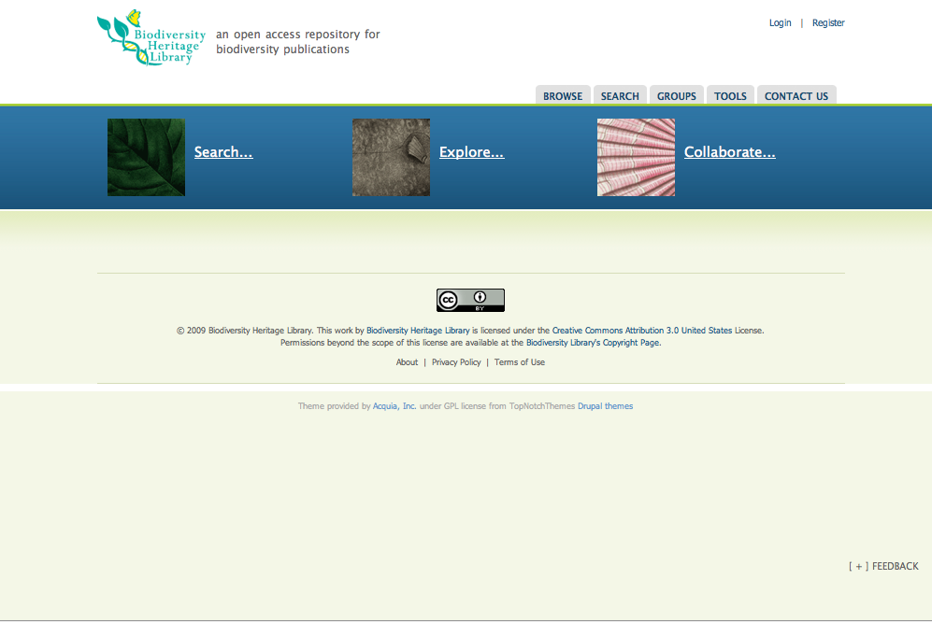
http://citebank.biodiversitylibrary.org/

Slide 24
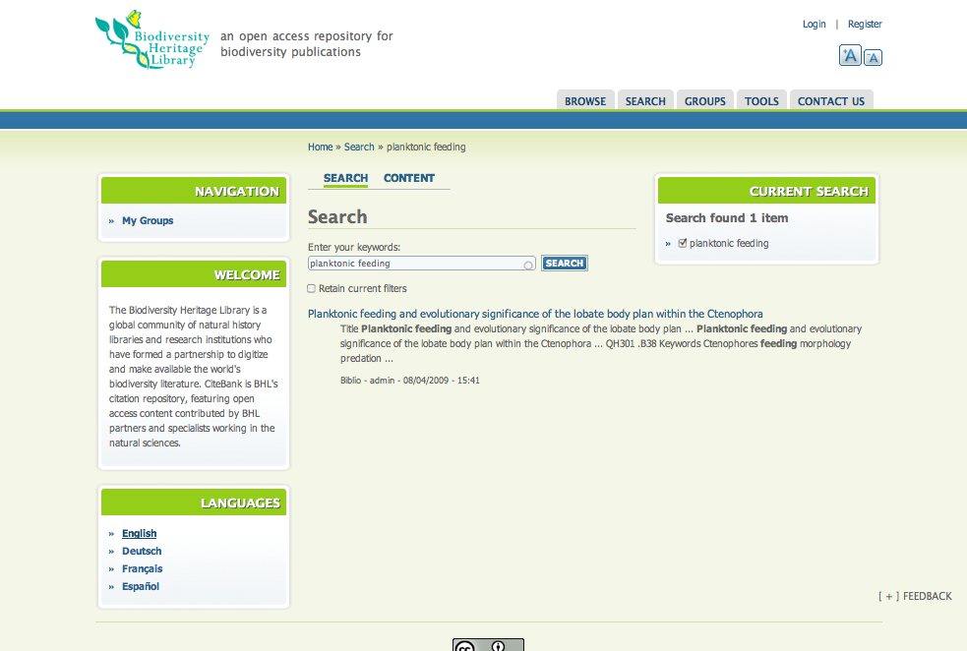
http://citebank.biodiversitylibrary.org/search

Slide 25
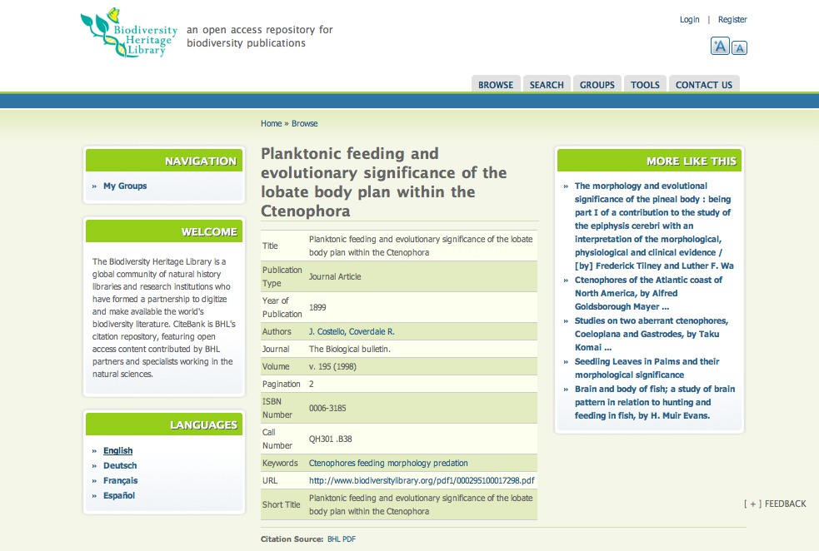
http://citebank.biodiversitylibrary.org/node/47423

Slide 26
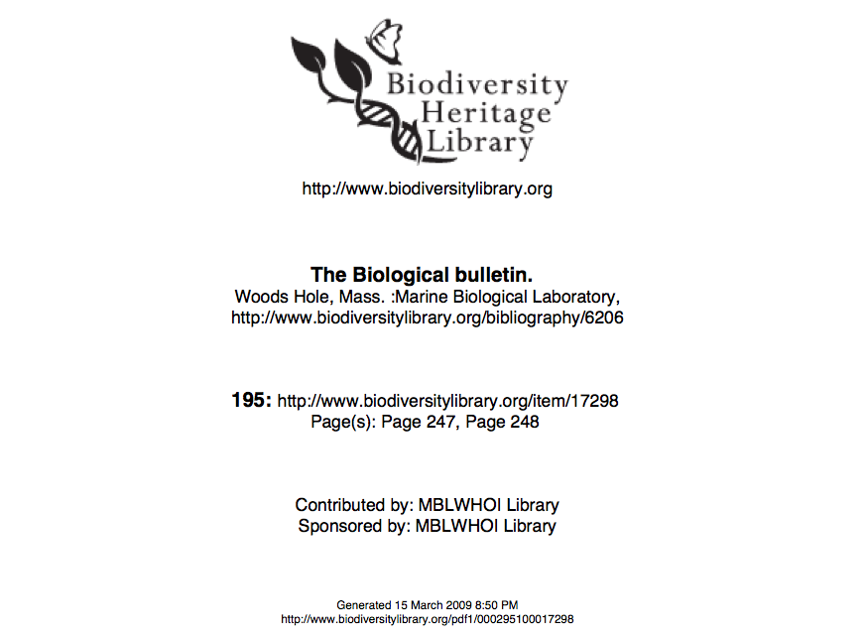
PDF
http://www.biodiversitylibrary.org/pdf1/000295100017298.pdf

Slide 27
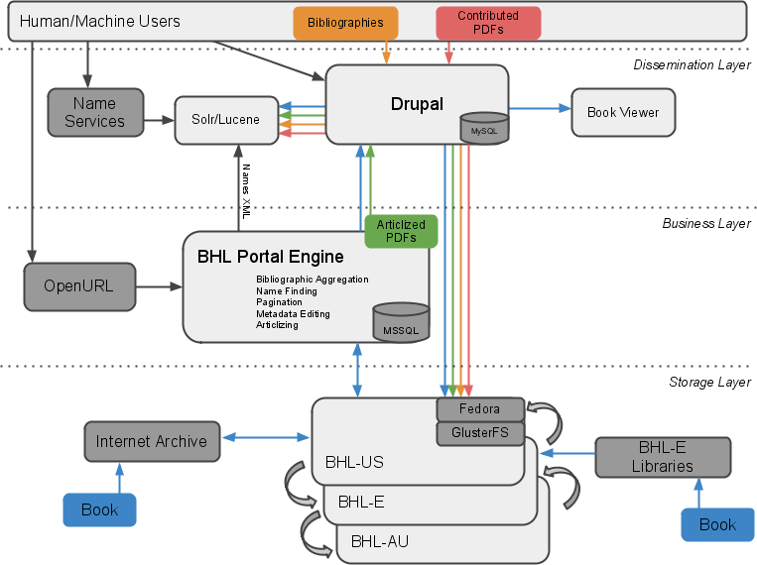
BHL Data Flow – Sep 2009

Slide 28

Storage
DuraCloud Pilot
  Test of cloud storage & computing with DuraSpace Foundation & New York Public Library
  Early alpha stage
  More info: http://www.duraspace.org/duracloud.php
Inhouse solution demo’d by MOBOT & MBL
  Redundant high performance storage on commodity hardware
  http://www.tdwg.org/conference2009/program/working-sessions/

Slide 29
Next steps
Bring hardware online at MBL
  Have one point of redundancy
  By Q1 2010
Bring BHL-Europe & other nodes online
  In conjunction with DuraCloud & other solutions
Release CiteBank for beta & sandbox testing
  Production release by Q2 2010
Integration of BHL-Europe tools & content

Slide 30
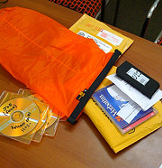
Coming soon
Darwin’s Library
  AMNH, NHM, CUL, BHL (MOBOT)
  Funded by NEH/JISC
  Digitization of Darwin’s personal library, with annotations
    New interfaces for recording, indexing, displaying annotations
Inhouse scanning from
partners/contributors

Slide 31
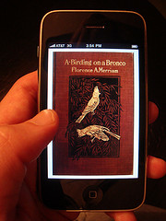
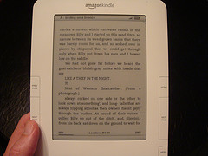
Fun: BHL In Your Pocket!
Content now available in EPUB format
  Used by Stanza, transferable to Kindle
Blog post by John Mignault (NYBG):
  http://john.mignault.net/blog/2009/10/28/first-bhl-e-book-experiments/

Slide 32
Thanks!
Biodiversity Heritage Library
http://biodiversitylibrary.org
BHL Blog
http://biodiversitylibrary.blogspot.com
Follow @BioDivLibrary on Twitter
http://twitter.com/BioDivLibrary/
Become a fan on Facebook
http://www.facebook.com/pages/Biodiversity-Heritage-Library/63547246565

